Slide 1
Conveying Messages

Slide 2
Learning objectives
Identify photographic skills and techniques such as: line, form, pattern, shape, colour, detail, atmosphere, lighting
Show an understanding of photo analysis
Discuss how photographers convey messages

Slide 3
Starter activity
Is the photographer sending any messages in this photograph?

Slide 4
Watch this short video
https://www.youtube.com/watch?v=upV5LihZuc0

Slide 5
We’ve all heard the cliché, “a picture tells a thousand words”.
There is real value in using images to convey messages.
Images help us learn, images grab attention, images explain tough concepts, and inspire.

Slide 6
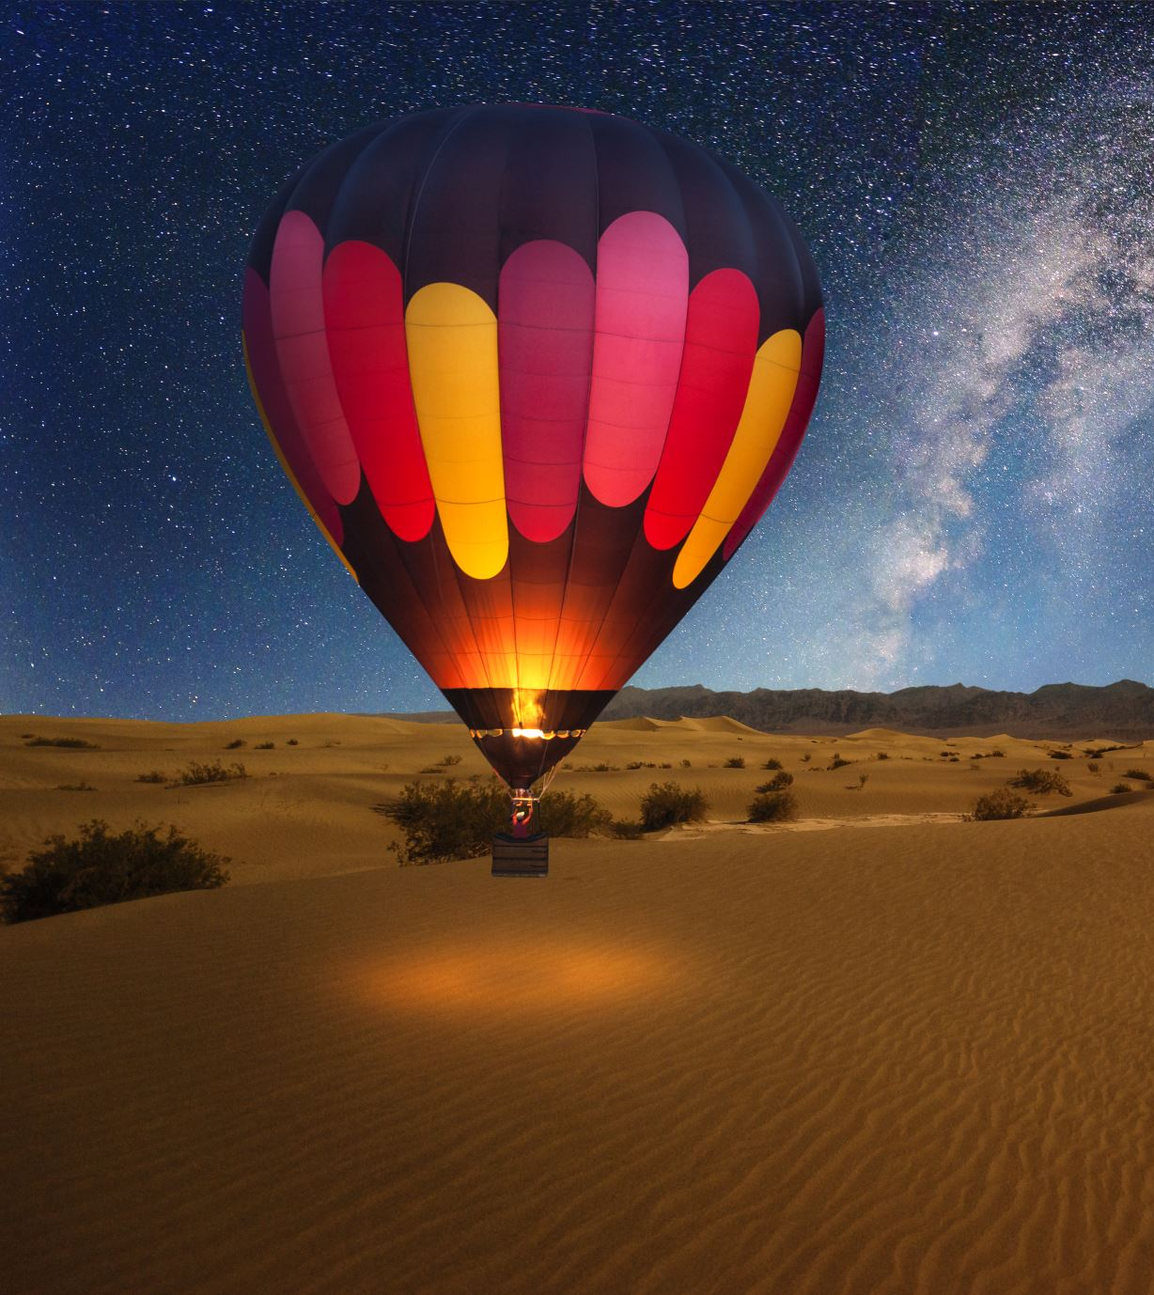
Meaning can come from a lot places. It’s in the mood lighting, the expressions on your subjects faces, the decision to use human subjects or not, and so much more

Slide 7
Tips
Creative lighting and composition
Instead of using a bright flash to illuminate, consider doing the shot under candle light with no flash. It creates an entirely different meaning, one with so much more emotion than what you would get from an ordinary snapshot.
Also consider where you’re placing your subject within the frame

Slide 8
Annotation Guidance
Things to write about for the analysis
What can you see – explain what you see / what's going on
Composition: leading lines, rule of thirds, framing, viewpoint, fill the frame, symmetry
Colours – are they bright? Dull? You could look at colour symbolism (red = passion, anger etc)
Depth of field: shallow (blurry background), wide (all of the photo is in focus)
Contrast- are there dark and light areas and how intense?
Lighting: above, front, back, shadow, natural light, time of day, overcast, sunny etc
Artificial light, flash, neon light, florescent, candle, flame, filament bulb etc
Texture, maybe a contrast of textures.
The focal point of the photo is...... (where do your eyes go to first)
The mood – is the photo happy, sad, angry, confusing, mysterious, dark – how has the photographer achieved this mood?
What do you think the photographer is communicating? For example, are they telling a story? Or are they trying to make you the viewer feel a certain way?

Slide 9
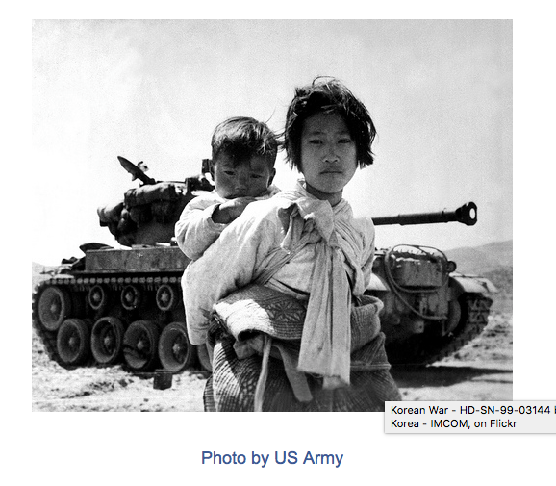
What can you see – explain what you see / what's going on
Composition: leading lines, rule of thirds, framing, viewpoint, fill the frame, symmetry
Colours – are they bright? Dull? You could look at colour symbolism (red = passion, anger etc)
Depth of field: shallow (blurry background), wide (all of the photo is in focus)
Contrast- are there dark and light areas and how intense?
Lighting: above, front, back, shadow, natural light, time of day, overcast, sunny etc
Artificial light, flash, neon light, florescent, candle, flame, filament bulb etc
Texture, maybe a contrast of textures.
The focal point of the photo is...... (where do your eyes go to first)
The mood – is the photo happy, sad, angry, confusing, mysterious, dark – how has the photographer achieved this mood?
What do you think the photographer is communicating? For example, are they telling a story? Or are they trying to make you the viewer feel a certain way?

Slide 10
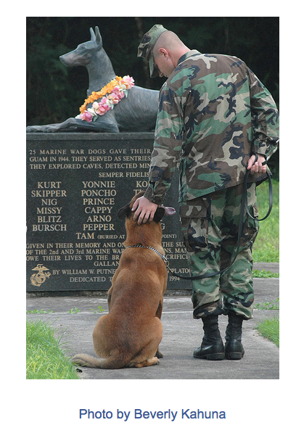
What can you see – explain what you see / what's going on
Composition: leading lines, rule of thirds, framing, viewpoint, fill the frame, symmetry
Colours – are they bright? Dull? You could look at colour symbolism (red = passion, anger etc)
Depth of field: shallow (blurry background), wide (all of the photo is in focus)
Contrast- are there dark and light areas and how intense?
Lighting: above, front, back, shadow, natural light, time of day, overcast, sunny etc
Artificial light, flash, neon light, florescent, candle, flame, filament bulb etc
Texture, maybe a contrast of textures.
The focal point of the photo is...... (where do your eyes go to first)
The mood – is the photo happy, sad, angry, confusing, mysterious, dark – how has the photographer achieved this mood?
What do you think the photographer is communicating? For example, are they telling a story? Or are they trying to make you the viewer feel a certain way?

Slide 11
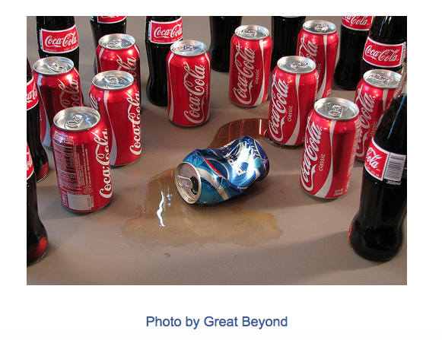
What can you see – explain what you see / what's going on
Composition: leading lines, rule of thirds, framing, viewpoint, fill the frame, symmetry
Colours – are they bright? Dull? You could look at colour symbolism (red = passion, anger etc)
Depth of field: shallow (blurry background), wide (all of the photo is in focus)
Contrast- are there dark and light areas and how intense?
Lighting: above, front, back, shadow, natural light, time of day, overcast, sunny etc
Artificial light, flash, neon light, florescent, candle, flame, filament bulb etc
Texture, maybe a contrast of textures.
The focal point of the photo is...... (where do your eyes go to first)
The mood – is the photo happy, sad, angry, confusing, mysterious, dark – how has the photographer achieved this mood?
What do you think the photographer is communicating? For example, are they telling a story? Or are they trying to make you the viewer feel a certain way?

Slide 12
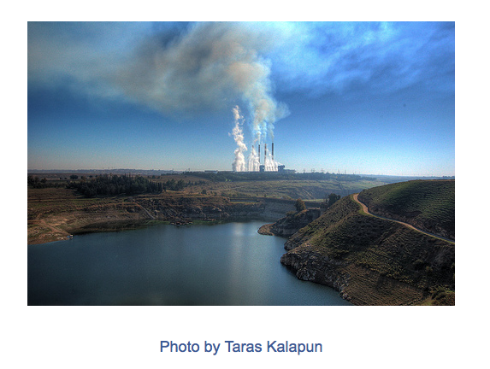
What can you see – explain what you see / what's going on
Composition: leading lines, rule of thirds, framing, viewpoint, fill the frame, symmetry
Colours – are they bright? Dull? You could look at colour symbolism (red = passion, anger etc)
Depth of field: shallow (blurry background), wide (all of the photo is in focus)
Contrast- are there dark and light areas and how intense?
Lighting: above, front, back, shadow, natural light, time of day, overcast, sunny etc
Artificial light, flash, neon light, florescent, candle, flame, filament bulb etc
Texture, maybe a contrast of textures.
The focal point of the photo is...... (where do your eyes go to first)
The mood – is the photo happy, sad, angry, confusing, mysterious, dark – how has the photographer achieved this mood?
What do you think the photographer is communicating? For example, are they telling a story? Or are they trying to make you the viewer feel a certain way?

Slide 13
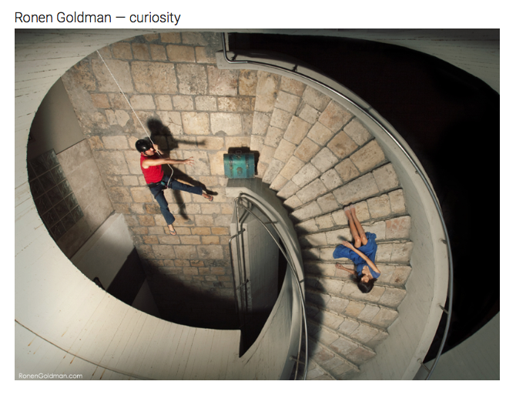
http://www.thephotoargus.com/40-outstanding-examples-of-conceptual-photography/
What can you see – explain what you see / what's going on
Composition: leading lines, rule of thirds, framing, viewpoint, fill the frame, symmetry
Colours – are they bright? Dull? You could look at colour symbolism (red = passion, anger etc)
Depth of field: shallow (blurry background), wide (all of the photo is in focus)
Contrast- are there dark and light areas and how intense?
Lighting: above, front, back, shadow, natural light, time of day, overcast, sunny etc
Artificial light, flash, neon light, florescent, candle, flame, filament bulb etc
Texture, maybe a contrast of textures.
The focal point of the photo is...... (where do your eyes go to first)
The mood – is the photo happy, sad, angry, confusing, mysterious, dark – how has the photographer achieved this mood?
What do you think the photographer is communicating? For example, are they telling a story? Or are they trying to make you the viewer feel a certain way?

Slide 15
Use PowerPoint
Create a title Conveying messages
Create a moodboard of images that you think convey messages (at least 10)
Annotate at least 2 images from the moodboard

Slide 16
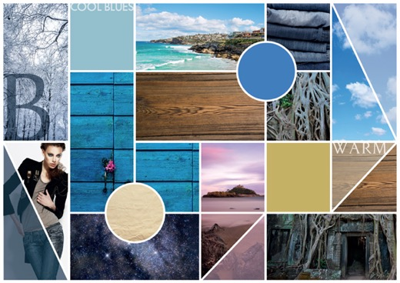
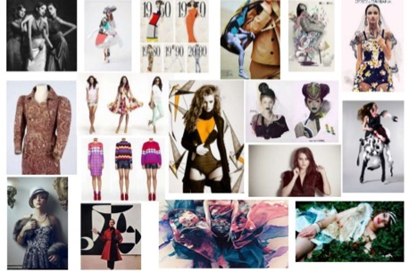
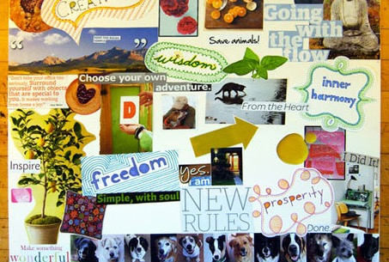
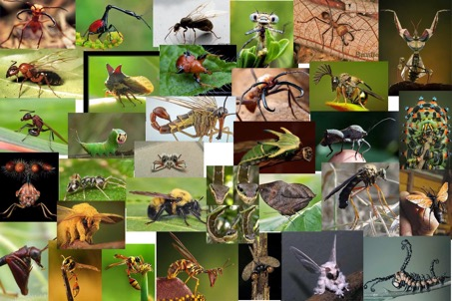
Mood board
15 mins
A mood board is typically a combination of images, fonts, colors, and textures that define the style of the project. It is a tool to come to help you decide a particular style or develop your ideas.
Some of the key points to consider: Layout, format, color, typography, and texture.

Slide 17
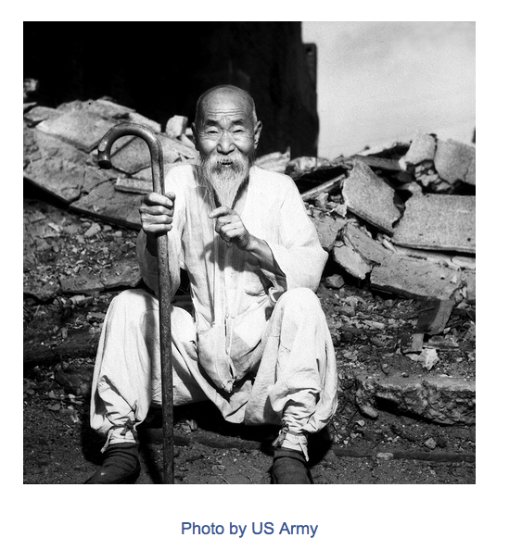
Choose 2 images from your moodboard
2 images annotated use the guidance

Slide 18
What message do you want to get across with your photography?
Are you using it to create something beautiful, or do you want to make a statement?

Slide 19
If you could send a message out to the world what would it be? What do you want to say?
Do you want more people to pay more attention to keeping the world cleaner?
Do you want animals to be treated better?
Do you want the media to stop portraying ‘thin and skinny’ as the ideal?
Do you want certain ‘images’ to be accepted
Do you want government to change their ways?
Try and keep it theme related!
YOU CAN SEND A MESSAGE TO THE WORLD!!

Slide 20
Animals – conveying messages
The problems
My messages
Ideas
Techniques
Animals are viewed as inferior
Stop hurting animals
Photograph animals when they
are playing to capture character
Black and white
Animal consumption
Be a voice for animals
Low or high angle to
communicate
dominance
Dog fighting
Treat animals as equal
Show animals in their natural
habitats vs captivity
Animal sports
Raise awareness
Hunting
Animals feel pain
Take portraits of animals as you
would a human (traditional portraiture)
Photomontage
Zoos
Animals are sentient
Lighting for mood
Farms?

Slide 21
Close up (leaves) – conveying messages
The problems / issue / topic
My messages
Ideas
Techniques
Leaves change colour a lot and may not be appreciated all year round
Leaves die
Leaves fall from the tree and are stood on
Leaves are food and habitats for many animals
Leaves are very important
No education about trees/leaves / the environment
The importance of leaves
How magical they are close up – another world for insects etc
Micro beauty – what we don’t see – it’s another world for other species
The beauty of each season and how leaves change
Photograph leaves during each season
Capture the patterns of leaves
Photograph crushed leaves
Lighting for mood
Use a macro lens for extreme detail and close up
Enhance colours via hue and saturation
Collect leaves and press them to combine with a photograph which will create texture

Slide 22
Plenary
Write down 2 things you have learnt today?

