Slide 1
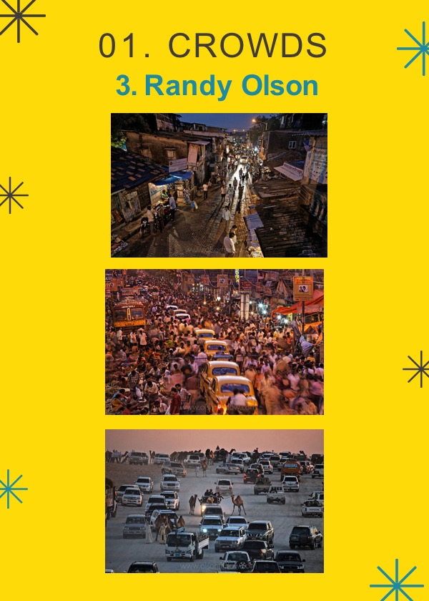
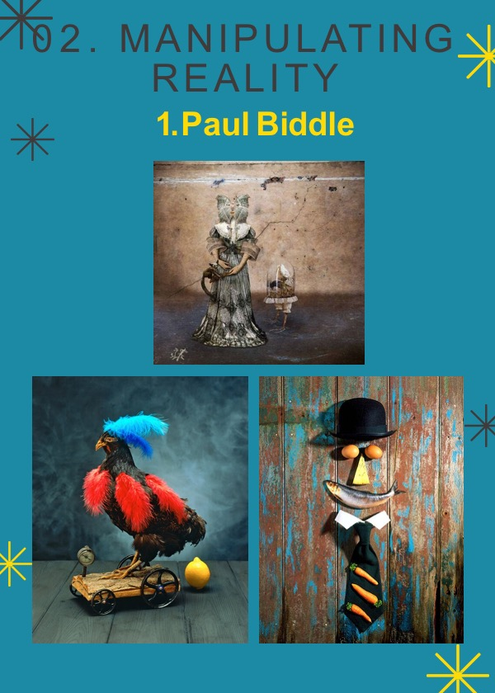
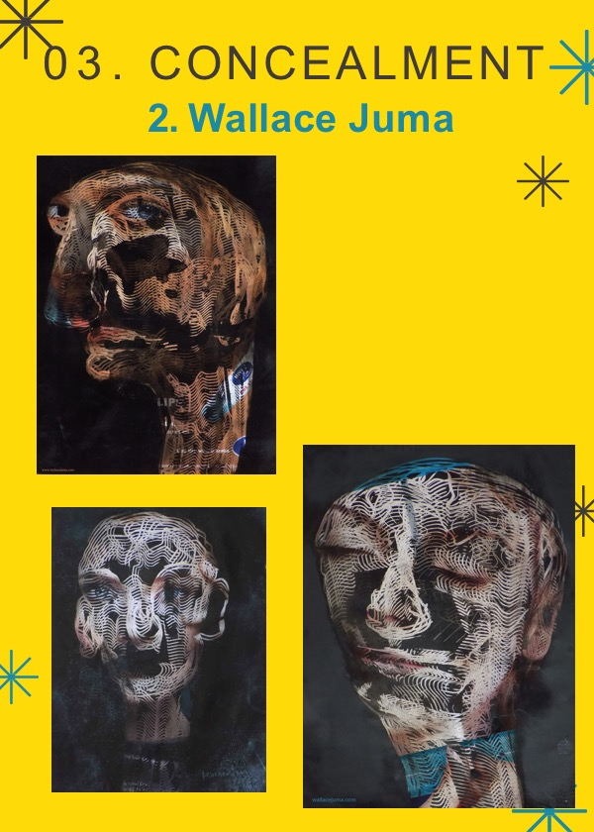
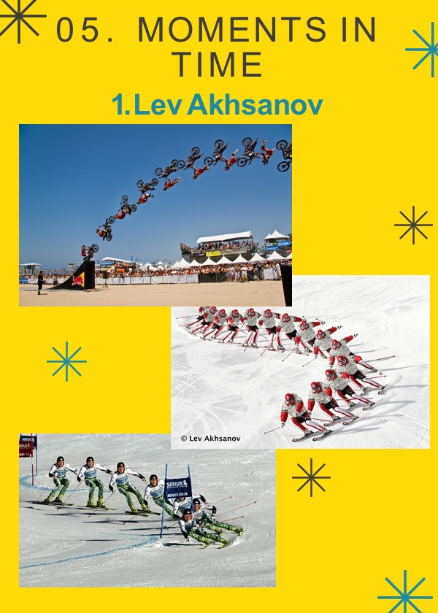
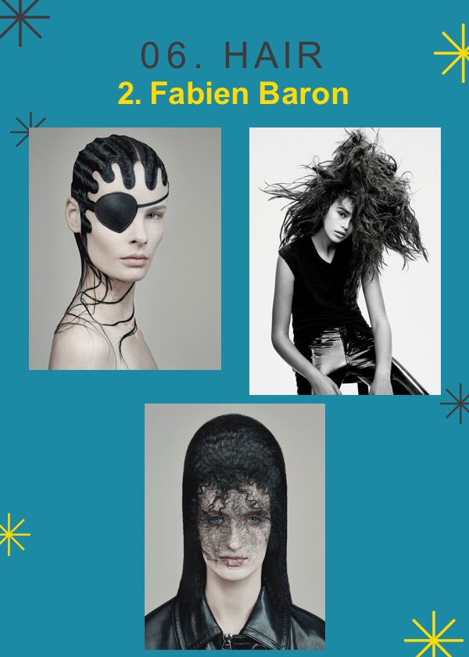
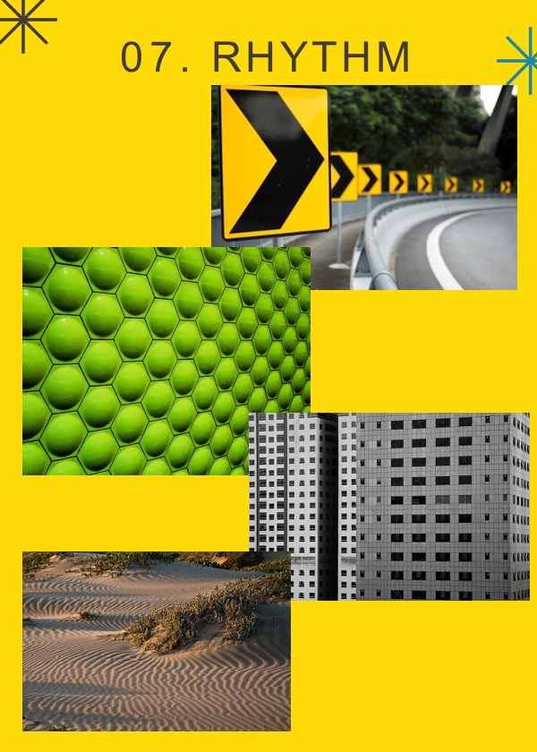
Photography Exam 2020
Guidance

Slide 2
Any work that you create will be marked according to how well you have displayed evidence of:
• Developing ideas through research of relevant sources. AO1
• Refining work by selecting and experimenting with necessary media, materials, techniques and processes to explore ideas. AO2
• Recording ideas and observations which are relevant to your theme as work develops. AO3
• Present a personal response which concludes your intentions and shows your comprehension of visual language. AO4

Slide 3
AO2
Experiment techniques and processes
Refining ideas
Improvement
Explore & Select
AO1
Develop/Explore ideas
photographer research
Investigate
Galleries & Museums
Exhibitions
Idea Development
Tip: Always discuss your ideas with your teacher BEFORE you commit to a starting point
Tips for success
TIP: Time is limited so be as
efficient as you can!
Make use of the same props but vary the images with different backgrounds and viewpoints (AO2/AO3)
Use your camera phone to do quick shoots when out and about.
AO3
Observations
Record
Sketch plans of shoots
Insights & Intentions
Reflect critically
Annotation
TIP: Keep to schedule.
Keep on top of the workload – you’ll be under pressure from all your subjects so use Art as part of your relaxation.
The timetable is the minimum expected – for higher grades you’ll need more (!).
TIP: Do as many photoshoots as possible at one time.
Often it can be difficult to get the camera equipment, models, props, and studio space together.
When everything is arranged, take advantage of that by completing as many photoshoots as possible for as many artists as possible.
Save all the images and edit them later, rather than doing each photoshoot one at a time.
AO4
Present personal and
informed meaningful response
Highly developed
Make connections
Final Piece
TIP: Find a sketchbook layout and style that looks good and can be done quickly.
If working in a physical sketchbook, consider using a background; layout etc particular font throughout
If working digitally, create a master slide or background to speed up your productivity and give a professional, clean look to your pages.
Each sheet should include a title, reference images, brief information on the photographer, and most importantly your own ideas! (mind maps, photoshoot ideas).

Slide 4
Exam Project Pyramid
Completion: When you have completed the task place a red dot in the box
Evaluation
Stage 5
Final images
Final experimentation & final outcomes
Best Images from each photoshoot
This is what you will complete during the
10 hour-controlled assessment
Final Experimentation
Evaluate shoot
Evaluate shoot
Evaluate shoot
Stage 4
Editing
Editing
Editing
Review & Select
Review & Select
Review & Select
Final planning & photoshoots
based on own ideas
Photoshoot
Photoshoot
Photoshoot
Planning
Planning
Planning
Stage 3
Project review
Project Review
Stage 2
Evaluate shoot
Evaluate shoot
Evaluate shoot
Editing
Editing
Editing
Photographer research
& Responses
Review & Select
Review & Select
Review & Select
Photoshoot
Photoshoot
Photoshoot
Stage 1
Photographer Research
Photographer Research
Photographer Research
Moodboard
Mindmap
Statement of Intent
Preliminary
Photoshoot
Theme Research
Initial research & planning

Slide 5
EXAM JOURNEY
Title
Mood board
Mind map
Theme research
Statement of intent
Photoshoot response
Photographer
research
Photoshoot response
Photographer
research
Preliminary shoot
Review and select
Review and select
Review and select
Editing
Editing
Editing
Photographer
research
Photoshoot response
Planning
photoshoot
Photoshoot
Review and select
Project review
Review and select
Editing
Editing
Planning
final experimentation
Photoshoot
Planning
photoshoot
Photoshoot
Planning
photoshoot
Review and select
Review and select
Editing
Editing
10 HOUR CONTROLLED ASSESSMENT
Best images from
EVERY shoot
Final experimentation
Final piece(s)
Project evaluation

Slide 6
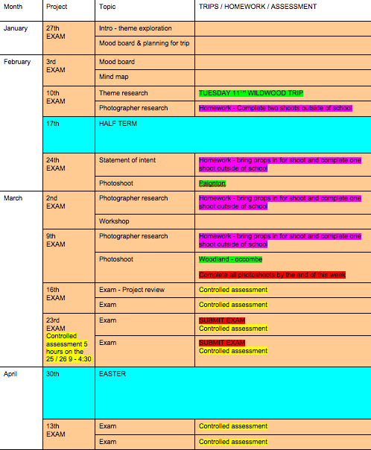
Exam planner / groups
Wednesday 25th
Elena Aldred
Trinity Chan
Cherie Desanta
Claudia Farley
Lia Hine
Lauren Pallas
Eleanor Russell
Holly Seymour
Amy Shepherd
Neve Storey
Jami-Leigh Woodbridge
Jack Tucker
Shaun Thomas-Gurney
Blake Rolfe
Abbie Quartley
Izzy Minty
Tia Johnson
Hermione Hemmings
Emilie-Mae Chiplin
Eliza Algar
Thursday 26th
Guy Akeroyd
Millie Arnold
Mia Bellamy
Isaac Cogger
Matthew Cook
George Croker
Gemma Evans
Heidi Farrow
Armarni Forbes
Lauren Hinkley
Jolyon Little
Frankie O'Keeffe
Kezia Ryan
Ollie Toms
Mia Waldron
Molly Royce-Dexter
Chloe Prior
Henry Lewis
Rebecca Keeling
Scarlett Johnstone
Billy Bird

Slide 7
Grades
To achieve a 3 / 4 you need to ensure you complete all the pyramid criteria.
To achieve a 5 or above you need to complete the following checklist.
GRADE 3 / 4 | GRADE 5 OR ABOVE
AT LEAST 3 PHOTOGRAPHER RESEARCH TASKS AT LEAST 7 PHOTOSHOOTS AT LEAST 2 SKETCHES ALL SHOOTS EVALATED WITH AT LEAST 2 IMAGES ANALYSED | AT LEAST 9 PHOTOGRAHER RESEARCH TASKS AT LEAST 9 PHOTOSHOOTS AT LEAST 5 SKETCHES ALL SHOOTS EVALUATED WITH AT LEAST 3 IMAGES ANALYSED

Slide 8
EXAM CHECKLIST

Slide 9
EXAM CHECKLIST |  | AO | TICK
Title | Starting point | AO1
Mood board | Make a photo college of images from sources to inspire your photoshoots | AO1
Mind map | See examples | AO1
Statement of intent | What are your project intentions | AO1
Photographer research 1 | Photographers name, context of their work, info on how they create their work and how it will inspire your own work. | AO1
Photoshoot plan 1 | Purpose / intention of shoot, props lighting technical info - Sketches of how you see your final images / sets of images being presented. Explore possibilities here | AO2/3
Contact sheet 1 | Select best shots | AO2/3
Best images and analysis 1 | Annotate / analyse images | AO2/3
Image editing 1 | Edit best shots – screen shot process | AO2/3
Final images 1 | Gallery of best editing images | AO4
Experiments 1 | Example - Print images onto alternative surfaces if appropriate or experiment with collaging, drawing into or sewing into images as appropriate. It depends on your research | AO2
Evaluate 1 | What went well, re shoot to refine? What next? | AO3/4

Slide 10
EXAM CHECKLIST |  | AO | TICK
Photographer research 2 | Photographers name, context of their work, info on how they create their work and how it will inspire your own work. | AO1
Photoshoot plan 2 | Purpose / intention of shoot, props lighting technical info - Sketches of how you see your final images / sets of images being presented. Explore possibilities here | AO2/3
Contact sheet 2 | Select best shots | AO2/3
Best images and analysis 2 | Annotate / analyse images | AO2/3
Image editing 2 | Edit best shots – screen shot process | AO2/3
Final images 2 | Gallery of best editing images | AO4
Experiments 2 | Example - Print images onto alternative surfaces if appropriate or experiment with collaging, drawing into or sewing into images as appropriate. It depends on your research | AO2
Evaluate 2 | What went well, re shoot to refine? What next? | AO3/4

Slide 11
EXAM CHECKLIST |  | AO | TICK
Photographer research 3 | Photographers name, context of their work, info on how they create their work and how it will inspire your own work. | AO1
Photoshoot plan 3 | Purpose / intention of shoot, props lighting technical info - Sketches of how you see your final images / sets of images being presented. Explore possibilities here | AO2/3
Contact sheet 3 | Select best shots | AO2/3
Best images and analysis 3 | Annotate / analyse images | AO2/3
Image editing 3 | Edit best shots – screen shot process | AO2/3
Final images 3 | Gallery of best editing images | AO4
Experiments 3 | Example - Print images onto alternative surfaces if appropriate or experiment with collaging, drawing into or sewing into images as appropriate. It depends on your research | AO2
Evaluate 3 | What went well, re shoot to refine? What next? | AO3/4

Slide 12
EXAM CHECKLIST |  | AO | TICK
Photographer research 4 | Photographers name, context of their work, info on how they create their work and how it will inspire your own work. | AO1
Photoshoot plan 4 | Purpose / intention of shoot, props lighting technical info - Sketches of how you see your final images / sets of images being presented. Explore possibilities here | AO2/3
Contact sheet 4 | Select best shots | AO2/3
Best images and analysis 4 | Annotate / analyse images | AO2/3
Image editing 4 | Edit best shots – screen shot process | AO2/3
Final images 4 | Gallery of best editing images | AO4
Experiments 4 | Example - Print images onto alternative surfaces if appropriate or experiment with collaging, drawing into or sewing into images as appropriate. It depends on your research | AO2
Evaluate 4 | What went well, re shoot to refine? What next? | AO3/4

Slide 13
EXAM CHECKLIST |  | AO | TICK
Photographer research 5 | Photographers name, context of their work, info on how they create their work and how it will inspire your own work. | AO1
Photoshoot plan 5 | Purpose / intention of shoot, props lighting technical info - Sketches of how you see your final images / sets of images being presented. Explore possibilities here | AO2/3
Contact sheet 5 | Select best shots | AO2/3
Best images and analysis 5 | Annotate / analyse images | AO2/3
Image editing 5 | Edit best shots – screen shot process | AO2/3
Final images 5 | Gallery of best editing images | AO4
Experiments 5 | Example - Print images onto alternative surfaces if appropriate or experiment with collaging, drawing into or sewing into images as appropriate. It depends on your research | AO2
Evaluate 5 | What went well, re shoot to refine? What next? | AO3/4

Slide 14
EXAM CHECKLIST |  | AO | TICK
Project review | Explain where your project is going and how it has altered from the initial starting point | AO1/3
Subtheme mind map | Focus down ideas from here and concentrate on a solid direction for the project to lead you into your exam | AO1/3
Photographer research 6 | Photographers name, context of their work, info on how they create their work and how it will inspire your own work. | AO1
Photoshoot plan 6 | Purpose / intention of shoot, props lighting technical info - Sketches of how you see your final images / sets of images being presented. Explore possibilities here | AO2/3
Contact sheet 6 | Select best shots | AO2/3
Best images and analysis 6 | Annotate / analyse images | AO2/3
Image editing 6 | Edit best shots – screen shot process | AO2/3
Final images 6 | Gallery of best editing images | AO4
Experiments 6 | Example - Print images onto alternative surfaces if appropriate or experiment with collaging, drawing into or sewing into images as appropriate. It depends on your research | AO2
Evaluate 6 | What went well, re shoot to refine? What next? | AO3/4

Slide 15
EXAM CHECKLIST |  | AO | TICK
Photoshoot plan 7 | Purpose / intention of shoot, props lighting technical info - Sketches of how you see your final images / sets of images being presented. Explore possibilities here | AO2/3
Contact sheet 7 | Select best shots | AO2/3
Best images and analysis 7 | Annotate / analyse images | AO2/3
Image editing 4 | Edit best shots – screen shot process | AO2/3
Final images 4 | Gallery of best editing images | AO4
Experiments 4 | Example - Print images onto alternative surfaces if appropriate or experiment with collaging, drawing into or sewing into images as appropriate. It depends on your research | AO2
Evaluate 4 | What went well, re shoot to refine? What next? | AO3/4

Slide 16
EXAM CHECKLIST |  | AO | TICK
Photoshoot plan 8 | Purpose / intention of shoot, props lighting technical info - Sketches of how you see your final images / sets of images being presented. Explore possibilities here | AO2/3
Contact sheet 8 | Select best shots | AO2/3
Best images and analysis 8 | Annotate / analyse images | AO2/3
Image editing 8 | Edit best shots – screen shot process | AO2/3
Final images 8 | Gallery of best editing images | AO4
Experiments 8 | Example - Print images onto alternative surfaces if appropriate or experiment with collaging, drawing into or sewing into images as appropriate. It depends on your research | AO2
Evaluate 8 | What went well, re shoot to refine? What next? | AO3/4

Slide 17
EXAM CHECKLIST |  | AO | TICK
Photoshoot plan 9 | Purpose / intention of shoot, props lighting technical info - Sketches of how you see your final images / sets of images being presented. Explore possibilities here | AO2/3
Contact sheet 9 | Select best shots | AO2/3
Best images and analysis 9 | Annotate / analyse images | AO2/3
Image editing 9 | Edit best shots – screen shot process | AO2/3
Final images 9 | Gallery of best editing images | AO4
Experiments 9 | Example - Print images onto alternative surfaces if appropriate or experiment with collaging, drawing into or sewing into images as appropriate. It depends on your research | AO2
Evaluate 9 | What went well, re shoot to refine? What next? | AO3/4

Slide 18
EXAM CHECKLIST |  | AO | TICK
Final images in a gallery | From each shoot | AO4
Final piece(s) for your project | Work that you have worked toward producing (final experimentation etc. – between 1 – 10 images) | AO4
Final Evaluation | What went well, what are you unhappy with? How can you improve? What have you learnt? How did your theme change? Wat techniques did you use? | AO3/4

