Slide 1
Experimentation
EXPERIMENTATION

Slide 2

Learning objectives
AIM: Learners explore different forms of experimentation and meaning
Review and discuss a variety of experimental artists and assess the images
Identify at least three types of experimentation
Demonstrate your understanding of using experimentation to communicate meaning or a message

Slide 3
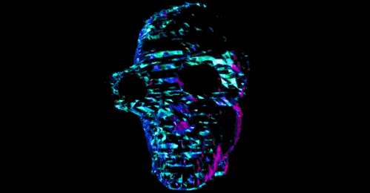
What is experimentation?
Camera
Composition
Materials
Scene
Other
Notes:
Get into pairs and write down – person next to you – 3

Slide 4
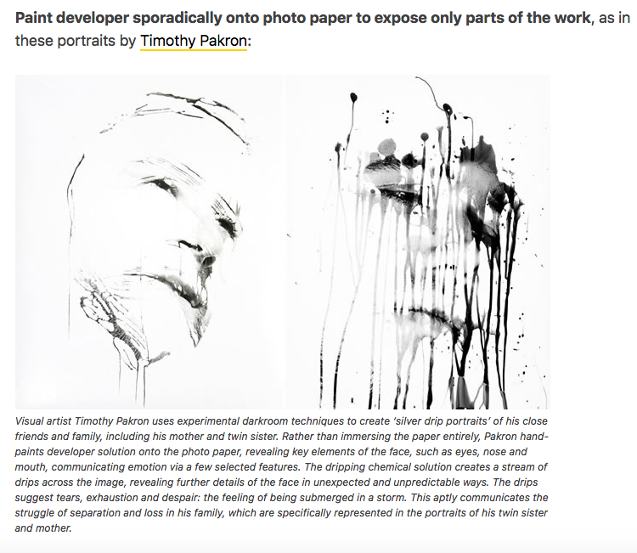

Slide 5
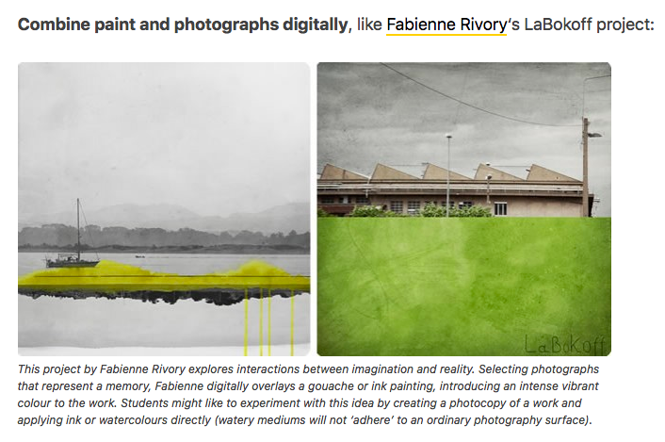

Slide 6
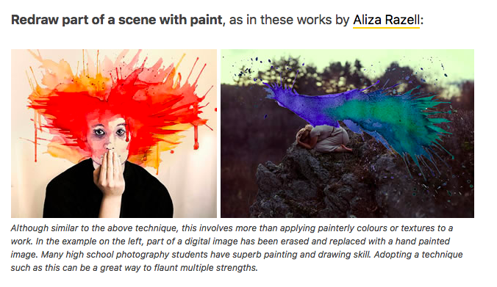

Slide 7
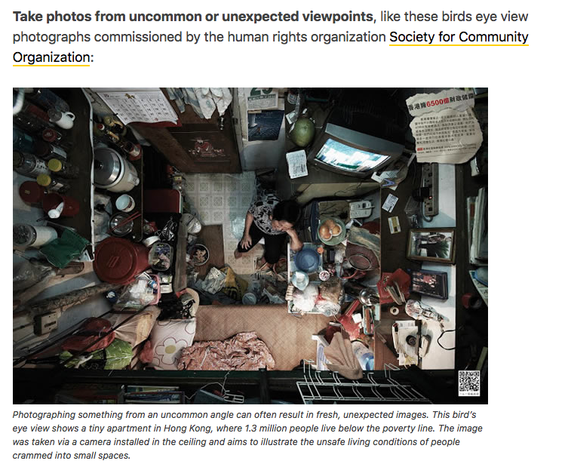

Slide 8
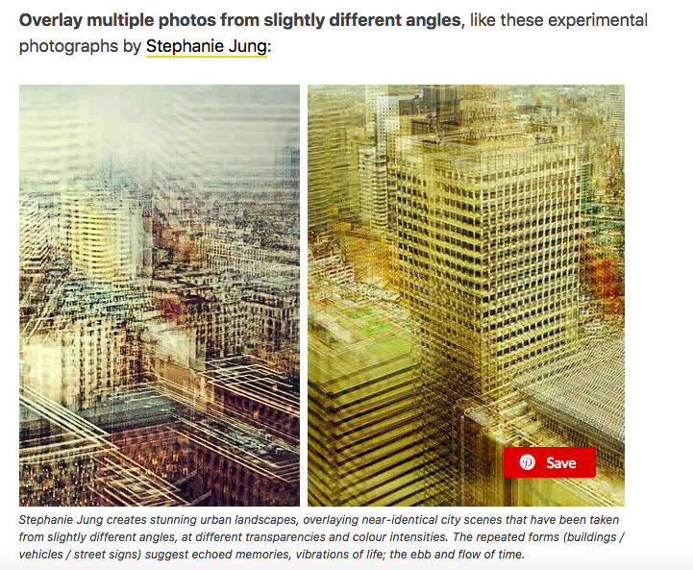

Slide 9
Activity
Work in pairs and think of certain messages or meaning you could communicate using the technique you are given. (think of themes that the technique would work well for)
EXAMPLE:
Using a slow shutter speed can convey a feeling of distortion and intense emotion, so it is a good form of experimentation to use for the theme identity, mental health, emotions or anything identity related.

Slide 10

What’s your intention?
Message
Statement
Aesthetic

Slide 11


Has any form of experimentation caught your eye?
Has it got you thinking about a theme and intentions?
Or do you just like the look of it and want to try it out?

Slide 12
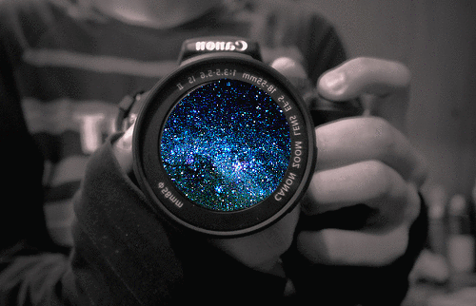
Individual activity
Apply learning to your own theme
Choose a form of experimentation
Use spark and include:
Choose at least one image of the experimentation you wish to use and analyse it
Why you have chosen it and why it will be effective for you to use it.
How will you do it – write a paragraph explaining how you will use it

Slide 13

Plenary
What did you choose?
DISCUSS this with your partner

Slide 14
Learning objectives
AIM: Learners explore different forms of experimentation and meaning
Review and discuss a variety of experimental artists and assess the images
Identify at least three types of experimentation
Demonstrate your understanding of using experimentation to communicate meaning or a message

Slide 15
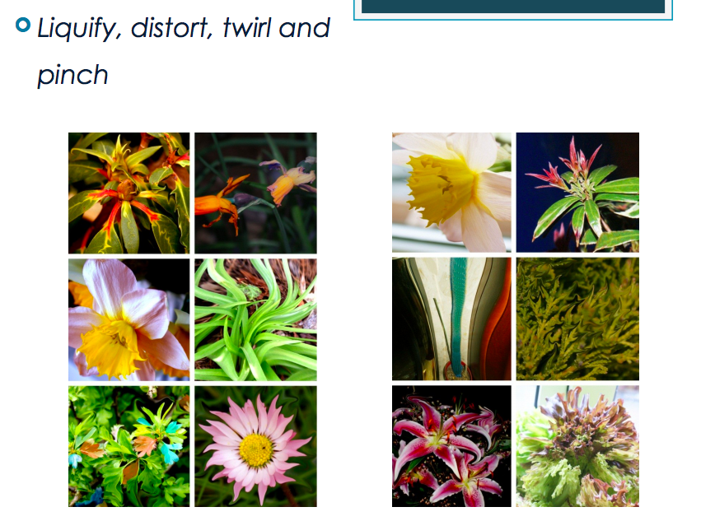

Slide 16
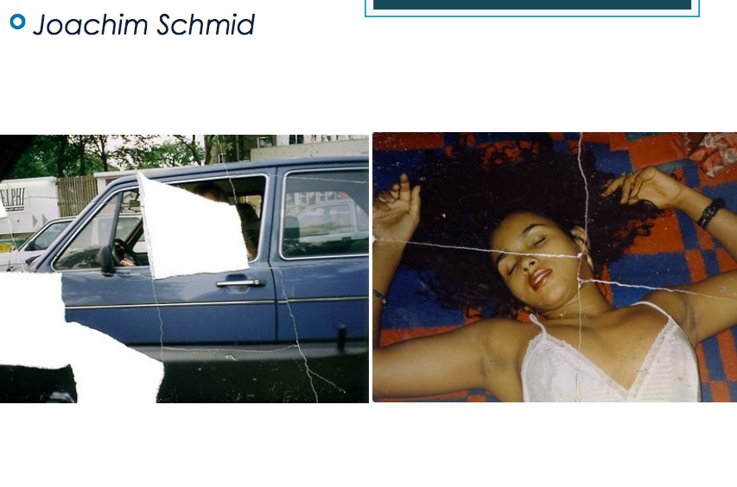

Slide 17
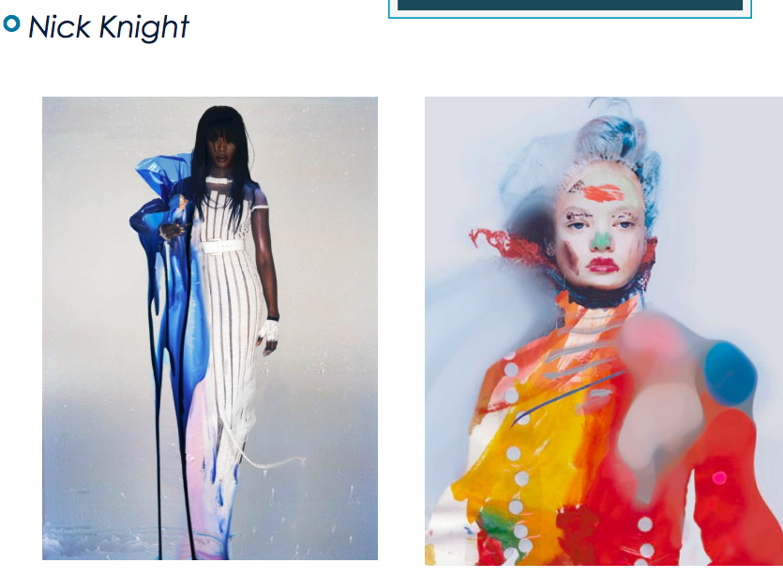

Slide 18
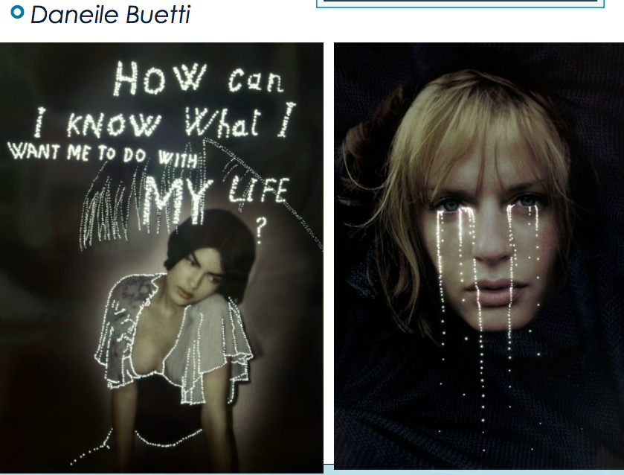

Slide 19
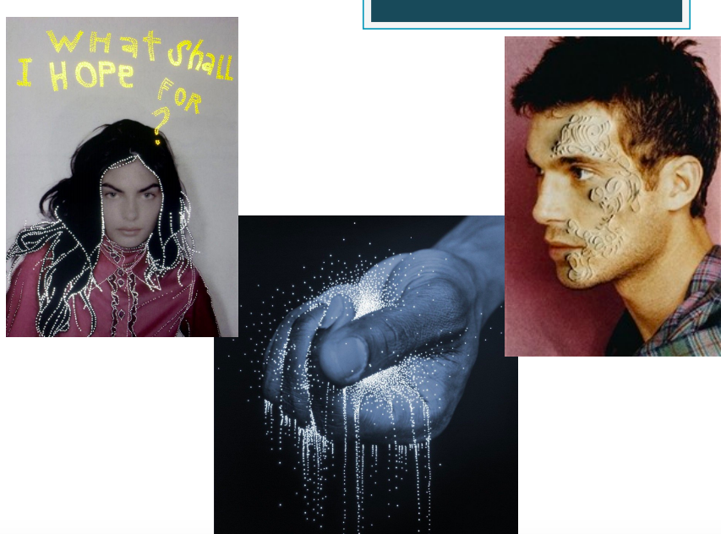

Slide 20
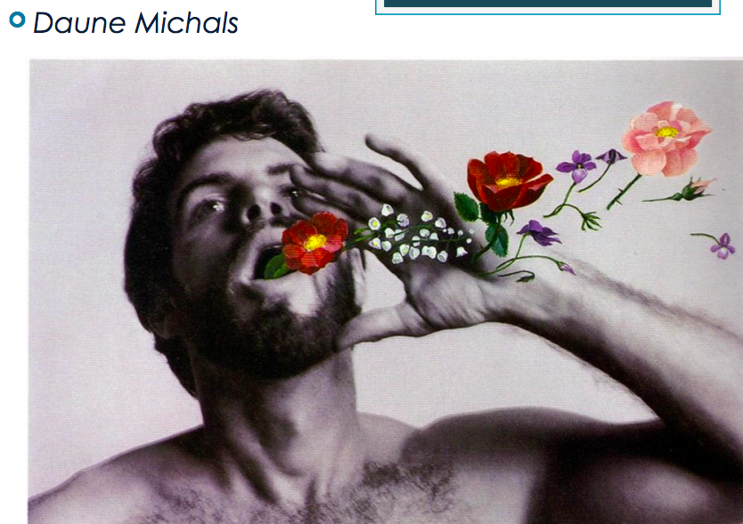

Slide 21
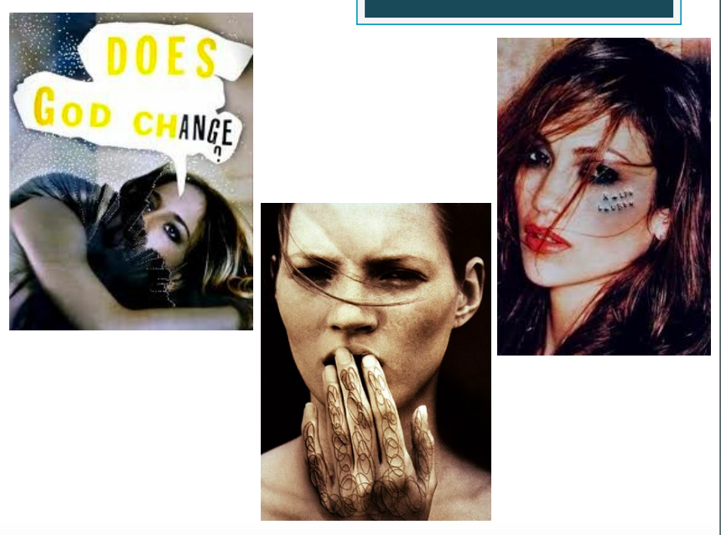

Slide 22
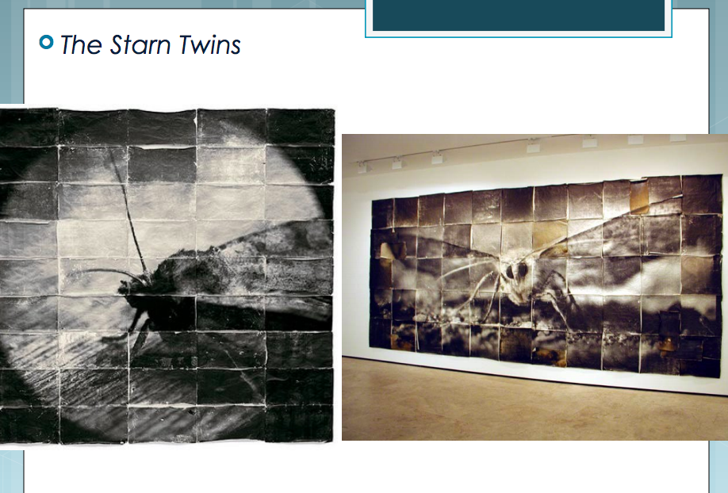

Slide 23
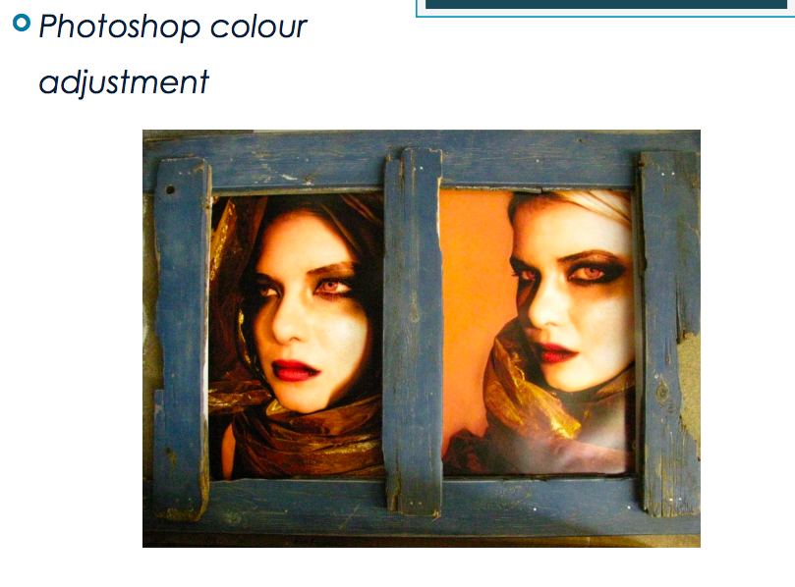

Slide 25
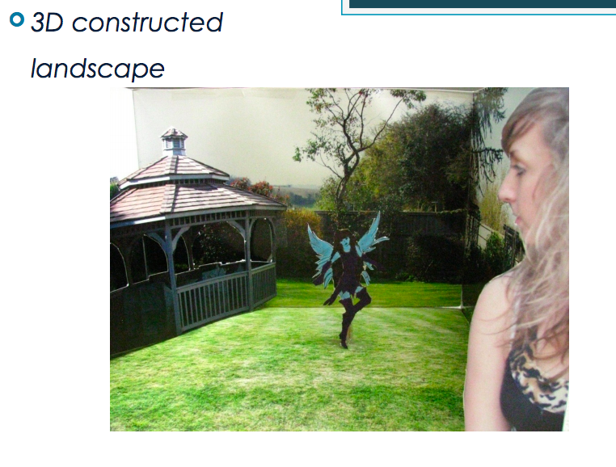

Slide 26
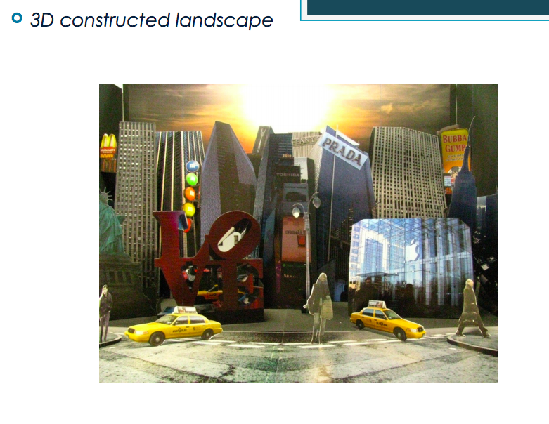

Slide 27
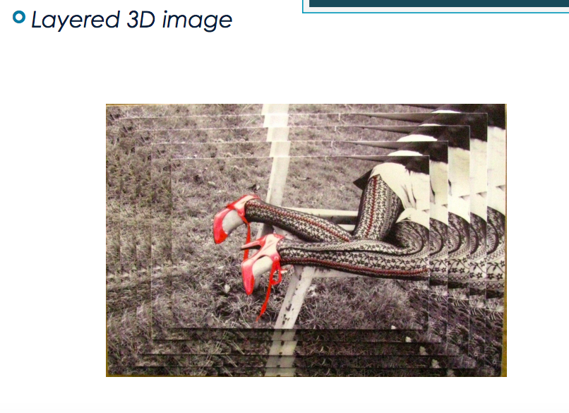

Slide 28
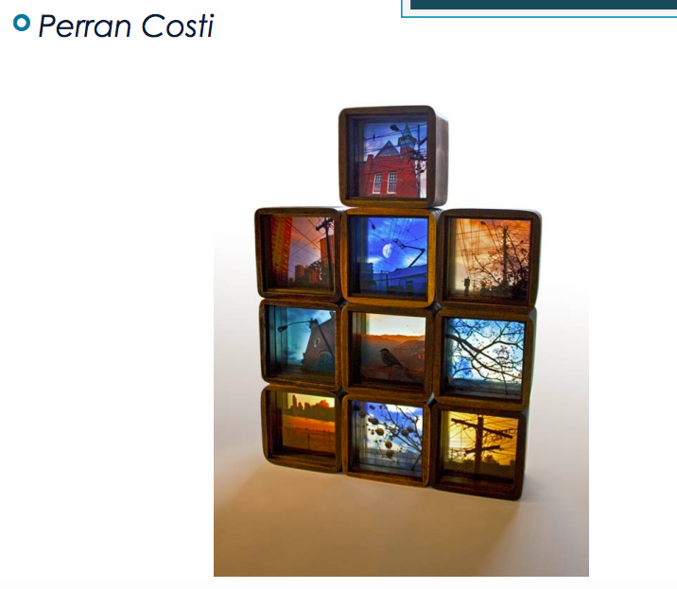

Slide 29
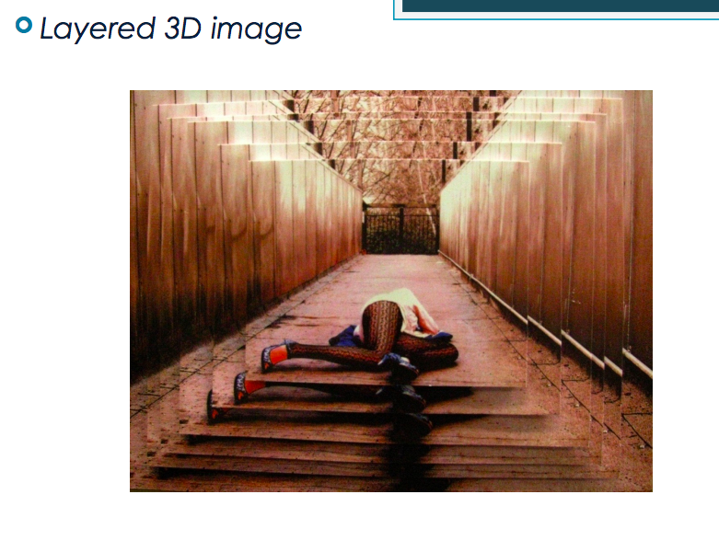

Slide 30
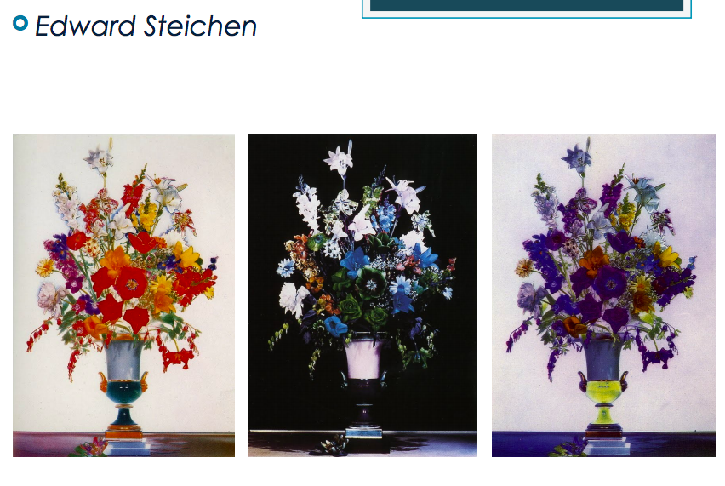

Slide 31
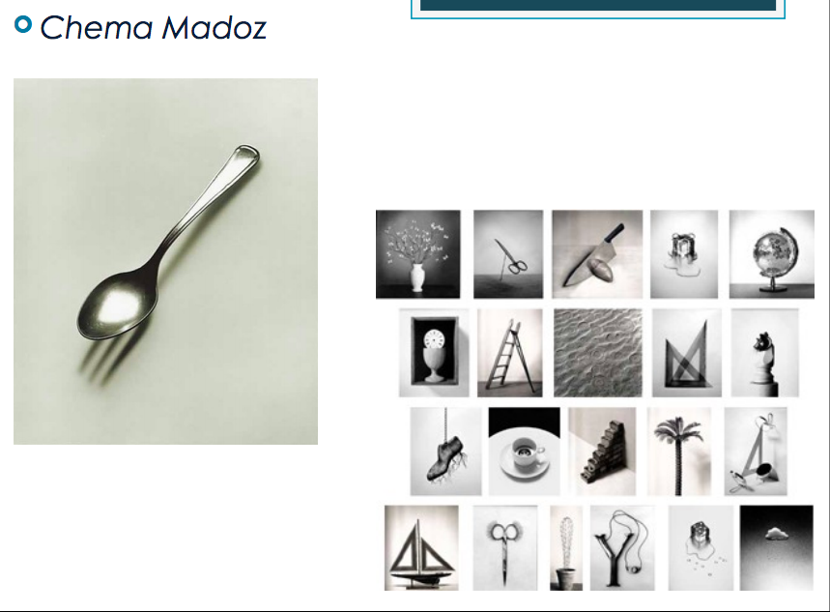

Slide 32
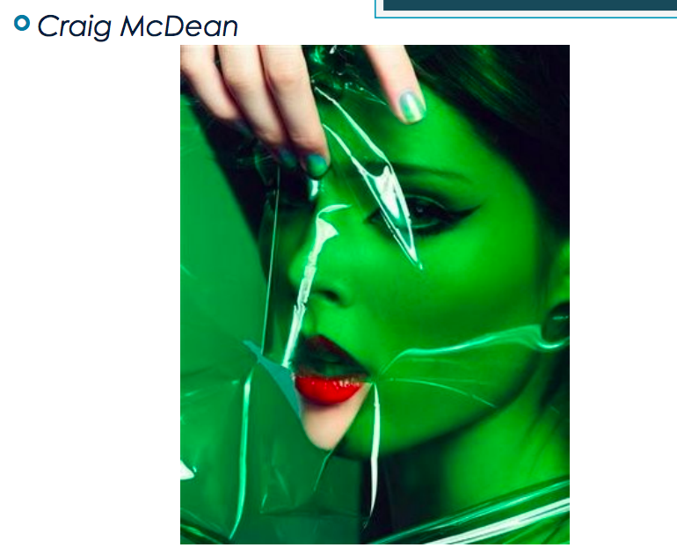

Slide 33
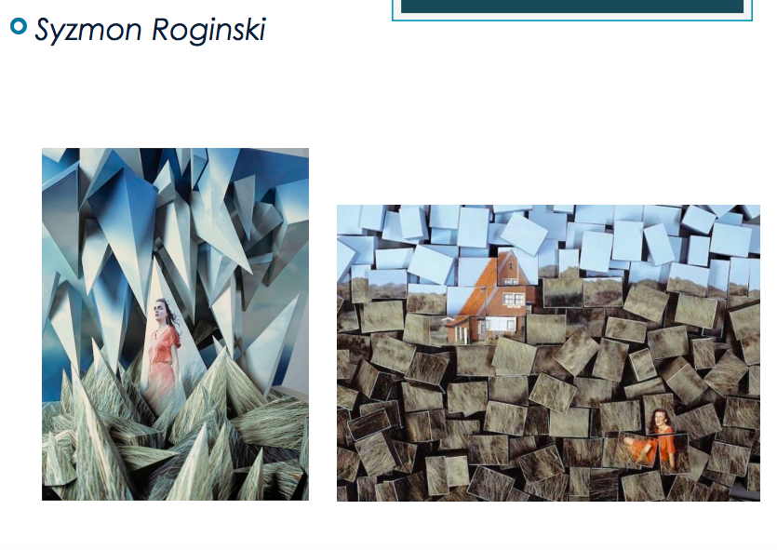

Slide 34
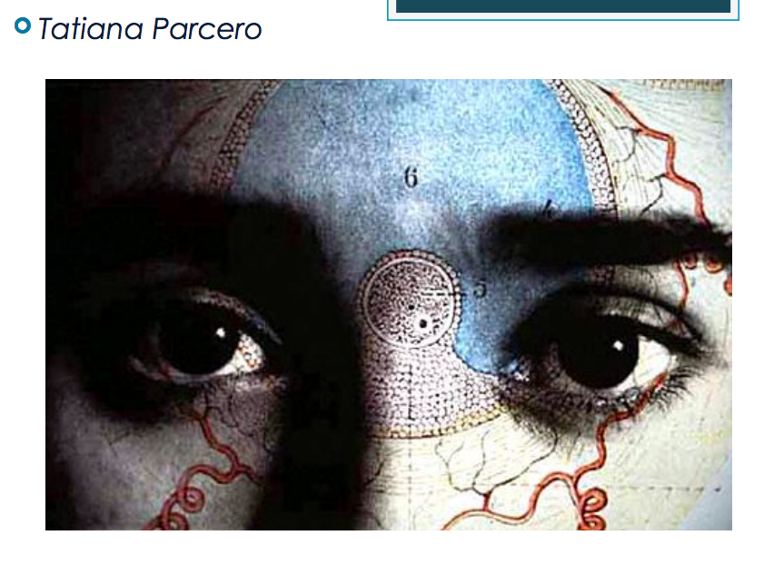

Slide 35
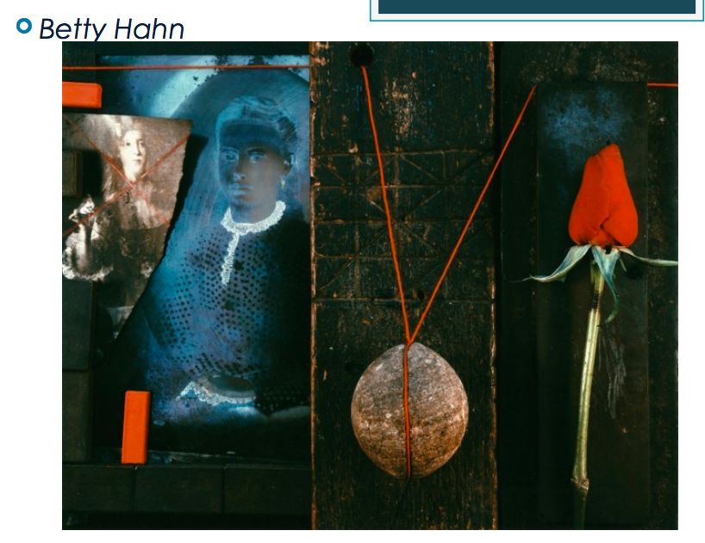

Slide 36
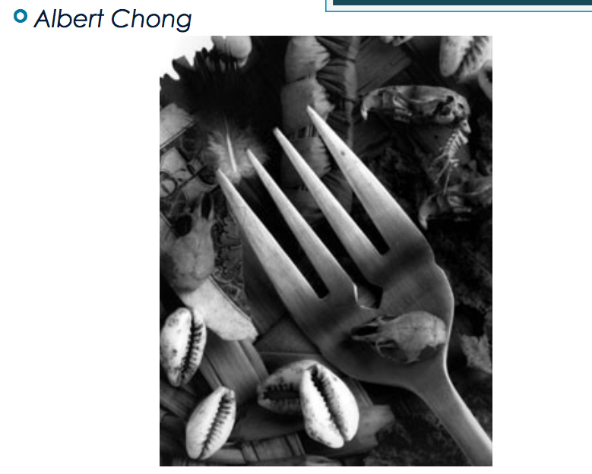

Slide 37
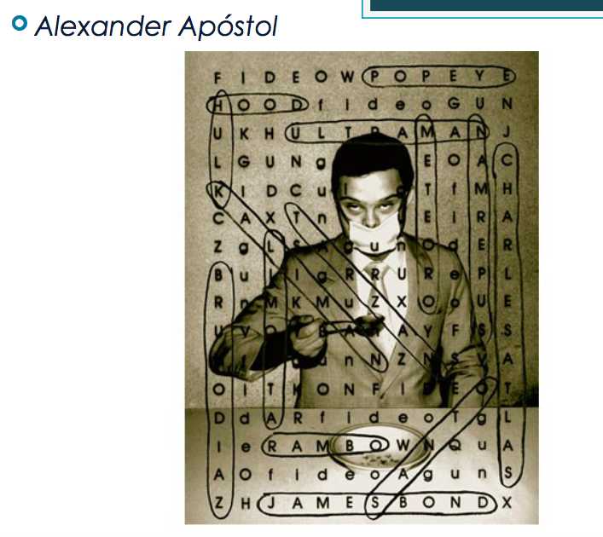

Slide 38
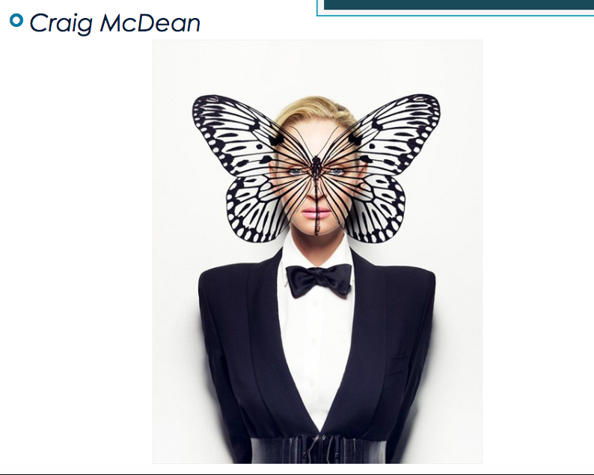

Slide 39
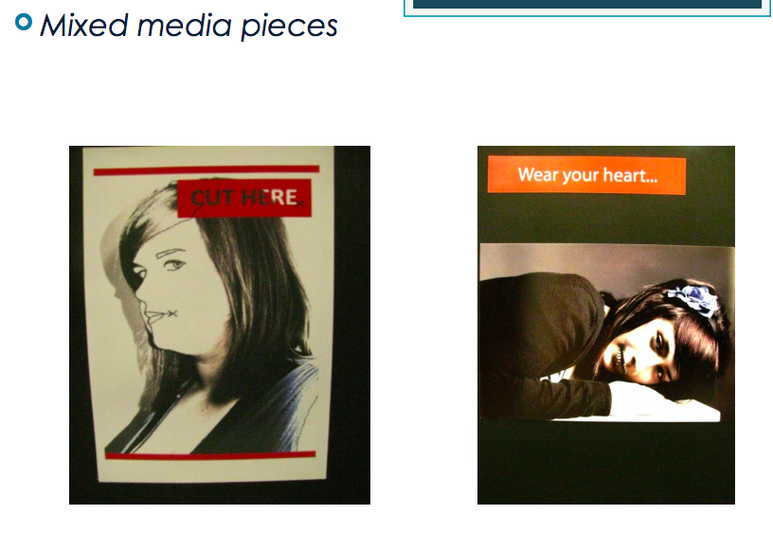

Slide 40
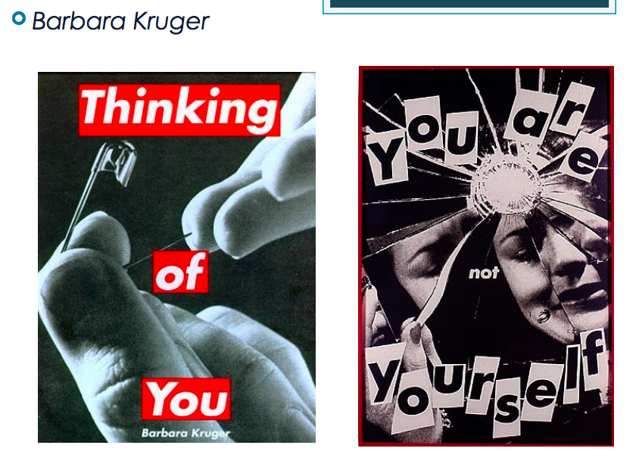

Slide 41
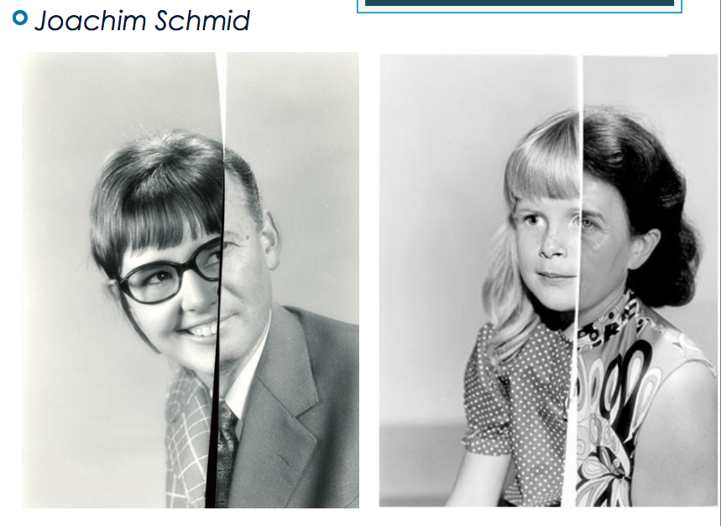

Slide 42
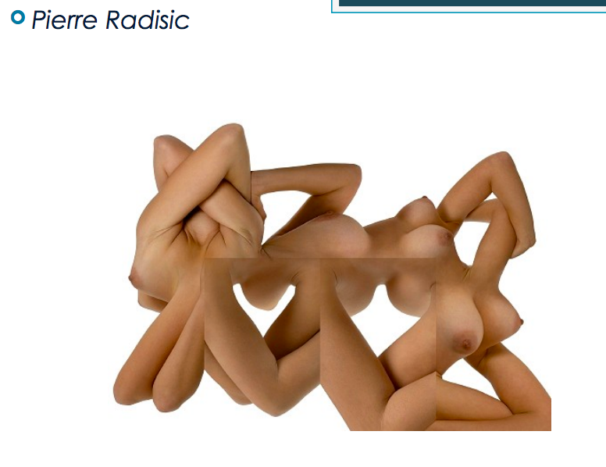

Slide 43
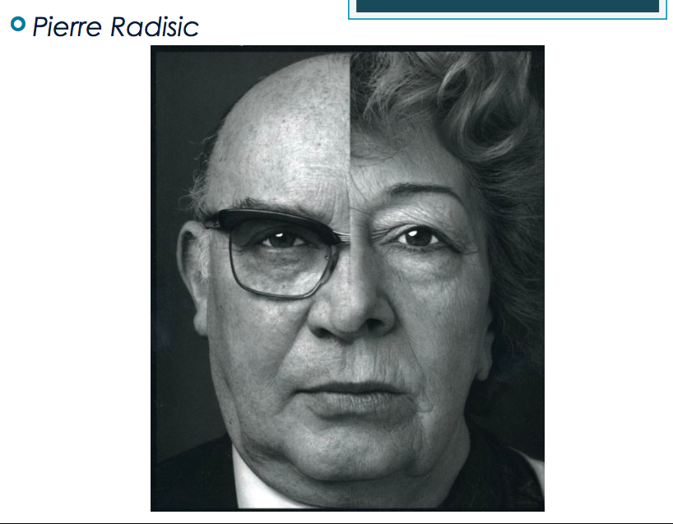

Slide 44
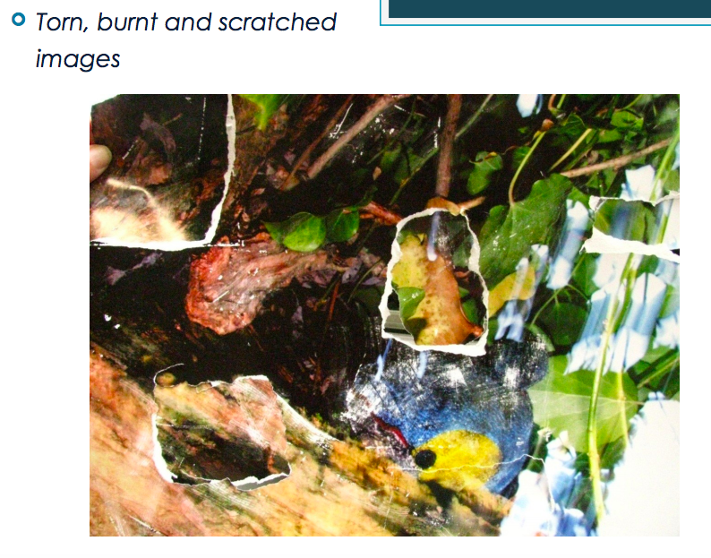

Slide 45
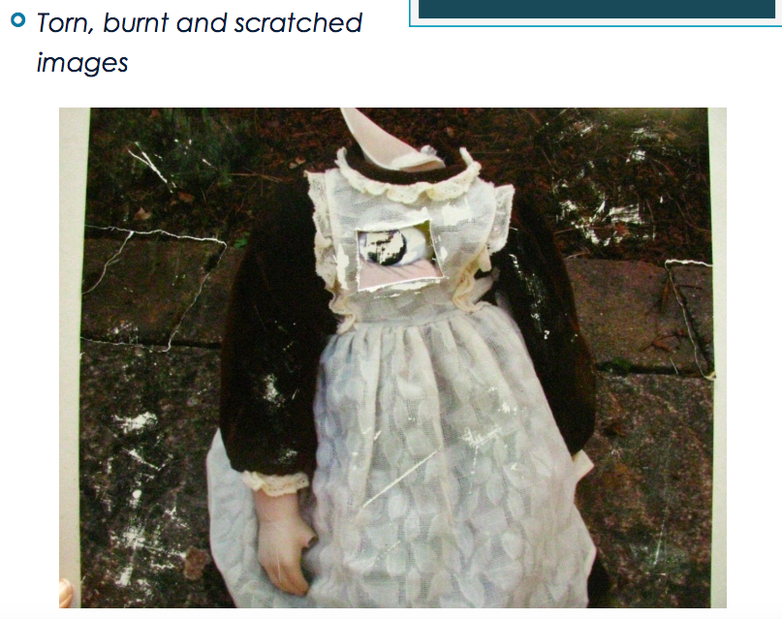

Slide 46
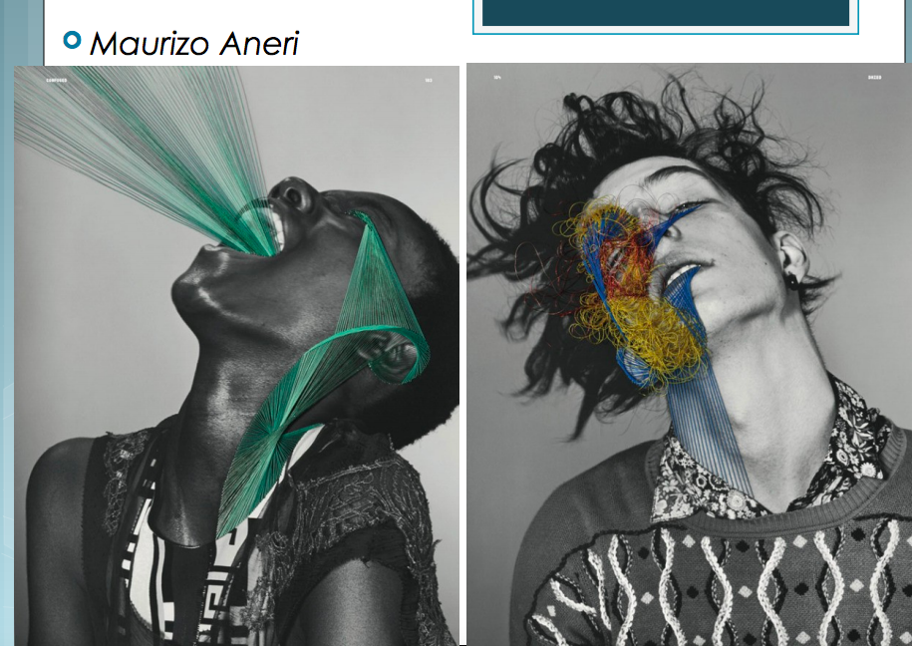

Slide 47
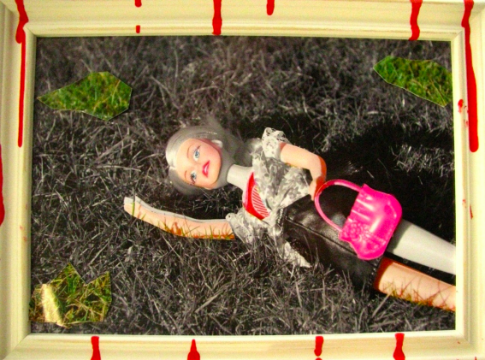

Slide 48
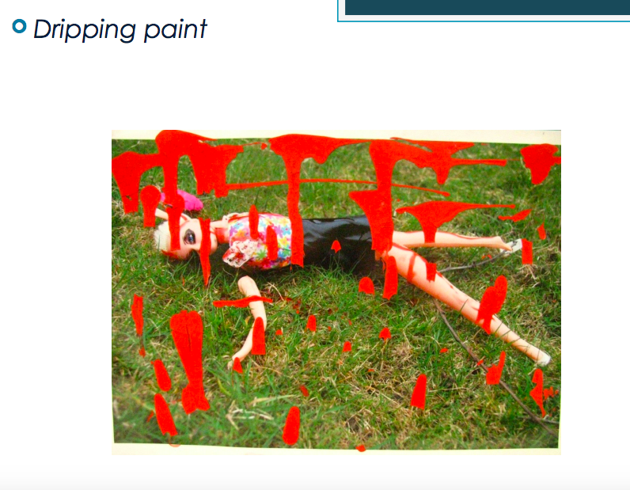

Slide 49
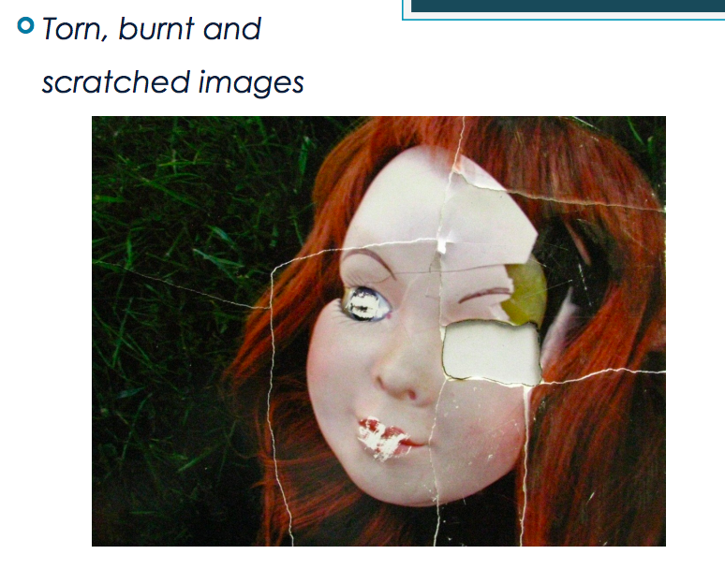

Slide 50
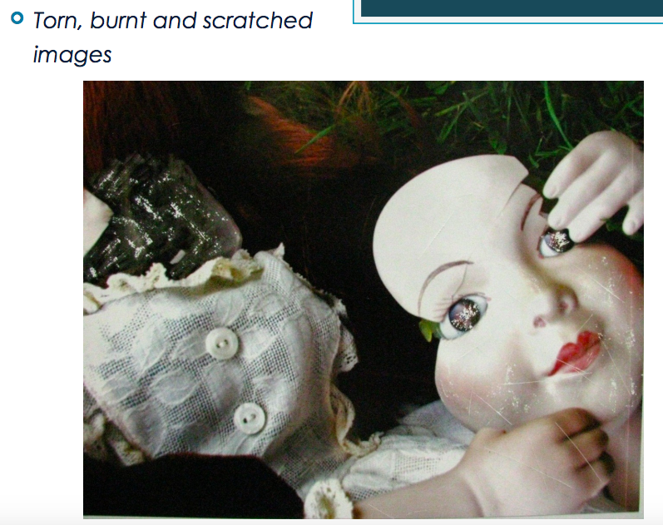

Slide 51
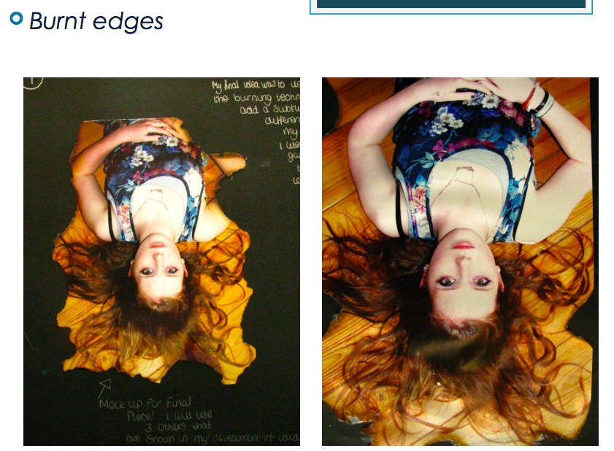

Slide 52
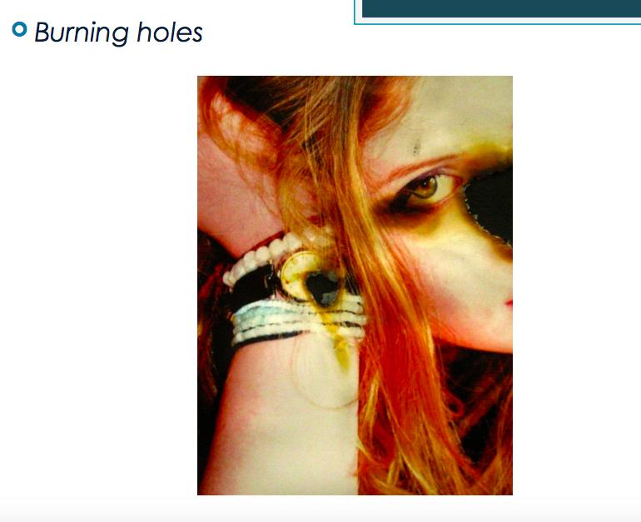

Slide 53
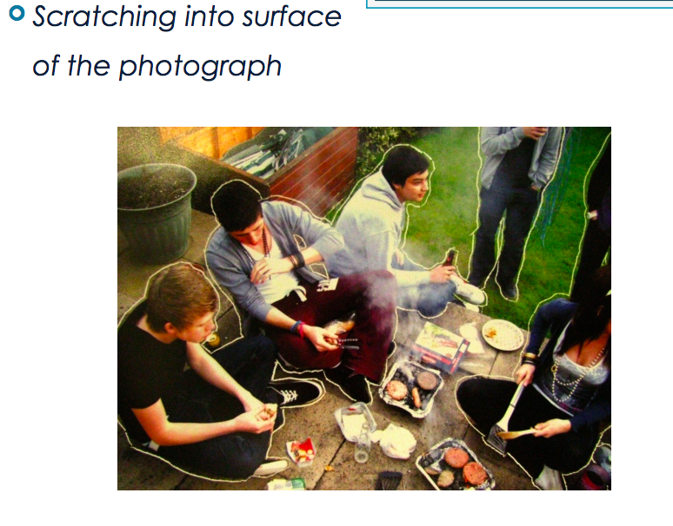

Slide 54
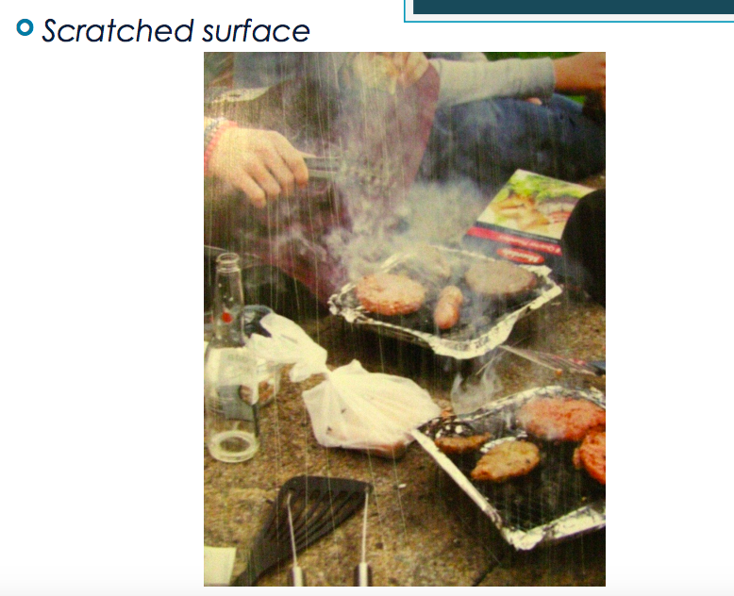

Slide 55
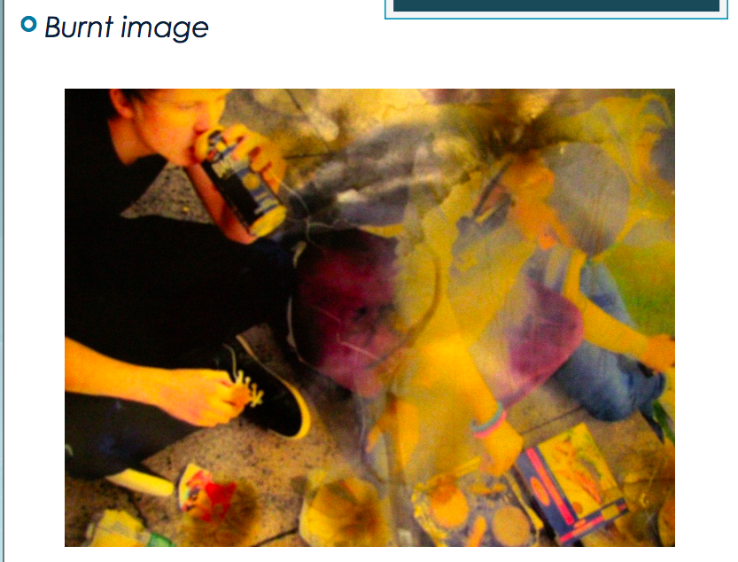

Slide 56
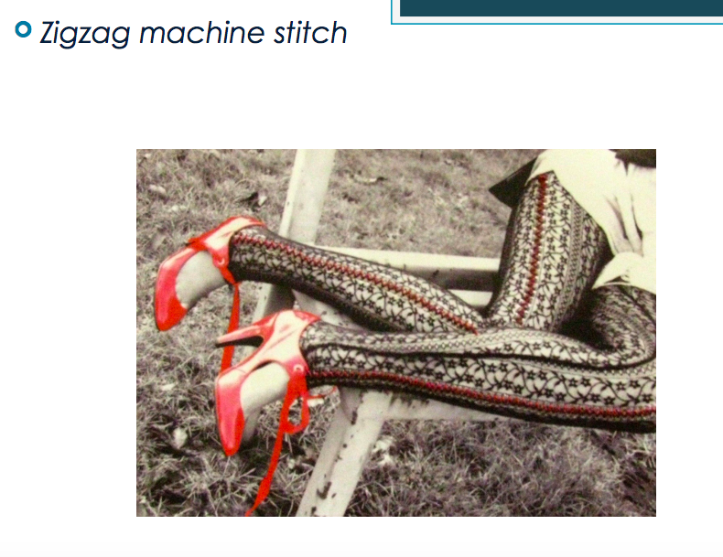

Slide 57
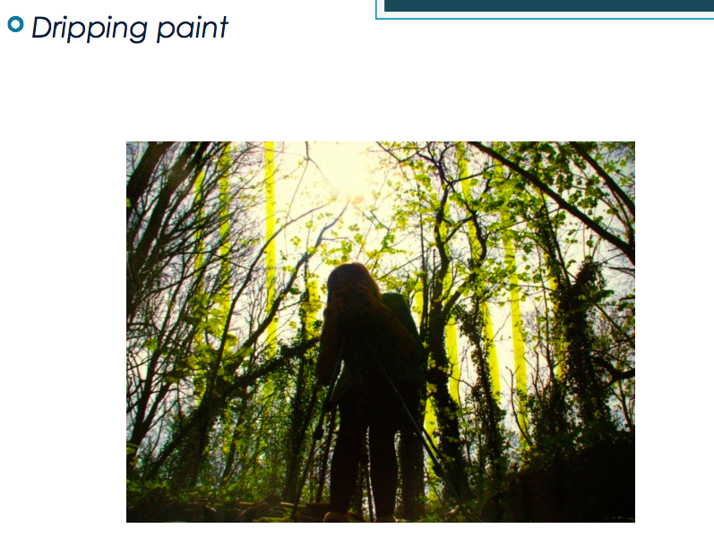

Slide 58
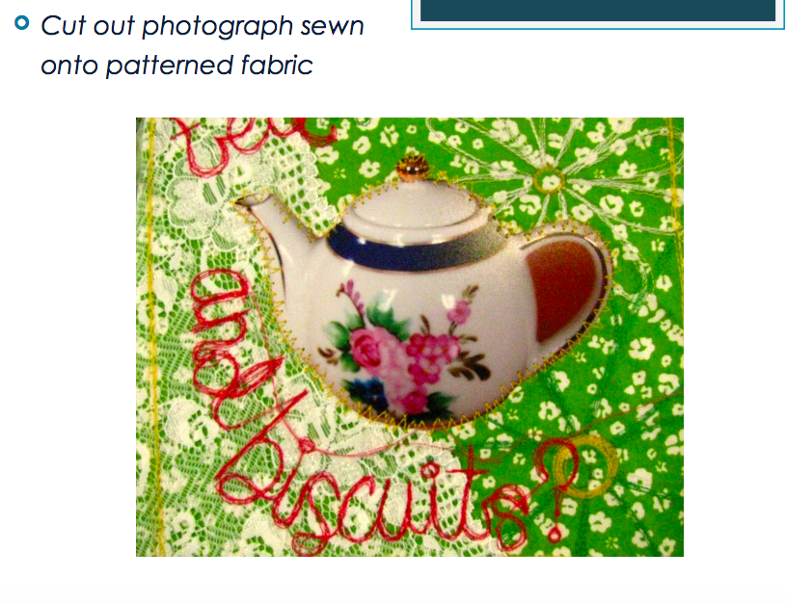

Slide 59


Slide 60


Slide 61
Experimentation
Choose two forms of experimentation you can use for your theme. This must include:
A image of the experimentation
An analysis of the experimentation –
How has the artist created this outcome? – what is the experimentation?
Why did you choose it and how does it relate to your theme?
What will you need?
What phots will you need to take in order to do this?

