Slide 2
Any work that you create will be marked according to how well you have displayed evidence of:
• Developing ideas through research of relevant sources. AO1
• Refining work by selecting and experimenting with necessary media, materials, techniques and processes to explore ideas. AO2
• Recording ideas and observations which are relevant to your theme as work develops. AO3
• Present a personal response which concludes your intentions and shows your comprehension of visual language. AO4

Slide 3
AO2
Experiment techniques and processes
Refining ideas
Improvement
Explore & Select
AO1
Develop/Explore ideas
photographer research
Investigate
Galleries & Museums
Exhibitions
Idea Development
Tip: Always discuss your ideas with your teacher BEFORE you commit to a starting point
Tips for success
TIP: Time is limited so be as
efficient as you can!
Make use of the same props but vary the images with different backgrounds and viewpoints (AO2/AO3)
Use your camera phone to do quick shoots when out and about.
AO3
Observations
Record
Sketch plans of shoots
Insights & Intentions
Reflect critically
Annotation
TIP: Keep to schedule.
Keep on top of the workload – you’ll be under pressure from all your subjects so use Art as part of your relaxation.
The timetable is the minimum expected – for higher grades you’ll need more (!).
TIP: Do as many photoshoots as possible at one time.
Often it can be difficult to get the camera equipment, models, props, and studio space together.
When everything is arranged, take advantage of that by completing as many photoshoots as possible for as many artists as possible.
Save all the images and edit them later, rather than doing each photoshoot one at a time.
AO4
Present personal and
informed meaningful response
Highly developed
Make connections
Final Piece
TIP: Find a sketchbook layout and style that looks good and can be done quickly.
If working in a physical sketchbook, consider using a background; layout etc particular font throughout
If working digitally, create a master slide or background to speed up your productivity and give a professional, clean look to your pages.
Each sheet should include a title, reference images, brief information on the photographer, and most importantly your own ideas! (mind maps, photoshoot ideas).

Slide 4
Crowds
Perhaps consider
Reasons for crowds of people and types of crowds (birds/ animals?)plus locations
(sporting events, concerts, demonstrations, shopping, protests, conferences, queues, corridors etc)
Locations - Sport events, cafes, shops
Flocks of Birds flying, feeding, animals
How accessible is this question to you
Colours you could pick out in crowds? The way someone is dressed? Things which “stand out” in a crowd
Suggested artists Alex Prager – film maker and photographer (creates attention to particular faces in a crowd)
https://uk.phaidon.com/agenda/photography/articles/2014/january/24/alex-prager-captures-the-face-in-the-crowd/

Slide 5
Lisa Larsen was a documentary photographer. Her images often depict the mood of large crowds.
The imagery captures a moment in time, the subjects’ expressive faces suggest the mood
Source; https://www.icp.org/browse/archive/constituents/lisa-larsen?all/all/all/all/0

Slide 6
Randy Olson created a series of images called “7 Billion Humans 2011” He uses bokeh effect by manipulating shutter speed. This has the effect effect of appearing to emphasise movement in crowds.
Source; https://www.nationalgeographic.com/contributors/o/photographer-randy-olson/
Key term
Bokeh - It comes from the Japanese word boke, which means 'blur
Bokeh is defined as “the effect of a soft out-of-focus background that you get when shooting a subject. Simply put, bokeh is the pleasing or aesthetic quality of out-of-focus blur in a photograph.

Slide 7
Kolman Rosenberg’s work gives the visual impression of crowds of dancers through the use of multiple exposure.
Source;
https://photographyunposed.wordpress.com/2013/03/03/ballet-multiple-exposures/
This web page provides an explanation of the work to gain a further understanding of the process involved.
“The camera serves as a portal for me to view common sites in an uncommon way. It enables me to see, and point out to others, the beauty, irony, interest, humour and sometimes the ugliness of the world we live in” - Rosenberg
Key term
Multiple exposure - the act or process of recording two or more superimposed images on a photographic medium

Slide 8
Manipulating reality – Photographers and Artists have often juxtaposed unrelated elements together to create unusual, strange and bizarre compositions by manipulating the reality that an image presents. Often the origins of this as a concept come from Surreal Art and Photography c.1920’s
Paul Biddle
Source;
www.paulbiddle.com
Paul Biddle carefully arranges objects, together with layers of collage, before digitally manipulating his photographs.

Slide 9
Kevin Corrado
Source;
https://www.saatchiart.com/kevincorrado
Kevin Corrado’s work combines landscape imagery as well as people which have been physically and / or digitally manipulated to create effects

Slide 10
Eresha Sale

Slide 11
Concealment –Photographers have created portraits that deliberately disguise or partially conceal parts of an image. This could be to communicate a deeper message or meaning
Rosanna Jones
Source;
https://www.rosannajones.co.uk/
Facial features within the work by Rosanna Jones are concealed by overlapping and rearranging parts of the photograph.

Slide 12
Wallace Juma
Wallace Juma portraits are physically
worked over with collage and other medium to
conceal the sitters identity
Source;
http://www.wallacejuma.com/

Slide 13
Jose Romussi
The textile artist Jose Romussi features collaging techniques and stitch work to hide and conceal parts of her original photographic portraits
Source; https://trc-leiden.nl/trc-needles/people-and-functions/artists-designers-and-embroiderers/romussi-jose-1979

Slide 14
Pablo Thecuadro
Pablo Thecuadro creates detailed collages from his fashion photographs. These collages often cover and conceal sections of his faces or figures featured in his work.
Source; https://www.ignant.com/2017/04/21/the-duality-of-human-being-expressed-by-pablo-thecuadro/

Slide 15
Paper - Paper can be manipulated, positioned and photographed in interesting ways. Lighting can be used to create some dramatic effects.
Jerry Reed
Jerry Reed’s and Ion Zupcus’ work features photos of paper constructions. These are carefully lit to create exaggerated shadows and are presented in monotone.
Ion Zupcus
Source; https://azurebumble.wordpress.com/2012/11/28/jerry-reed-paper-work-series-photography/
http://ionzupcu.com/
https://passionforpaperandprint.wordpress.com/2013/12/20/ion-zupcus-minimalist-paper-photographs/

Slide 16
Abigail Reynolds
Abigail Reynolds and Aldo Tolino Create images by often combining them to create 3D paper relief images. This is achieved by ripping, cutting, folding or layering the images.
Source;
https://www.escapeintolife.com/artist-watch/abigail-reynolds/
https://www.designboom.com/art/aldo-tolino-folds-portraits-into-geometric-facial-landscapes-10-28-2013/
Aldo Tolino

Slide 17
Aaron Siskind
“Photography is a way of feeling, of touching, of loving. What you have caught on film is captured forever…it remembers little things long after you have forgotten everything.” Aaron Siskind
Siskind observes textures, within buildings within urban spaces which we would simply walk past.
His images emphasise form, line tone and texture
Perhaps consider shooting around your area to record posters, old billboards, stickers which have been weathered, distressed for e.g. Peeling posters, old stickers on lamp posts, old billboards, faded distressed shop window posters
Source;
https://www.ideelart.com/magazine/aaron-siskind

Slide 18
Moments in time - As photographers we are able to capture moments in time in a variety of ways.
Lev Akhsanov
Lev Akhsanov and Ray Demski use a fast shutter speed to capture moments in time in their sport photography
Source;
https://levakhsanov.net/p1053078832/h6741DC7#h6741dc7
https://www.raydemski.com/Action/Action/thumbs
Key term
Composite images
Composite Photography is simply the blending of two or more images to create one final image. While this definition makes Compositing sound quick and easy, it's anything but, often involves requiring several hours of photography and Photoshop work to complete a final piece.
Ray Demski

Slide 19
David Hilliard
Source;
http://www.artnet.com/artists/david-hilliard/
David Hilliard creates imagery known as “ composite images” These consist of a few images placed together which record different moments in time.

Slide 20
Hair - Photographers over the years have captured interesting cultural and fashion imagery of hair
Perhaps consider the
Style, movement, structure, colour, texture of hair.
Hair to symbolise cultural origins, ethnicity, individuality?
Photography at a barbers? Hairdressing salon? (OBTAIN PERISSION FIRST!) with a focus on the community aspect
Suggested Photographers
Marc Laroche – whose work often represents the movement of hair.
Source;
http://larochemarc.com/hair/
Marc Laroche

Slide 21
Fabien Baron
Fabien Baron and Alex Styles – Fashion photography
Source;
http://alexstyles.co.uk/galleries/hair/
http://baron-baron.com/fabien-baron/
Alex Styles

Slide 22
J.D. ’Okhai Ojeikeres
J.D. ’Okhai Ojeikeres work captures intricacy
of the textures and pattern within several
Nigerian hairstyles.
Source; http://www.nae.org.uk/exhibition/jd-okhai-ojeikere-hairstyles-and/66
https://www.coeval-magazine.com/coeval/jd-okhai-ojeikere

Slide 23
Sabrina Santiago
Sabrina Santiago has created a set of images called ‘East Flatbush, Brooklyn’, These documentary style photographs capture the significance of the hair salon and the role they play in the African Caribbean community
Source; https://nylon.com/articles/afro-caribbean-hair-photo-series

Slide 24
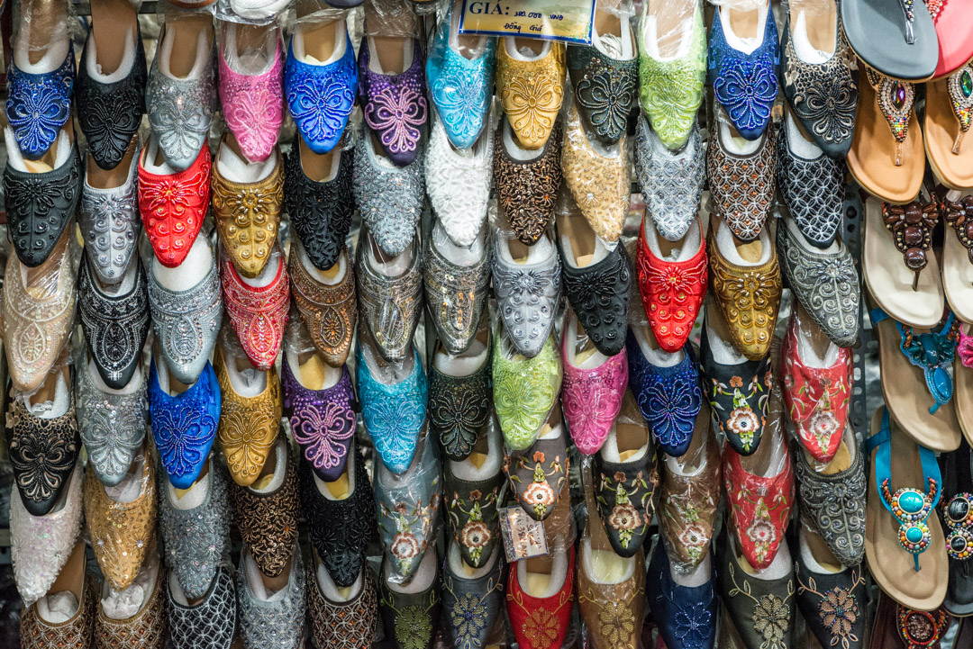
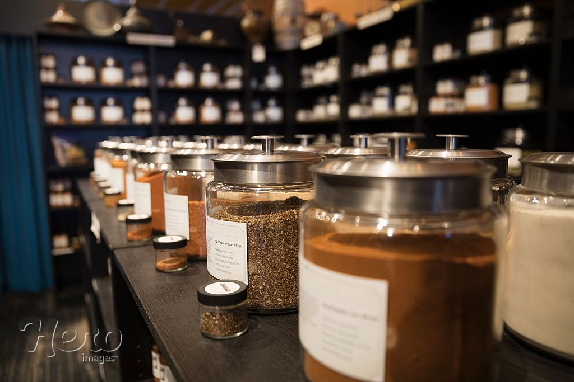
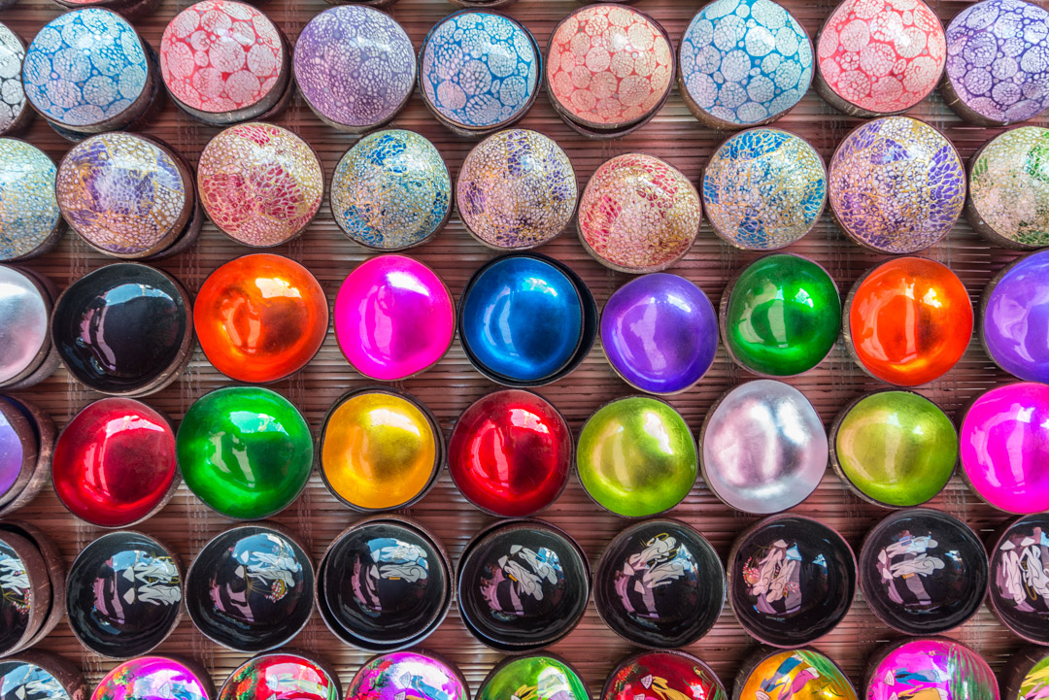
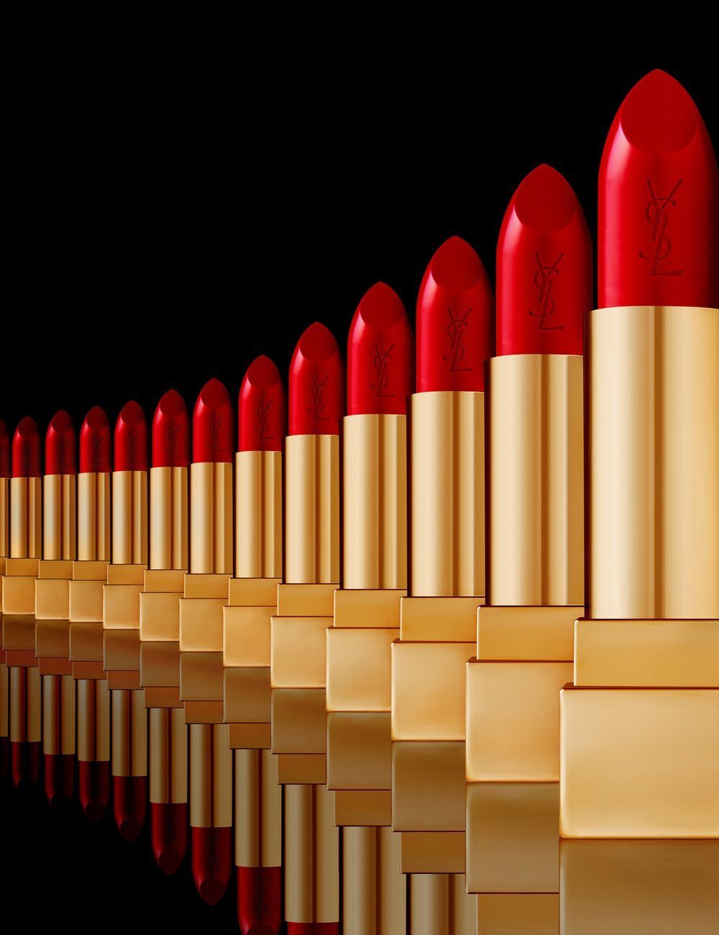
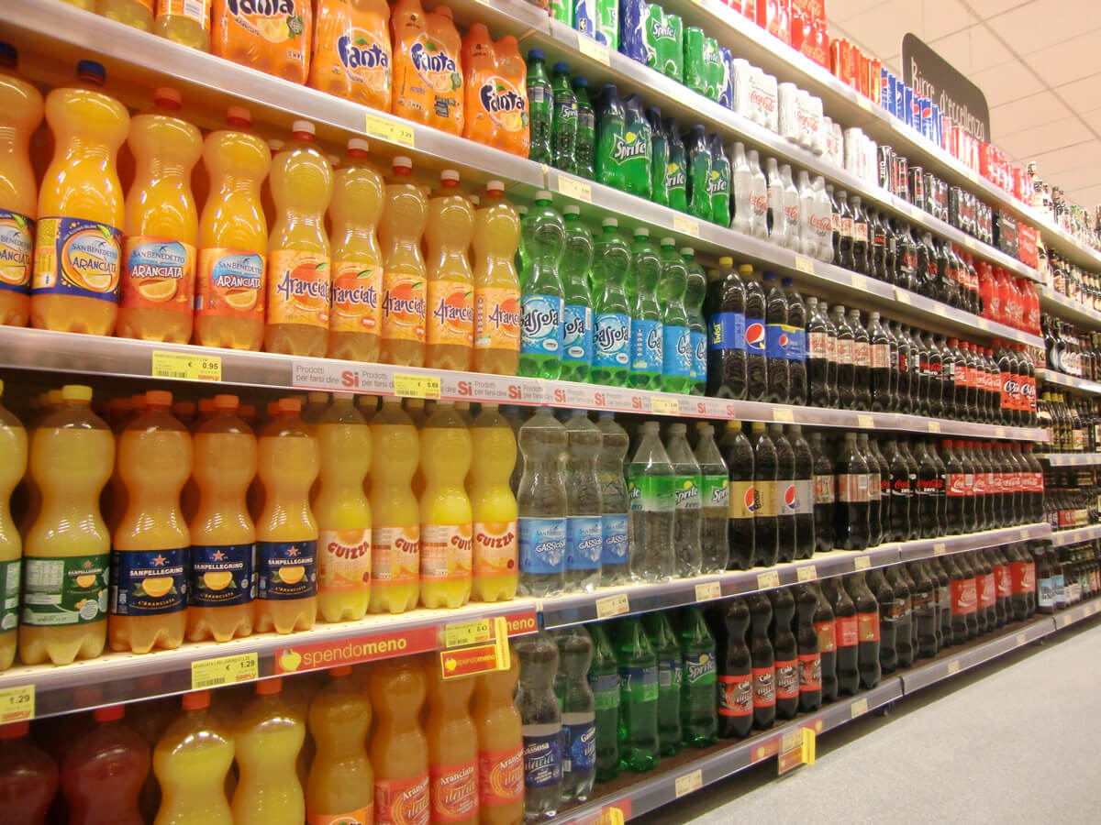
Rhythm – This is a theme which can be interpreted in many ways.
Consider
Repetition of displayed objects in stores on shelving units?
Source;
https://ianrobertknight.com/using-repetition-in-composition/
Key considerations – Ask permission BEFORE taking photographs in shops

Slide 25
Rhythm and pattern can be found in the textures and patterns of natural forms such as shells, plants.
Source;
https://americanart.si.edu/artist/henry-troup-6202
https://www.andysmall.co.uk/
http://www.paulcanningphotography.com/blog/1601
https://www.pinterest.co.uk/pin/404690716492743165/?lp=true
Other suggested Photographers for inspiration;
Henri Troup – sand ripples
Andy Small – fruit, plants
Paul Canning – shells, sand
Marc Anderson – bark and driftwood

Slide 26
‘Rhythm’: an online music magazine featuring images of a range of stringed instruments;
Perhaps design a cover page for their latest issue.
Source;
https://www.magazinecafestore.com/digital/rhythm-digital-magazine.html
Considerations.
Spend time researching the magazine, its target audience and the types of imagery used, create your own response.

Slide 27
Further tips for success
Tip- get a good start!
Create a detailed mind map. With ideas for subject matter and shoot ideas / imagery. This will assist you if you run out of ideas later in the project.
Tip – avoid changing your mind
Once you have discussed your starting point with your teacher, STICK WITH IT! Ideas can evolve along the way, Avoid altering your initial decision to answer your chosen question.
Tip – research is key
Spend time researching the work of your photographic sources. This will help you to understand their work and gain a greater understanding of what YOU are attempting to do!
Tip – Be resilient
Keep going, hard work and efforts will be rewarded. Additional effort now will ensure a successful examination.

Slide 28
How to begin - Mind map your original thoughts / ideas
Photographic / artistic experimental techniques
These will vary dependant on your chosen question
(ADD RELEVANT IDEAS HERE TO YOUR THEME EACH STUDENT WILL BE DIFFERENT
SCANOGRAPHY
DIGITAL EXPERIMENTS TO EMPHASISE COLOURS / DESATURATE COLOURS
PRINT IMAGERY ONTO DIFFERENT SURFACES/ BROWN PAPER , TRACING PAPER, FOILS , ACETATE, FABRIC
LOW KEY IMAGERY
MID KEY
LAYER IMAGES (physically and digitally)
Create multiple exposed
COLLAGE / PHOTOMONTAGE
CAPTURING IMAGES IN WAX
DRAWING INTO SEWING IMAGES
Weaving images
Headings for a mind map in Photography
Photographic / Artistic influences
List these and add a sentence or phrase to describe the work of each photographer / artist
Only include artists / photographers you are going to use to influence your work
Add examples of their work here.
Shoot locations and ideas.
Where are your shoots going to be taken ? Be specific!
Title of project?
Insert question title
Subject matter
(What will you take photographs of AND WHY? (objects? Natural forms man made? List these and be specific
Composition rules
List which composition rules you intend to explore here and what effect you will attempt to achieve?
For e.g. CLOSE CROP—To observe my subject in detail to analyse pattern / rhythm ,
Unusual viewpoints and close crop - to obtain more abstract shots
Add inspirational images from a variety of sources
Key words and phrases associated with the theme.

Slide 29
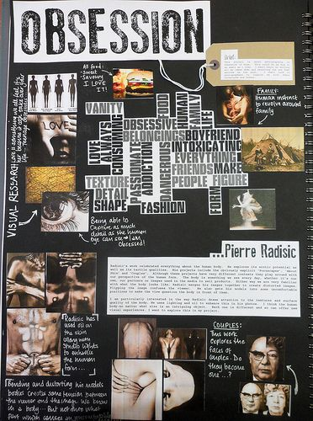
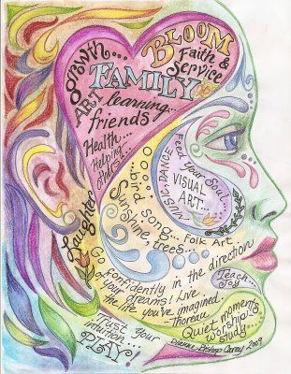
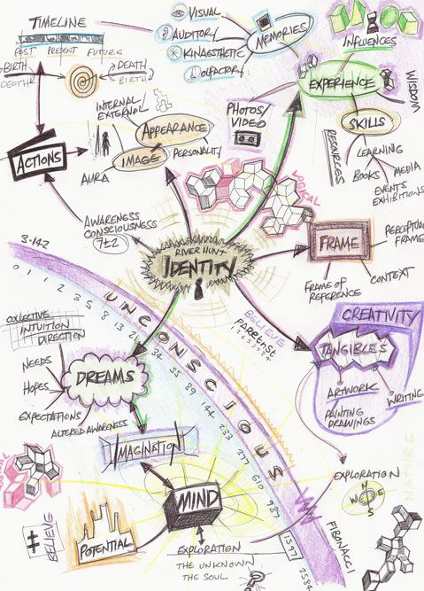
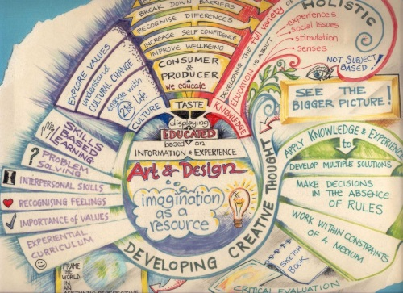
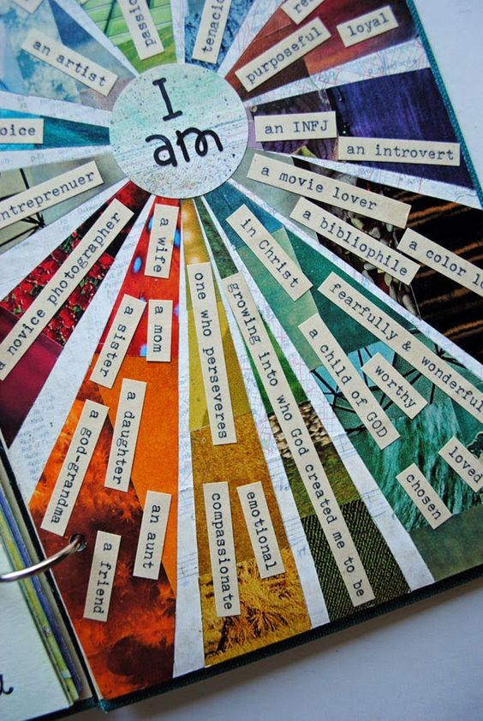
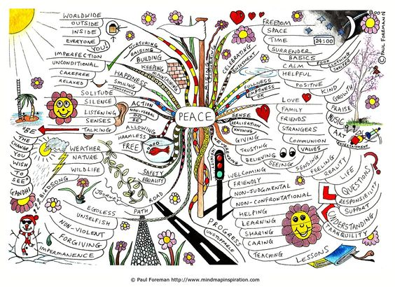
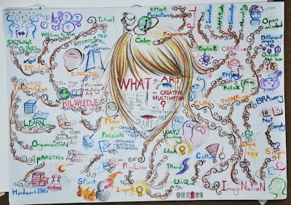
Create an interesting mind map/ visual ideas board to inspire your project
Examples of creative looking mind maps to present your initial ideas
Remember
Content is more important than Presentation
What are the positive qualities within these examples of mind maps?

Slide 30
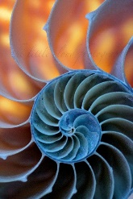
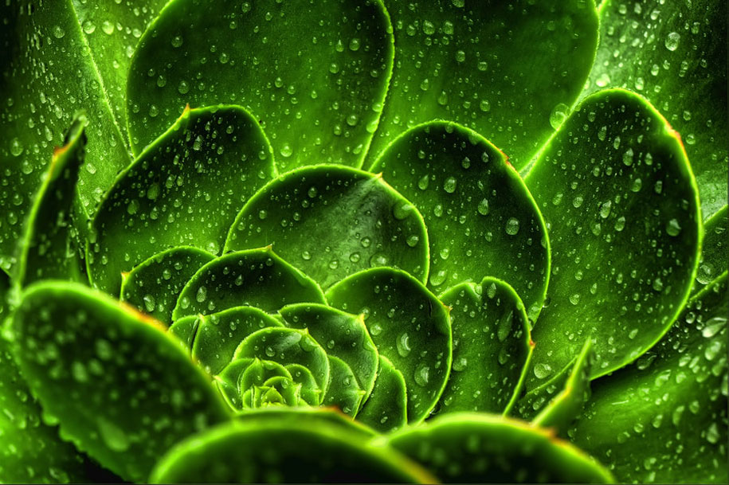
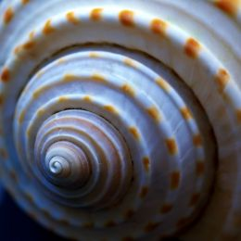
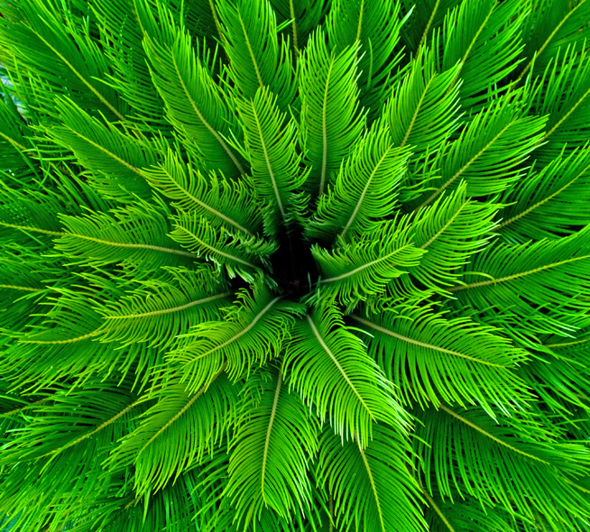
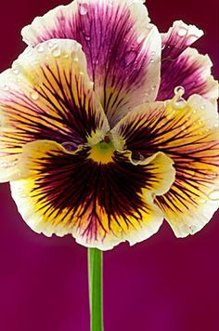
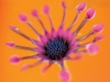
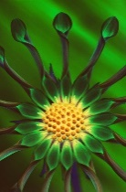
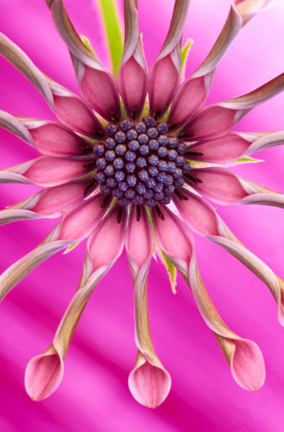
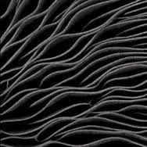
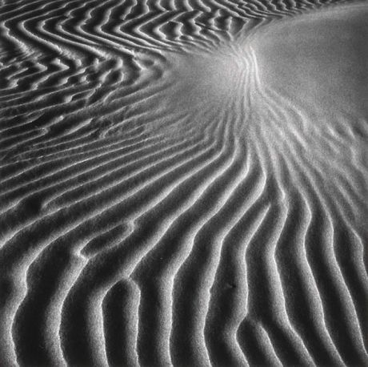
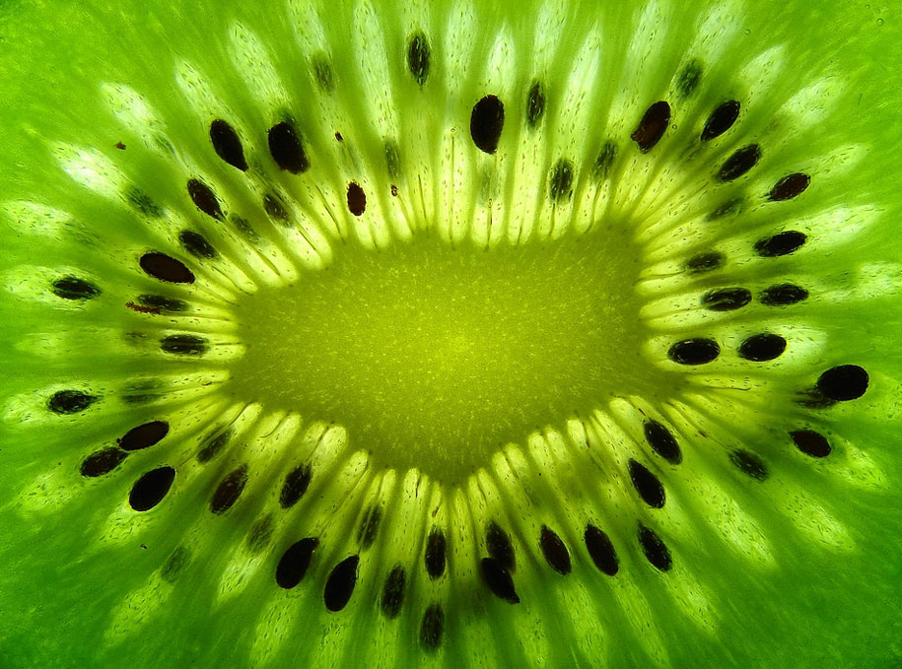
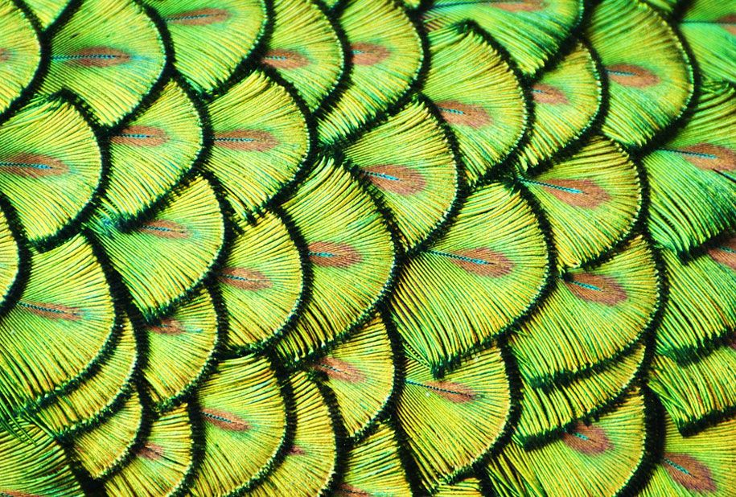
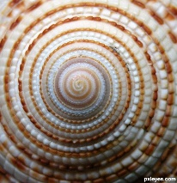
Ideas for shoots
Close up sections
Observe my objects in close up
Create abstract images
Observe my subject in Low Key
Backlighting of objects to create silhouettes / to see the structure of natural forms in more detail
Create exaggerated shadows of my subject using lamps
Reflect ions in mirrors
Observe objects reflected in water
Observing my subject in detail to emphasise pattern
Composition rules
Fill the frame / close crop to obtain detail and or abstract looking images
Rule of thirds
Placing the subject within top, bottom, left or right of the image
Photographers
Henry Troup—sand ripples
Edward Weston—Shadows/ Low Key
Andy Small—flowers/ fruit close up / rhythm structure
Marc Anderson – Bark
Paul Canning – Natural forms
Subjects.
What to photograph...
Example of a simple computer generated mind map
Rhythm in natural forms in the environment
Flowers / plants, dried or dead flowers
Water ripples/ reflections
Shells, seeds, pine cones, leaves, bark, wood,
Insects, sand ripples, texture in natural stone, skulls.
Portraits, tattoos
Experimental ideas
Layering images using PixLR / Photoshop,
Transfer images onto surfaces
(Acetate, tracing paper, fabric
Photographing objects under coloured light
Backlighting of objects to create see through x ray type images to emphasise pattern

Slide 31
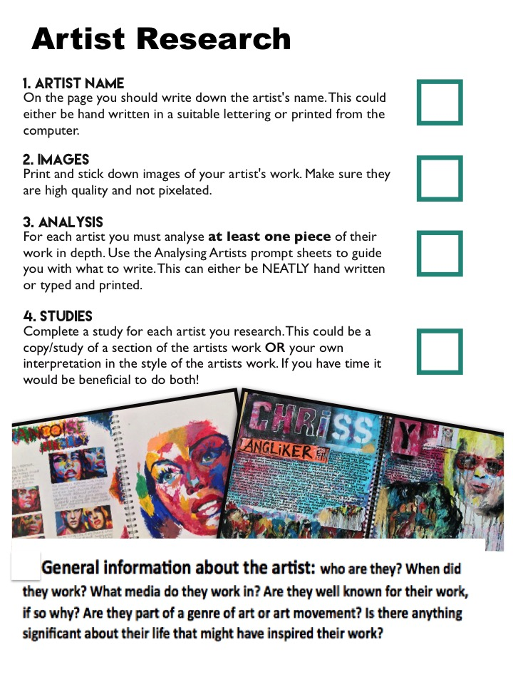
How to create an Artist / Photographer influence page for photography
Photographer research
Success Criteria
PHOTOGRAPHS “IN THE STYLE OF”
1.Artist/ Photographers name
2.Images – include images of the work by the your chosen photographer Photo
3. Analysis – use analysing artists prompt sheet
4. Photographs in the style of or an interpretation of your chosen photographers work
5. Explain how the work of your chosen photographer is going to influence your own
5. Artist / photographer response;
Explain how the artist/photographer going to influence the creation of your own images?
Add a study using one of YOUR own images and recreate it using the style of
your chosen artist.
I intend to interpret the technique / style of this artists / photographer by ……………….
(using similar subject matter / colours/ composition/ techniques and media/ creating the same mood/ concept)

Slide 32
Summary
Choose question wisely, make sure that subject matter is accessible to you
Discuss with staff your ideas BEFORE starting.
Create a written and visual map of ideas relating to your question title
Research appropriate photographers who will influence your work
Listen to advice and guidance, your teachers want you to achieve your full potential
Good luck!

