Slide 1
GCSE Photography handbook
Personal Project

Slide 2
Contents
Sketching Guidance
Drawing a photoshoot plan
Analysis example
Photographic terminology
Composition techniques
Camera settings
Getting to know the camera
Formal elements
Lens ranges
Useful Links
Personal project Pyramid
Moodboard
Mindmap
Photographer Research
Photographer research and questions/analysis guidance
Statement of Intent
Theme Research
Photoshoot
Review and Select
Editing
Experimentation
Project Review
Final Experimentation
Best Images from each photoshoot
Final outcomes
Project Evaluation
Camera settings for analysis
Assessment Objectives

Slide 3
Personal Project Pyramid
Contents page
Evaluate
Stage 5
Final images
Final experimentation & final outcomes
Best Images from each photoshoot
Final Experimentation
Evaluate
Evaluate
Evaluate
Stage 4
Editing
Editing
Final planning & final photoshoots
Editing
Review & Select
Review & Select
Review & Select
Completion: When you have completed the task place a red dot in the box
Photoshoot
Photoshoot
Photoshoot
Project Review
Stage 3
Experimentation
Experimentation
Experimentation
Experimentation
Experimentation Research
Experimentation Research
Experimentation Research
Stage 2
Evaluate
Evaluate
Evaluate
Evaluate
Editing
Editing
Editing
Editing
Photographer research
& Responses
Review & Select
Review & Select
Review & Select
Review & Select
Photoshoot
Photoshoot
Photoshoot
Photoshoot
Stage 1
Photographer Research
Photographer Research
Photographer Research
Photographer Research
Moodboard
Mindmap
Photographer Research
Statement of Intent
Preliminary
Photoshoot
Theme Research
Initial research & planning

Slide 4
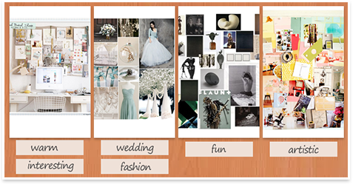
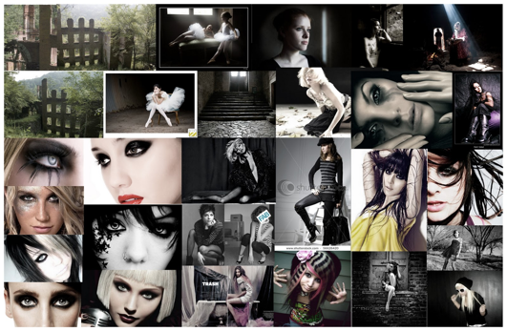
Moodboard
Contents page
A moodboard is and arrangement of images, materials, pieces of text, etc. intended to communicate a particular style or concept - it's also a great way to develop ideas. See examples below but also have a look at a wide variety of mood boards on the internet.

Slide 5
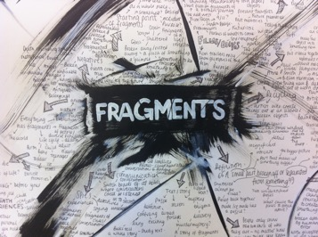
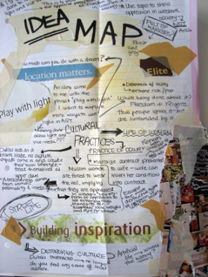
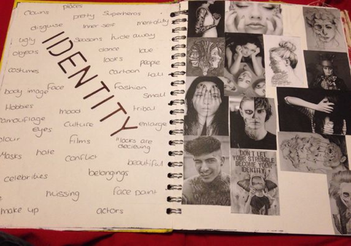
Mind map
Contents page
A mind map is a diagram to visually organise information. It's a great way to ‘map out’ your ideas. You can create it in whatever way you find suits you best. Include information like:
Photoshoot ideas
Locations
Equipment / materials needed
Theme expansion (sub themes - for example Identity / emotion etc)
Intended use of camera and composition techniques
Intended experimentation
Possible photographers to research
It is not uncommon to create multiple mindmaps throughout your project!

Slide 6
Photographer Research
Include in your photographer research:
A brief introduction to the photographer (a mini bio - age, birth place etc,, the style and nature of their work, the motives and influences and why you have chosen them in relation to the topic - what inspires you about their work). A good way of gaining an insight into a photographers’ way of working is to step into their shoes by trying to recreate some of their images. But before you do this you need to closely look at their work to try to work out how they did it (which lens, how it was lit? etc.) It is important that you clearly lay out your research in such a way that this method is clear as this is a good opportunity to receive some good marks under AO1. The simplest way is as follows:
Analyse at least 2 images of theirs that interest you – ensure you discuss visual elements, possible meanings, and your own interpretation – if the photographer is well known, you may find other peoples reviews on line. - see photo analysis guidance.
There is no wordcount for photographer research but remember the more you research, and the more critical you are (interpreting meaning and stating opinions) the higher the grade.
Don’t forget, if your chosen photographer is well established, there might be a documentary on YouTube
You can find lots of photographers on the internet but also try the library… you can also visit exhibitions etc. You don’t necessarily have to look at JUST photographers. Anything can inspire you! So use any source of inspiration! For example, if you like Tim burtons style you can research him and his works, but you must be clear to identify what style/technique/idea you are interested in, and why.
www.abbiesdhsphotography.weebly.com
Contents page
PTO

Slide 7
Contents page
Photographer Research
Questions to consider:
What is it? What is it about? What is happening?
Where and when was it taken?
What do you think that the relationship between the photographer and subject/s is?
What does the photograph represent?
What has the photographer called the photograph?
Does the title change the way we see the photograph?
Is it a realistic depiction?
Have any parts been exaggerated or distorted? If so, why?
What is the theme of the photograph?
What message does the photograph communicate?
www.abbiesdhsphotography.weebly.com
Composition - How the photograph is set out.
Form - 3 Dimensional shape through use of tone
Colour -Is the photograph colour or black and white? How does this affect the mood?
Tone -Is the photograph high or low contrast? How and why? The quality of light source can affect the tonal contrast? What kind of light source is there?
Line -What sorts of lines are there in the photograph? How have they been positioned in relation to the rest of the composition? What effect does this have?
Shape -What sorts of shapes are there in the image? Doe they remind you of anything? Do you think the photographer meant this? What kind of marks does the photographer use?
Pattern/Texture -What kinds of patterns and/or textures are there in the photograph?
How does the photograph make you feel?
Why do you think you feel like this?
Does the colour, texture, form or theme of the photograph affect your mood? How and why?
www.theinspiringphotographers.wordpress.com

Slide 8
Statement of Intent
Y­­our statement of intent is a written document explaining your intentions for your project. You can structure it anyway you like, but it’s important to include certain elements. Ensure to answer the questions below. Also, you can view examples of statement of intents on the guidance website.
Contents page
Why did you choose your theme?
You can talk about why it appeals to you, and maybe any other factors that led to choosing it, for example, it might be you have seen someone else's work that inspired you.
Do you have a story or experience to share that led you to choose your theme? For example, perhaps someone would choose mental health as a theme because they have experienced mental health issues, or they have witnessed a loved one suffering from it.
If you choose a hobby for a theme, you can write about your history with it, and share a happy memory, or a negative one.
What is the purpose of your project?
This can cover different areas, but firstly, consider your message. Are you trying to communicate something to people viewing your work? Are you making a statement? Are you trying to express how you feel about something? Or are you just exploring something because you want to learn more about it? If you are only interested in taking photos to create something visually and aesthetically pleasing, this is fine, but you must justify why you want to do this.
www.abbiesdhsphotography.weebly.com
PTO

Slide 9
What research will you do to help you with your idea development?
Researching is very important to help your project progress and reach final outcomes. There are different areas of research and it is dependant on your theme.
Photographer research is compulsory, so you can talk about photographers you have already identified as inspiration for project, and talk about why they are relevant and what techniques you will adopt from them.
You may also want to research your theme, so for example, if your project theme was ‘plastic crisis’ and your intention was to raise awareness, then you would browse the internet, watch documentaries, look at stats etc - you can say what you intent to research and why.
Questionnaires are very handy to help you gather information about particular topics - so for example, if you wanted to get an idea of how people feel about the plastic crisis. You could also interview people.
What experimentation do you think you will use?
Experimentation comes in many different forms, and you will definitely progress from what you write here. The statement of intent is just your initial intentions. You can experiment using the camera settings, composition techniques, art based (painting on images, sketching on images, collage, fabrics, darkroom) editing, scene experimentation (different locations, models, poses, props etc) .
Contents page

Slide 10
Theme Research
Theme research is dependant on your chosen theme. For example, theme research for ‘the plastic crisis’ or ‘homelessness in Torbay’ is going to differ greatly to ‘landscape’ or ‘pattern’.
Areas of research:
Internet - you can read articles related to your theme
Documentaries - you can watch documentaries related to your theme
Statistics - you can look at statistics related to your theme
Questionnaires - you can create a questionnaire to find out information
Interview people - interview people to get opinions and information
Example of research for a theme: Homelessness in Torbay
Internet - read articles online related to homelessness in Torbay, look at organisations/charities and the work they do, learn about the history of homelessness and how the majority of people that are homeless ended up in that situation. Look at statistics from the council to get an idea of how many people are homeless, if it has increased and what locations are most prone to homeless people.
Documentaries - Watch documentaries about homelessness – screen shot the doc and annotate it or/and take notes
Questionnaires - I would only use a questionnaire if I thought it would help give me ideas for my project. So, on this occasion, I would create a questionnaire to establish if the public are aware of just how many people are homeless in Torbay, as my project aim is to raise awareness and inspire people to donate to charities.
Interviews - (only under safe circumstances - never alone! and always in public). Request an interview with someone working with a charity in Torbay for the homeless, someone from Torbay council, and maybe even interview a homeless person (never attend ANY interview on your own and you must discuss them with tutors first)
Contents page

Slide 11
Photoshoot
Contents page
You must take at least 30 photos for a shoot. Its very important you have a wide variety of photos to choose from as well as exercising your skills. You may have a few images floating around that are not necessarily part of a shoot but if you are planning a shoot and out for a shoot you should aim for a minimum of 30 – this makes a decent contact sheet.
Composition: you should always consider / apply composition techniques – you must be able to identify techniques and why/how they are being used. We will expect you to discuss your composition intentions in your analysis as well as see evidence of application in your photography.
Camera: Its very challenging to use a camera manually, so please don’t be disheartened if you give it a go and don’t get the results you want. YOU MUST use the camera consistently and experiment to familiarise yourself with the settings, as well as putting yourself in different light situations. You won’t learn how to use the camera manually unless you practice! However, even if you re unsure of the settings you should always try… even if you are using the priority modes so you can get an idea of each setting. We will also expect you to discuss exposure in your analysis so the quicker you can get your head around the settings the better!

Slide 12
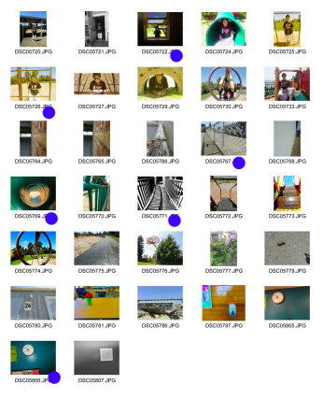
Review and Select
1. Contact sheet - make sure you select the best shots like the example below. You can create another colour category if you want to organise your images - for example - best, needs improving, and weak.
2. Analyse at least 2 photos from the shoot. You can analyse some of your best shots but its good to also analyse the images that you are not happy with so you know how to improve. Or analyse them as a group and not individually
Are you happy with the photoshoot? Please explain your answer
Why are you happy/not happy with this photo?
Did the shoot give you any ideas for another shoot?
What composition technique(s) have you used?
What camera settings did you use?
Why is it a good photo in relation to your theme?
Does the photo communicate a message? If so how?
Are you happy with the light? And what effect does it have?
What areas do you need to improve?
Contents page

Slide 13
EXAMPLE
Photo Analysis
Contents page

Slide 14
Editing
As part of this section you must use a computer photo-editing program, like ‘Photoshop’.
Photo Manipulation can be something as simple as taking out earrings, a person standing behind an object, removing telephone lines, removing a scar from a face etc.
More complicated manipulation might involve merging 2 photographs for example a good sky picture with a good foreground picture.
Possibly part of the photo is underexposed & the rest is fine, so brightening (and highlighting) just one part of the photo.
Creating a colour object in a black & white photograph makes a big impact.
Sometimes the photograph itself can be used to create a border. The list is endless & is simply an extension of what used to be done in the darkroom, but is now far easier & quicker on the computer.
Photo Manipulation
To manipulate your photo, the following skills are needed:
working with layers
Cloning
Colour balance
Selecting areas
Brush work
Cropping
Light corrections
Using filters
Sharpening or blurring an image or areas of an image
Contents page

Slide 15
Experimentation
Contents page
When you reach this stage of your project, you should already have experimented by responding to the photographers you researched. You may have mimicked there techniques, or used their shoot ideas etc…. But now you need to really focus on experimentation, and how you are using that experimentation to communicate an idea/message etc. For example, if your theme was ‘horror’ you may want to use tones, contrast and maybe even scratching on surfaces of images to create a mood. Martin Parr used colour to create a ‘snapshot happy holiday’ atmosphere.
Experimentation can be in many different forms.
Camera: use a slow or fast shutter speed, use out of focus, use shallow or wide depth of field
Composition: use composition techniques such as - fill the frame, framing, rule of thirds, viewpoint, depth, leading lines, breaking composition techniques
Scene: experiment with different locations, models, poses, props
Mixed media: combine photos with sketching, painting, fabrics, collage
Editing: use photoshop to improve images or transform them for further experimentation
Always consider your experimentation - how does it help to communicate something to the viewer.
You can look at any forms of experimentation! You don’t have to research more photographers if you don’t want to.
SEE EXAMPLE ON NEXT PAGES
PTO

Slide 16
Contents page
Reflection
Layering
Glass ball
Colour layers
Mixing materials
PTO
Abstract
Collage
Lighting

Slide 17
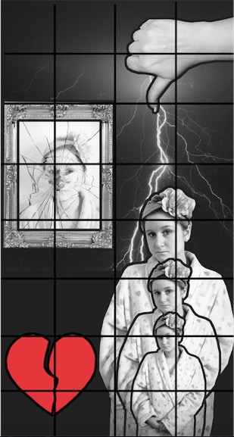
Contents page
Projector
Slow shutter speed
Photograph a photograph!
Multiple exposure
Double exposure
Fast shutter speed
Close up
Photomontage /scale
Frames

Slide 18
Project Review
A project review is essential for you to step back from your project and review everything you have done so far, and if you are happy you are making progress. You must choose a form of experimentation to develop – this is where you focus more on your outcomes now, and you should know what you want to do for your final outcomes. It might be you use your best form of experimentation and develop it, or you could combine lots of different experimentation together (for example, if you have experimented with light painting and photomontage, you may decide to combine them).
It doesn’t have to be lots of writing, 100 - 500 words. Answer these questions:
What has changed since you started your theme?
Do you think you are making progress?
What problems have you encountered so far? And are you putting things in place to overcome them?
Are your initial intentions still the same?
What form(s) of experimentation are you using for your final outcomes?
Can you explain your indented final outcomes?
What do you need to move forward? (resources, models, locations etc)
Contents page

Slide 19
Final Experimentation
Contents page
This stage is very important! You need to choose an area of experimentation (that you have already done) and expand on it…. Experimentation should be developed. You can combine forms of experimentation – this is actually encouraged…. Or you can just keep improving what you have already done. The assessors like to see development so you must show this. Anything you try must be kept for your sketchbooks (digital or not). It’s the journey that counts as well as the outcomes. If you aren’t ‘artistically’ experimental, and you’ve decided that all your experimentation is camera or composition techniques that's fine, but you still need to show development and progression. YOU MUST BE WORKING TOWARDS OUTCOMES!

Slide 20
Best images from each photoshoot
During the review and select process you select best images from the shoot. You can submit these as final images for the whole project but you must also submit FINAL OUTCOMES that you have worked towards. These final outcomes are not produced until the end stage of the project
Contents page

Slide 21
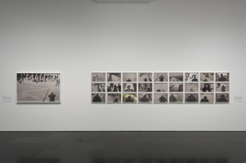
Final outcomes
These are all finals from different projects
Your final outcomes need to be viewed together - as a series they are powerful. It is better to show final outcomes (between 1 - 10 ) that you have worked towards, so for example, all your experimentation has led to these final outcomes, so it may be that these final images show evidence of all your experimentation. How you display your final work is very important. Display together as a group.
Contents page

Slide 22
Project Evaluation
It is very important to evaluate your work, not only to achieve good marks under AO4 but also to help you to build a greater insight into and understanding of your work and your motives behind it.
How evaluate your work – consider these questions:
​•How have you developed your ideas?
•How has your work changed through the techniques you experimented with?
•How has your opinion changed?
•What have you learnt about expression through photography?
•Do you think you should have done more or less?
•What artists, art movements or cultures have you looked at to help and inspire you?
•What materials, tools and techniques did these artists use?
•How have your skills developed during the project?
•Are there any aspects of your studies that you wish you had explored further?
•How have you used formal elements such as line, tone, colour and shape?
•What materials did you use, and why? Did they work successfully?
•What meaning and messages did you want to convey and were you successful?
•Are you happy with your final piece(s)? Are there any elements you like in particular?
•Is there anything you would change? Why?
Contents page

Slide 23
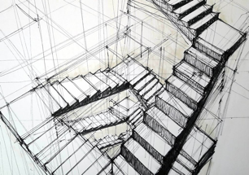
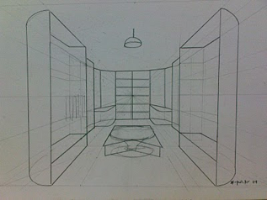
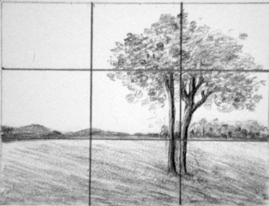
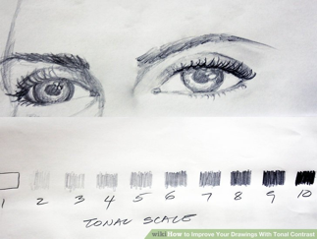
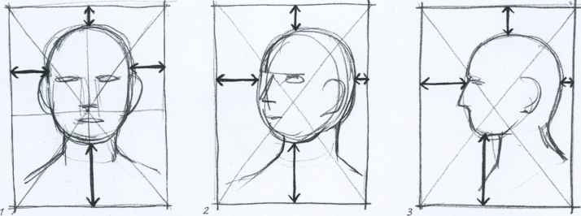
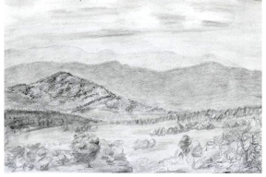
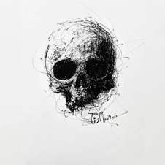
Sketching Guidance
Contents page
You will need to provide evidence of drawing for each photoshoot. You can do this in many different ways, but the easiest is to focus on the below.
For the photos you have chosen to analyse you can roughly sketch them (you can use tracing paper to do this).
Composition - draw over your sketch showing the composition technique you have used.
Areas of contrast - shade in areas of your sketch showing areas of varying light and contrast
Doodle! We love to see your doodles, so don’t worry about getting it perfect. It is great to draw your ideas out. For example, one of my students covered 3 or 4 pages with wildlife sketches – it was fantastic and gave them an idea of how to move forward in terms of focusing on details. This should be the fun part for you! You can literally just sketch anything that relates to your theme. Even if its just doodling….it's not supposed to be neat. Produce an A3 page full of sketching doodles and ideas related to your theme. Or you can draw digitally.

Slide 24
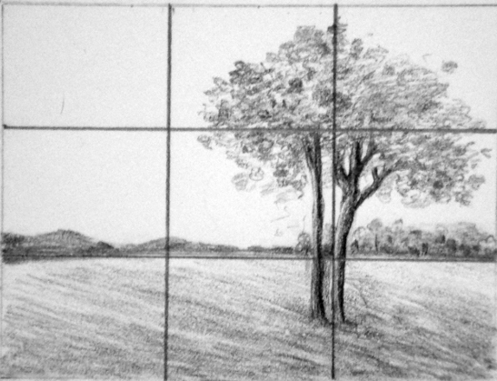
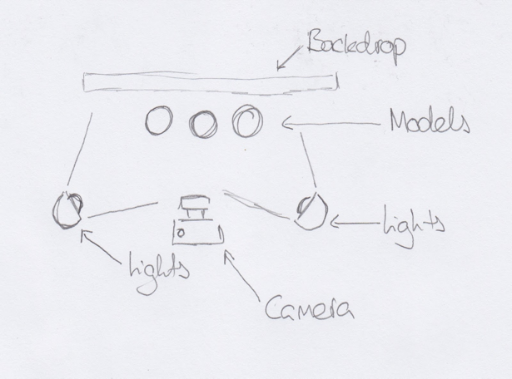
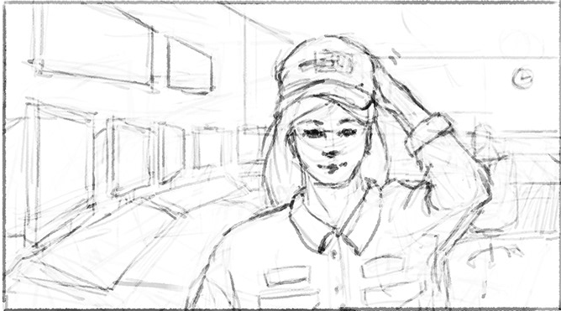
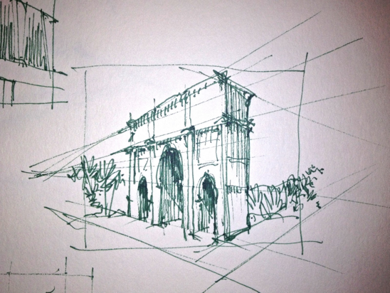
Drawing a Photoshoot plan
Intended composition
Diagram of scene
Frame contents
Contents page

Slide 25
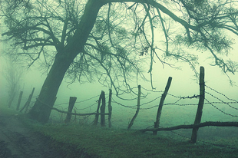
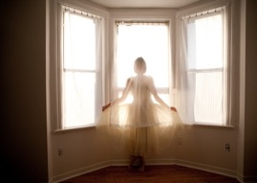
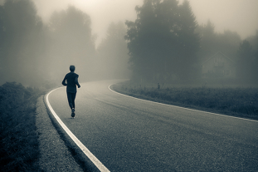
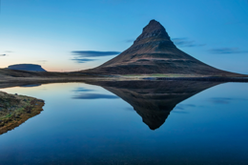
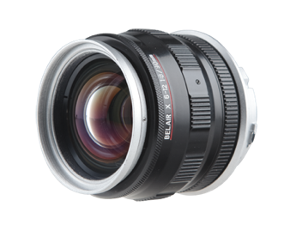
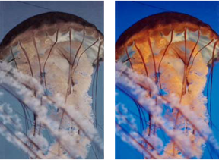
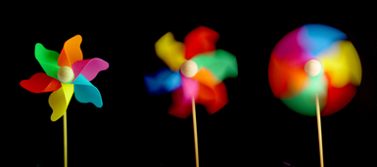
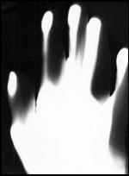
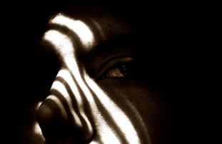
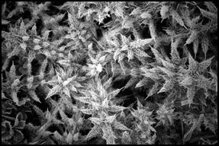
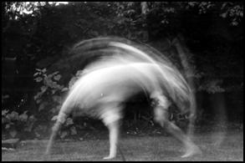
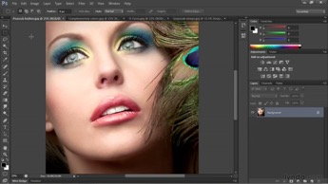
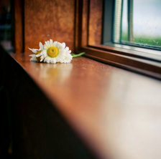
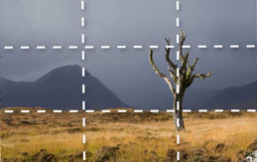
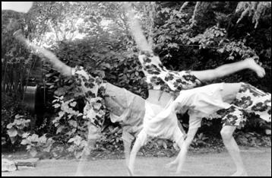
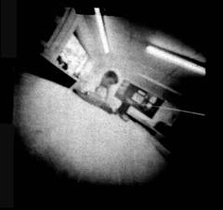
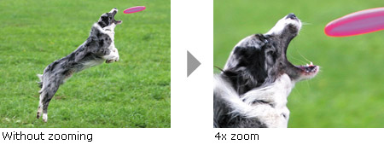
Photographic terminology
Bokeh
Contents page
Narrative
Landscape, seascape, city scape
Mood
Colour saturation
Lens
Atmosphere
Shutter speed
Slow Shutter
Photoshop
Macro(close up)
Photogram
Photomontage
Lighting
Rule of thirds
Multi Exposure
Pin Hole
Focal Point
Zoom

Slide 26
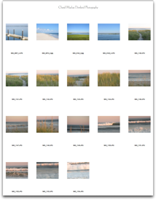
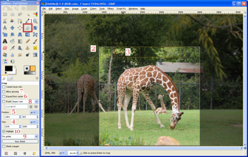
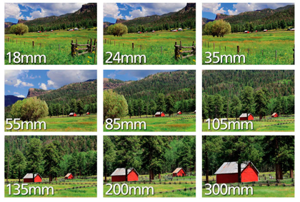
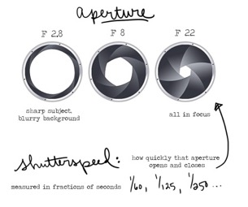
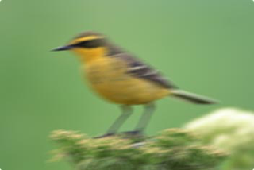
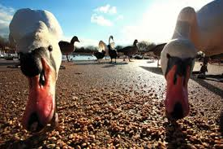
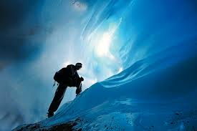
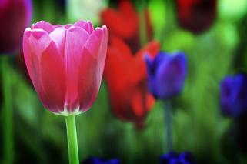
Aperture
Contact sheet
Crop
Focal length
Camera shake
Wide Depth of field
Shallow Depth of field
Over – exposure
ISO
Composition
Manual focus
Viewpoint
Exposure
Flash
Black and white
Contents page
White balance

Slide 27
Formal elements of visual language:
line, form, colour, tone, pattern, texture,
Line
Form
Colour
Tone
Pattern
Texture
Contents page

Slide 28
APERTURE & DEPTH OF FIELD
SHUTTER SPEED
CAMERA
ISO
Contents page

Slide 29
The camera
Contents page

Slide 30
Composition techniques
Symmetry and patterns
Rule of thirds
Balancing the elements
Composition is very important across any creative subject and you must make sure you know them and are using them consistently. It means the arrangement of elements in the photo (basically it means where everything is!). Remember, you can control this…. You can either, change the position of the objects or person/people you are photographing, or you change the position of your self. So if you are photographing a landscape, you cant move it… so you move.
Depth
Leading lines
Framing
View point
Background
Cropping
Contents page

Slide 31
Decorating your sketchbook (Inc. digital)
Your sketchbook, whether a book or PowerPoint MUST be decorated. It is best to do this in relation to your theme. Don’t decorate it using neon colours and backgrounds if it has no relevance. It should be linked to show you are developing your theme. Digital sketchbooks (PowerPoint) should not be used as a PowerPoint, you must think of it as a sketchbook and present your work as if it was a book. This means fitting more on a slide AND MAKING LESS LIKE A POWERPOINT PRESENTATION
Contents page

Slide 32
These are good example of how a sketchbook should look. You can see paining, sketching, and other materials have been used. Even when you paint or change the colour of the background this makes a huge difference! You can try using textures, or paint or even cut up magazines or newspapers and create a collage background.
Contents page

Slide 33
Different lens range
https://www.dpmag.com/how-to/tip-of-the-week/types-of-lenses/
Contents page

Slide 34
Assessment objectives
Contents page
AO1: Develop ideas through investigations, demonstrating critical understanding of sources.
AO2: Refine work by exploring ideas, selecting and experimenting with appropriate media,
materials, techniques and processes.
AO3: Record ideas, observations and insights relevant to intentions as work progresses.
AO4: Present a personal and meaningful response that realises intentions and demonstrates
understanding of visual language.

Slide 35
Camera settings for analysis
Include the camera settings you used. You don’t need to do this for every photo! Just show the settings for your best and worst images, OR give an idea of the settings you used for the whole shoot. For example, if the light was very low you would state that you used a higher ISO, slower shutter speed or a lower aperture f stop number. To make your life even easier you can even cheat! You can find out what the camera settings were even after you took the photo.
FOR A PC | FOR A MAC | PHOTOSHOP
In Microsoft Windows: right click on a file, choose Properties, and then look in the Details tab. | In Mac OS X, right click — or command-i — and then click the triangle by More Info to expand. Or On macOS, by opening up a photo in Preview. Once open, click on “Tools” up in the menu bar at the top. Click on the “Exif” tab if it's not already selected. You'll then see a slew of advanced information about the photo, including the various camera settings that were used | To do this go under FILE – FILE INFO. Once you click on it, click on Camera Data 1. Once you have selected the camera data, you can see the camera used, the date and time taken 4/15 – and the settings.
Contents page

Slide 36
Useful links
Contents page
https://theinspiringphotographers.wordpress.com/
https://www.studentartguide.com/articles/creative-photography-ideas
https://www.aqa.org.uk/subjects/art-and-design/gcse/art-and-design-8201-8206/subject-content/photography
https://www.aqa.org.uk/subjects/art-and-design/gcse/art-and-design-8201-8206/scheme-of-assessment
https://www.bbc.co.uk/bitesize/guides/zgwpnbk/revision/2
http://masters-of-photography.com/

