Slide 1
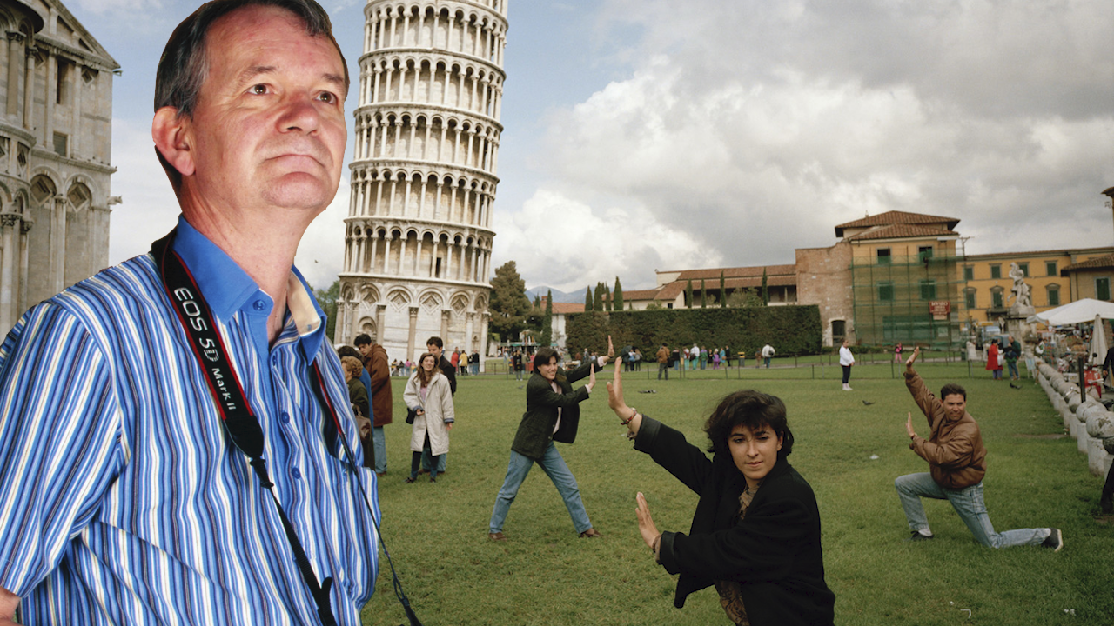
Martin Parr

Slide 2
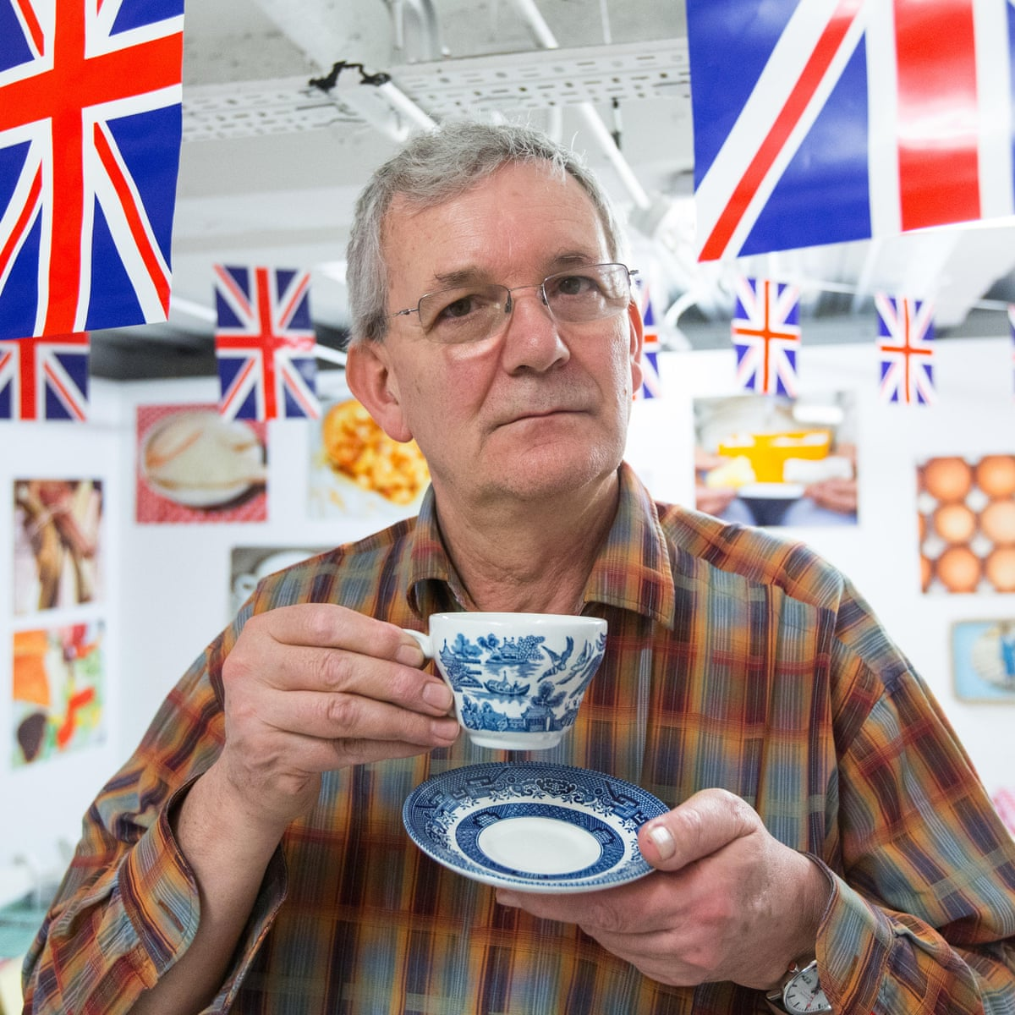
Martin Parr
Martin Parr was born on 23 May 1952 in Epsom, Surrey, UK. Parr studied photography at Manchester Polytechnic, from 1970 to 1973. He is known for his photographic projects that take an intimate, satirical and anthropological look at aspects of modern life, in particular documenting the social classes of England, and more broadly the wealth of the Western world.

Slide 3
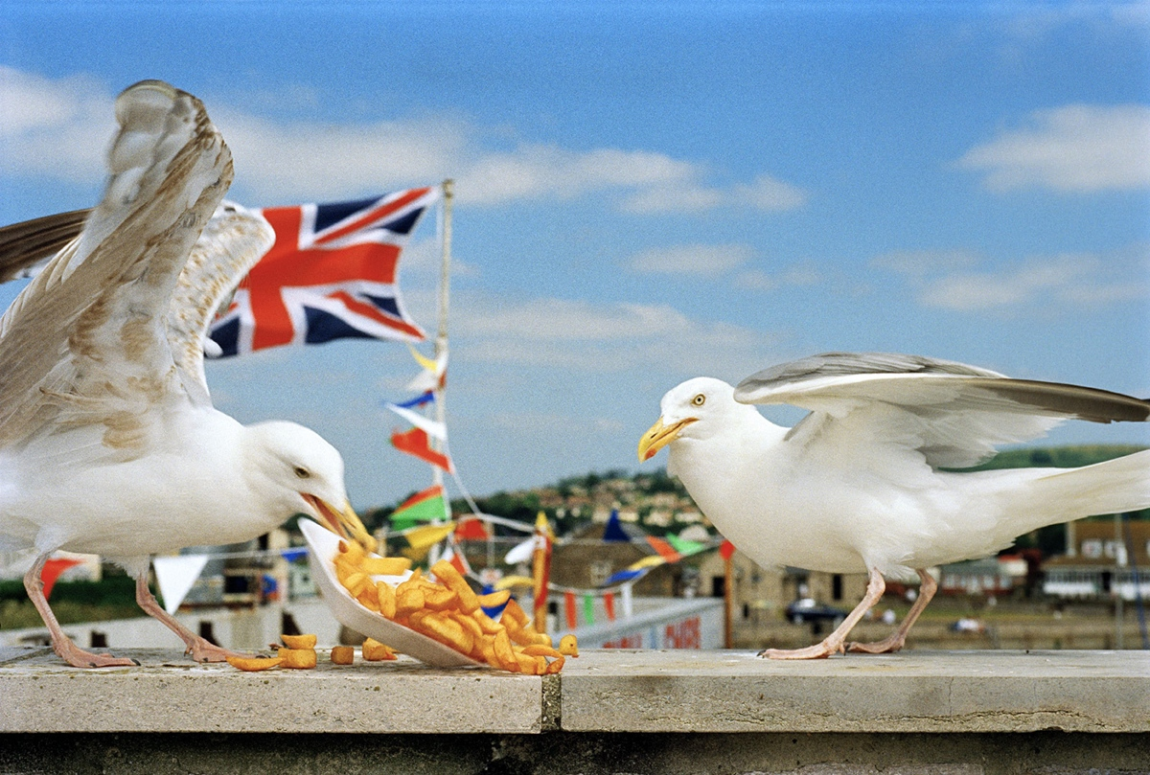
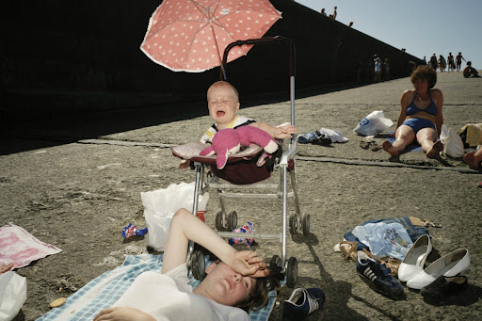
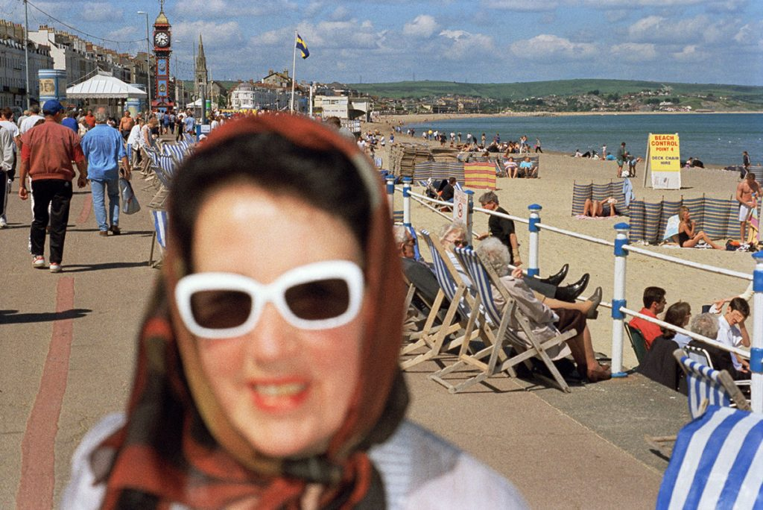
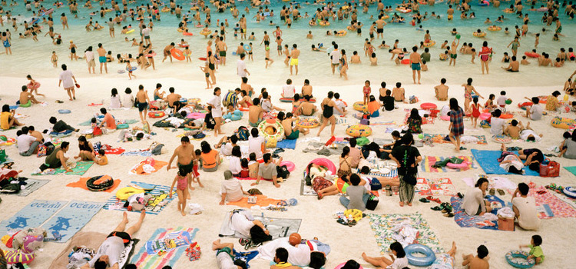
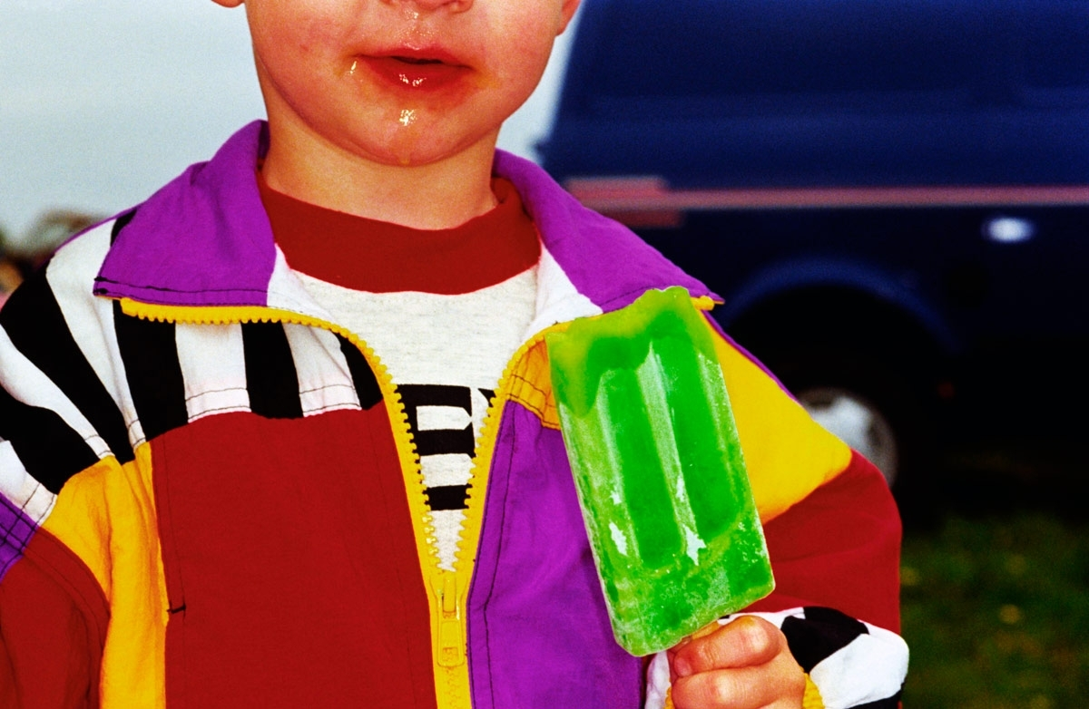
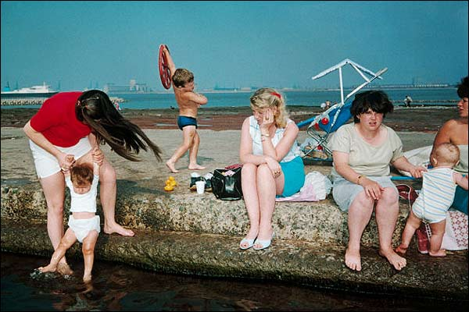
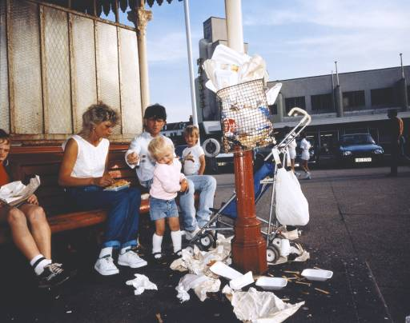
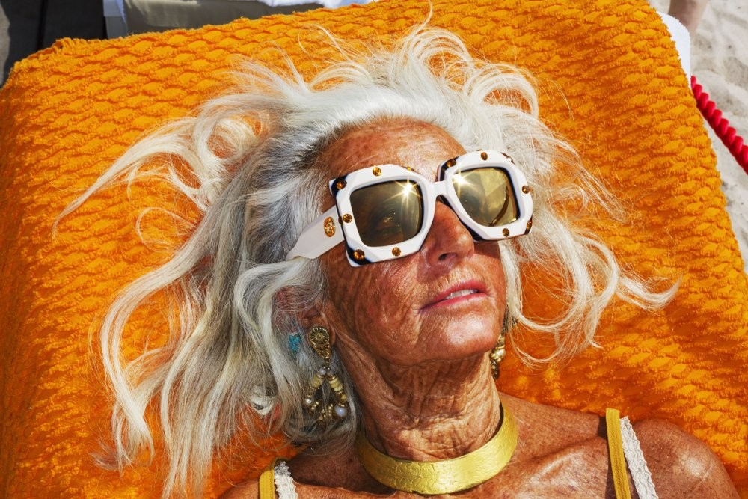
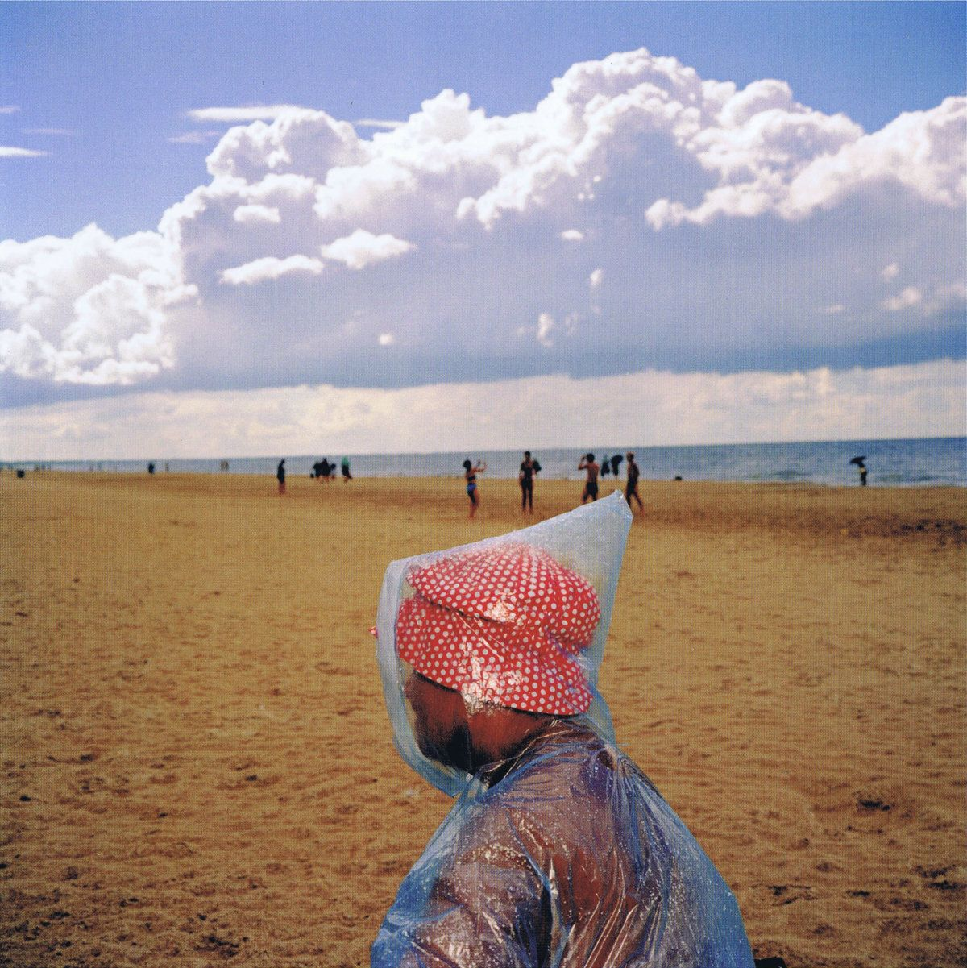

Slide 4
Two seagulls are fighting over chips, and you can see the union jack in the background. The location is a seaside setting with a sunny clear blue sky.
The composition isn’t exactly neat, and this is intentional. Parr isn’t trying to create a photograph that is ‘nice’ or ‘ordered’ to look at, rather he wants to make the viewer feel uneasy . This enhances his message and manipulates the viewer to feel a certain way. The background is blurry but not so much you cant see what's going on, but the focal point is the seagulls.
The colours are very bright and vibrant which is common in Parr's work. Using vibrant colours makes the viewer feel good and ‘jolly’ and draws us into that beach side atmosphere. This good mood is in direct opposition to the image of the gulls. Seagulls are not perceived well by the British public. They are commonly thought as pests and even persecuted. The majority of viewers would be able to connect with this photograph and even share a similar experience with a seagull – not usually positive. The fact that bright colours are present in a ‘negative’ and very ‘real’ situation creates a strange juxtaposition.
Parr may have used a flash to illuminate any shadow caused by the harsh sun.
Parr is showing a situation that is very familiar to the British public. The flag in the background is stating that the seagulls are very much part of our culture or way of living. The problems we have living alongside gulls have not been resolved, and we just continue to conflict with these animals despite the issues. The reality is, the gulls are wild animals and are trying to survive – they don’t know right from wrong. We do. So this could suggest our laziness or ignorance.

Slide 5
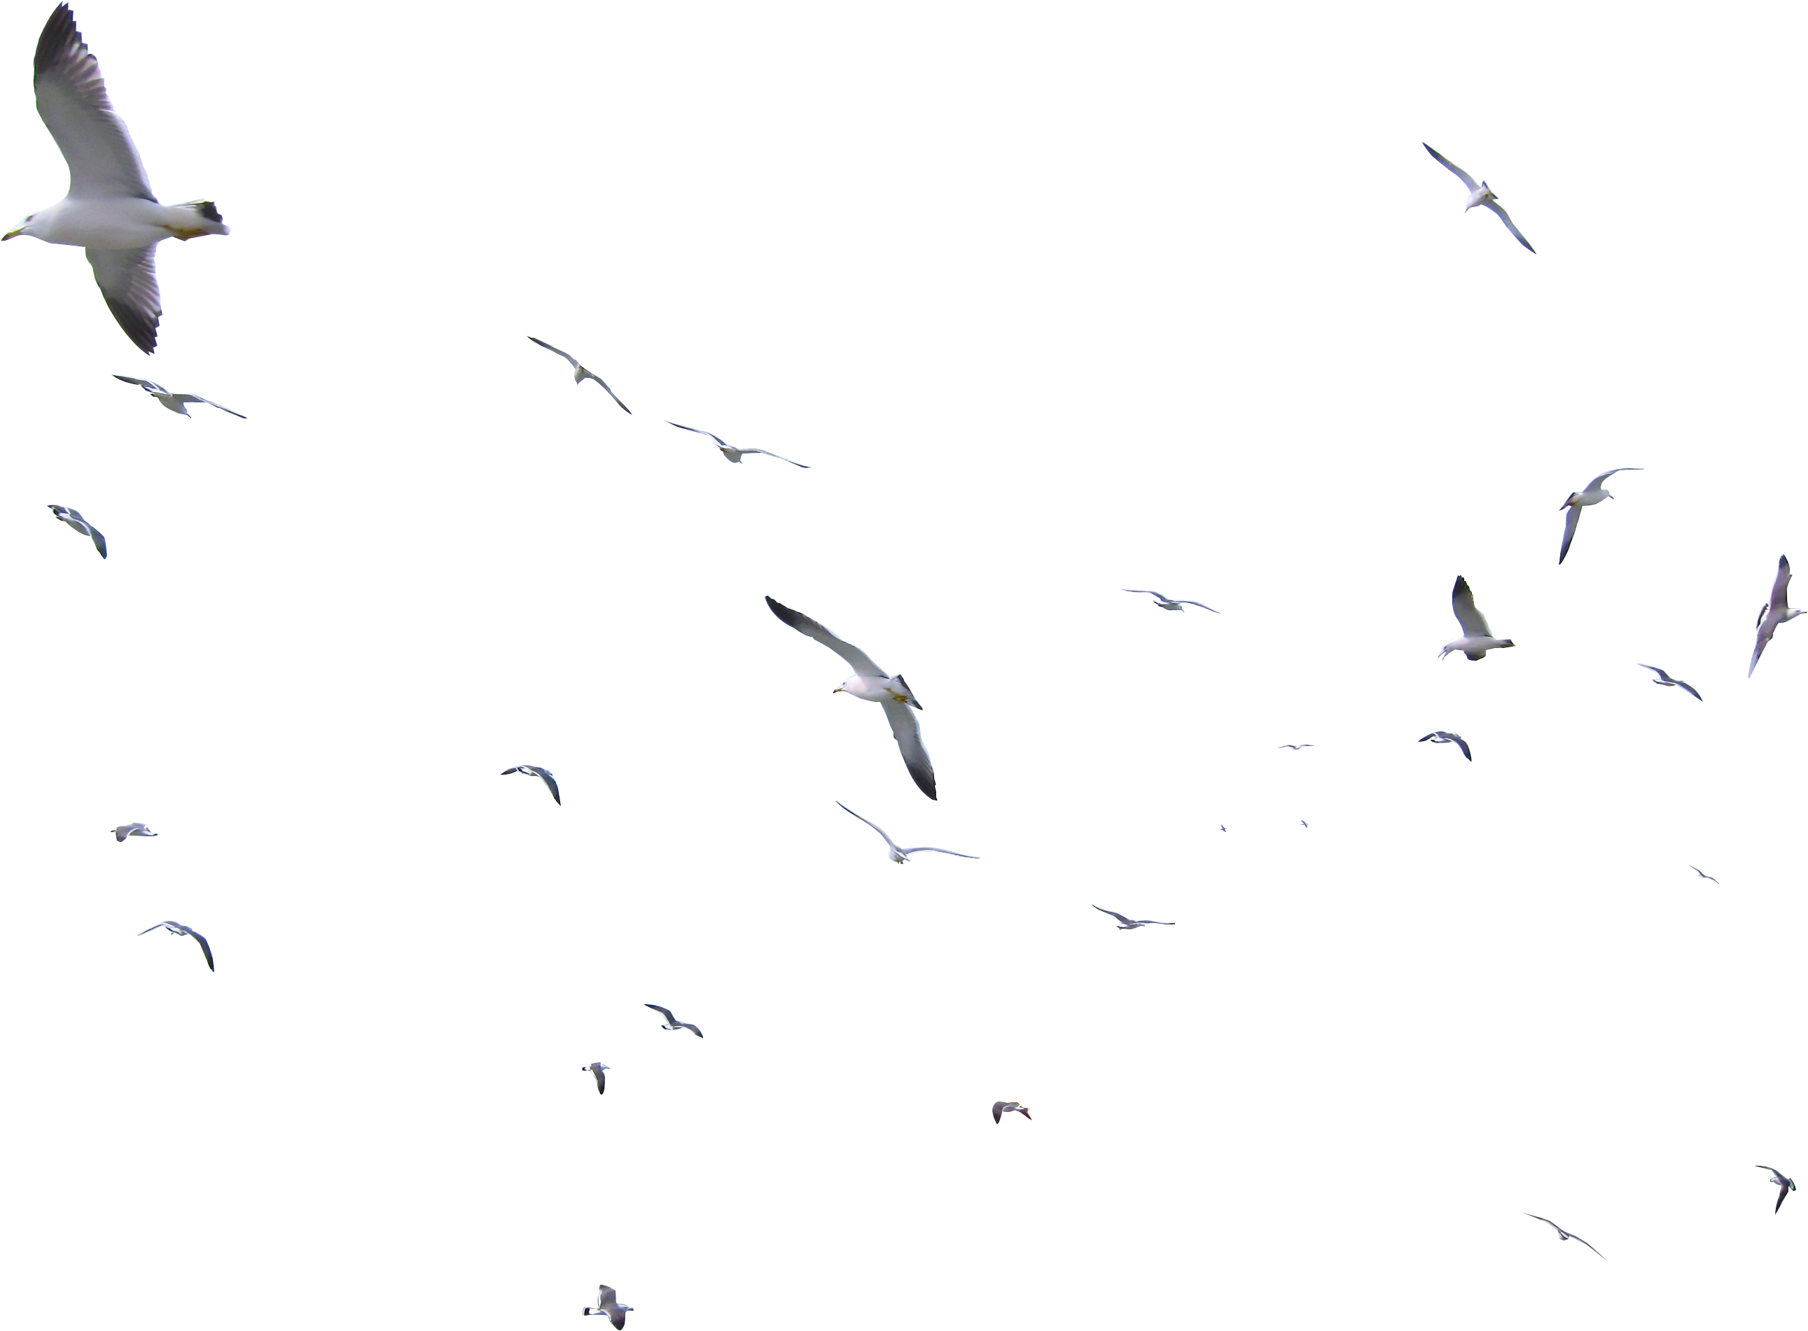
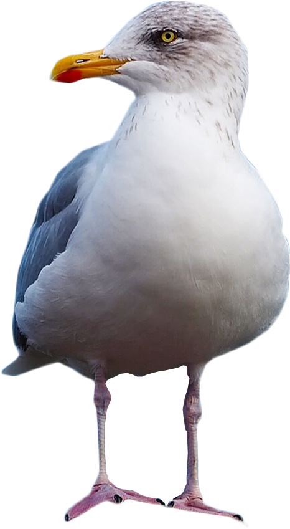
My Photoshoot idea in response to Martin Parr
I can photograph seagulls as I live at a seaside town where seagulls are present. I will visit Paignton seafront during the day and hopefully it will be sunny.
Parr’s seagull image isn’t about protecting the gulls, or even communicating something ‘good’ or ‘positive about them but it gets the message across. I like the idea of juxtaposition and using colour and a ‘negative’ situation/ scene.
My message would be that “seagulls are not the problem – we are”
I will use colour and a negative situation/scene combined as well as odd compositions. I will try to make the image as vivid and real as possible ensuring there is lots of colour present. I may also use photomontage to include the union jack

