Slide 1
Martin Parr
British
photojournalist

Slide 2
Learning objectives
AIM: Introduce learners to Martin Parr
and explore his ideas
Analyse 1 Martin Parr photo
Discuss how messages are conveyed via photos
Identify 3 photographic techniques used to convey messages/meaning
Explain how you will respond to Martin Parr

Slide 3
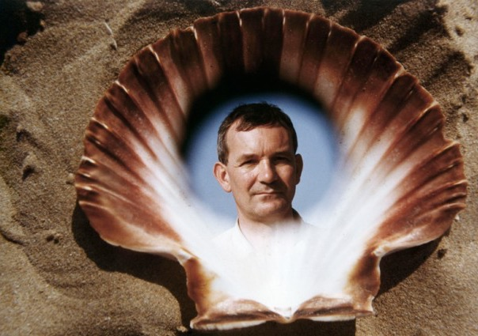

Slide 4
Analysis guidance
What can you see – explain what you see / what's going on
Composition: leading lines, rule of thirds, framing, viewpoint, fill the frame, symmetry
Colours – are they bright? Dull? You could look at colour symbolism (red = passion, anger etc)
Depth of field: shallow (blurry background), wide (all of the photo is in focus)
Contrast- are there dark and light areas and how intense?
Lighting: above, front, back, shadow, natural light, time of day, overcast, sunny etc
Artificial light, flash, neon light, florescent, candle, flame, filament bulb etc
Texture, maybe a contrast of textures.
The focal point of the photo is...... (where do your eyes go to first)
The mood – is the photo happy, sad, angry, confusing, mysterious, dark – how has the photographer achieved this mood?
What do you think the photographer is communicating? For example, are they telling a story? Or are they trying to make you the viewer feel a certain way?

Slide 8
Why is Martin Parr an important photographer?
He represented a massive change in documentary photography by enhancing the technical change from monochrome to colour for photographic expression.
Known for his study of humans past and present particularly focusing on social classes of England
Work was hugely controversial due to his negative view on society at that time.
He is known to take a satirical (mocking) view

Slide 9
Parr’s images are a reflection of his view of what was happening at that time. His message is quite clear in these images: society was falling apart (this was the time of Thatcherism 1979 -90)
‘I’m less interested in the fact that these people aren’t well off financially as in the fact that they have to deal with screaming kids, like anyone has to ... I’m also interested in making the photographs work on another level, showing how British society is decaying; how this once great society is falling apart’

Slide 10
Video
https://www.youtube.com/watch?v=9frLRE49i_A

Slide 18
His philosophy
He was exploring the difference between the mythology of a place and the reality of it.
He made serious photos disguised as entertainment
He was against Thatcher
He was mocking society

Slide 19
What does he photograph?
Screaming kids
Lifeless parents
Bad food
Junk food
Rubbish
Untidy environment
Greed

Slide 20
What photographic techniques did Parr use to convey a message?
Using bright colours to increase vibrancy
Increasing the saturation to get viewers attention
Using a flash to illuminate his subjects
Composition
Negative content with bright colour and snapshot atmosphere
Odd compositions
Very vivid detail
Showing reality (as opposed to traditional photography showing the best of everything)
Mocking – satire

Slide 23
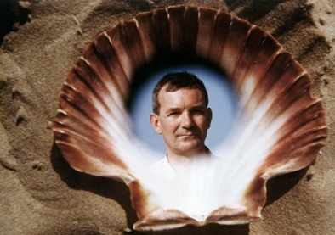
Research Task
Photo of him
Mini bio (very brief)
5 MP photos – analyse them: see example

Slide 24
Plan/intention
How could you use Martin Parrs techniques in relation to your own theme?
Where would you go?
Would you need any props?
What would your message be?
How are you going to convey that message?
What photographic techniques will you use to further communicate the message?

Slide 25
Analysis guidance
What can you see – explain what you see / what's going on
Composition: leading lines, rule of thirds, framing, viewpoint, fill the frame, symmetry
Colours – are they bright? Dull? You could look at colour symbolism (red = passion, anger etc)
Depth of field: shallow (blurry background), wide (all of the photo is in focus)
Contrast- are there dark and light areas and how intense?
Lighting: above, front, back, shadow, natural light, time of day, overcast, sunny etc
Artificial light, flash, neon light, florescent, candle, flame, filament bulb etc
Texture, maybe a contrast of textures.
The focal point of the photo is...... (where do your eyes go to first)
The mood – is the photo happy, sad, angry, confusing, mysterious, dark – how has the photographer achieved this mood?
What do you think the photographer is communicating? For example, are they telling a story? Or are they trying to make you the viewer feel a certain way?

