Slide 2
Photoshoot
Contents page
You must take at least 30 photos for a shoot. Its very important you have a wide variety of photos to choose from as well as exercising your skills. You may have a few images floating around that are not necessarily part of a shoot but if you are planning a shoot and out for a shoot you should aim for a minimum of 30 – this makes a decent contact sheet.
Composition: you should always consider / apply composition techniques – you must be able to identify techniques and why/how they are being used. We will expect you to discuss your composition intentions in your analysis as well as see evidence of application in your photography.
Camera: Its very challenging to use a camera manually, so please don’t be disheartened if you give it a go and don’t get the results you want. YOU MUST use the camera consistently and experiment to familiarise yourself with the settings, as well as putting yourself in different light situations. You won’t learn how to use the camera manually unless you practice! However, even if you re unsure of the settings you should always try… even if you are using the priority modes so you can get an idea of each setting. We will also expect you to discuss exposure in your analysis so the quicker you can get your head around the settings the better!

Slide 3
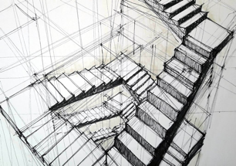
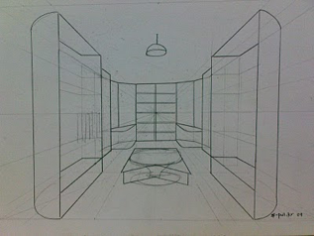
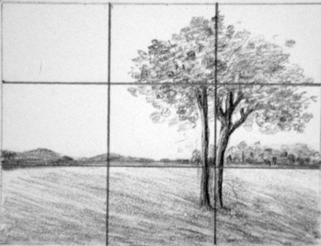
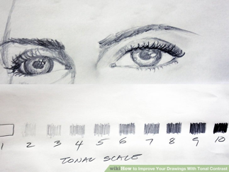
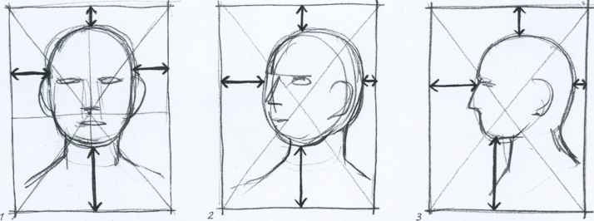
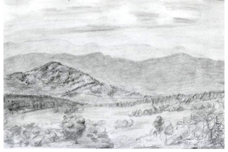
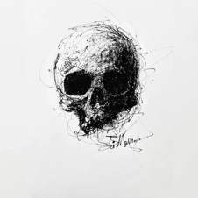
Sketching Guidance
Contents page
You will need to provide evidence of drawing for each photoshoot. You can do this in many different ways, but the easiest is to focus on the below.
For the photos you have chosen to analyse you can roughly sketch them (you can use tracing paper to do this).
Composition - draw over your sketch showing the composition technique you have used.
Areas of contrast - shade in areas of your sketch showing areas of varying light and contrast
Doodle! We love to see your doodles, so don’t worry about getting it perfect. It is great to draw your ideas out. For example, one of my students covered 3 or 4 pages with wildlife sketches – it was fantastic and gave them an idea of how to move forward in terms of focusing on details. This should be the fun part for you! You can literally just sketch anything that relates to your theme. Even if its just doodling….it's not supposed to be neat. Produce an A3 page full of sketching doodles and ideas related to your theme. Or you can draw digitally.

Slide 4
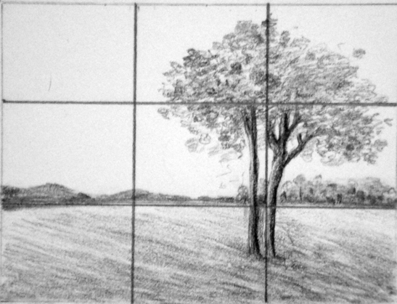
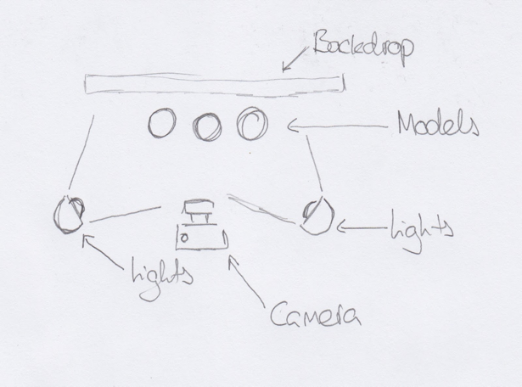
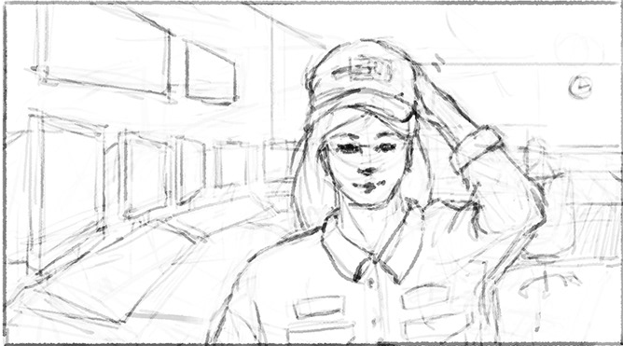
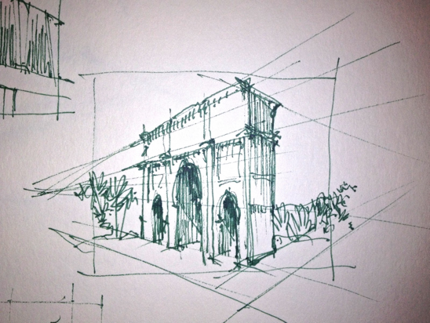
Drawing a Photoshoot plan
Intended composition
Diagram of scene
Frame contents
Contents page

Slide 5
Task – Plan a shoot
What will you photograph?
What techniques will you use?
Who has inspired you?
What will you need?
Sketch the scene (frame contents)
Sketch the composition

