Slide 1
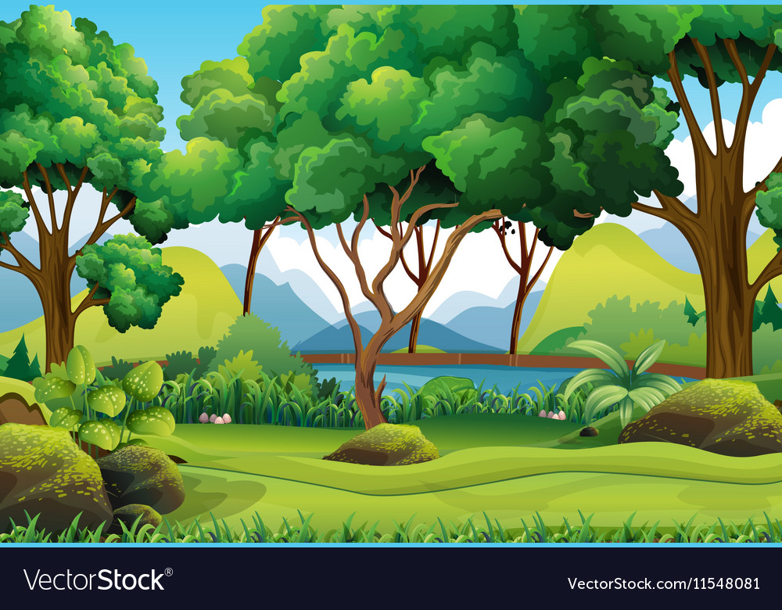
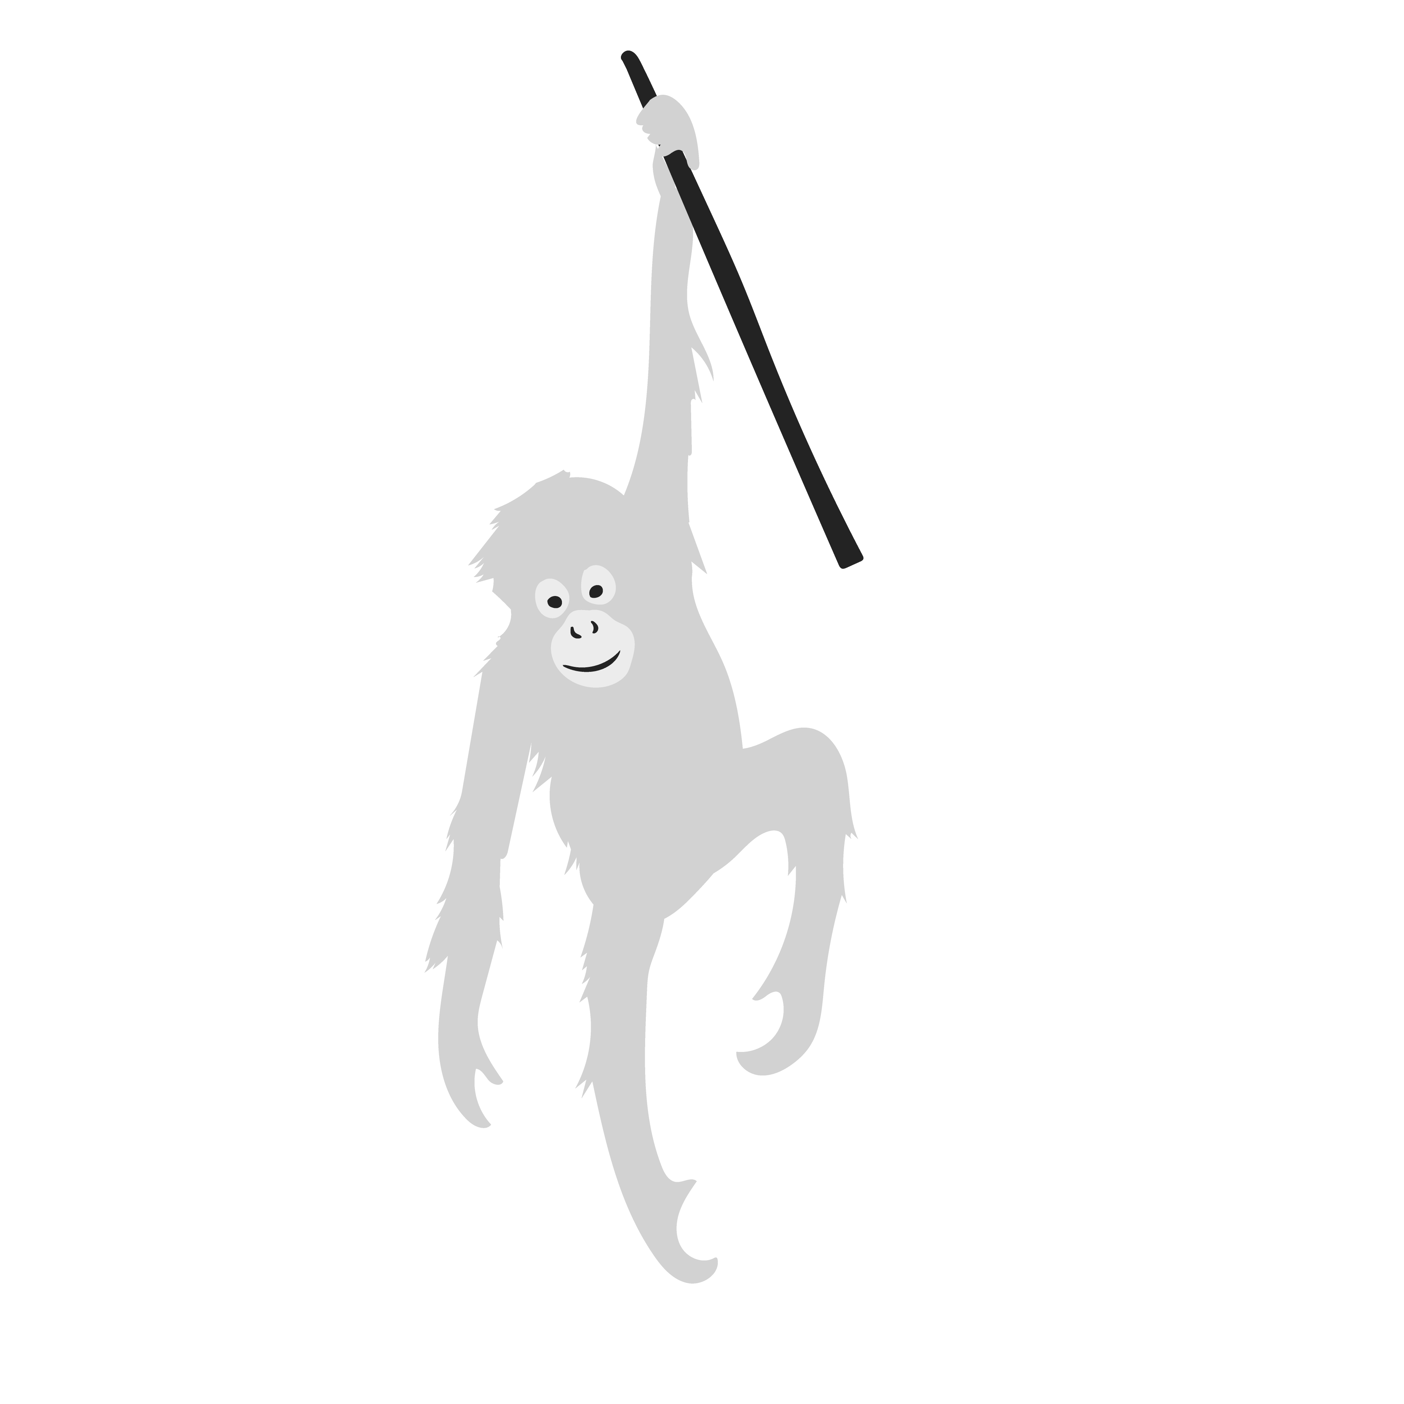
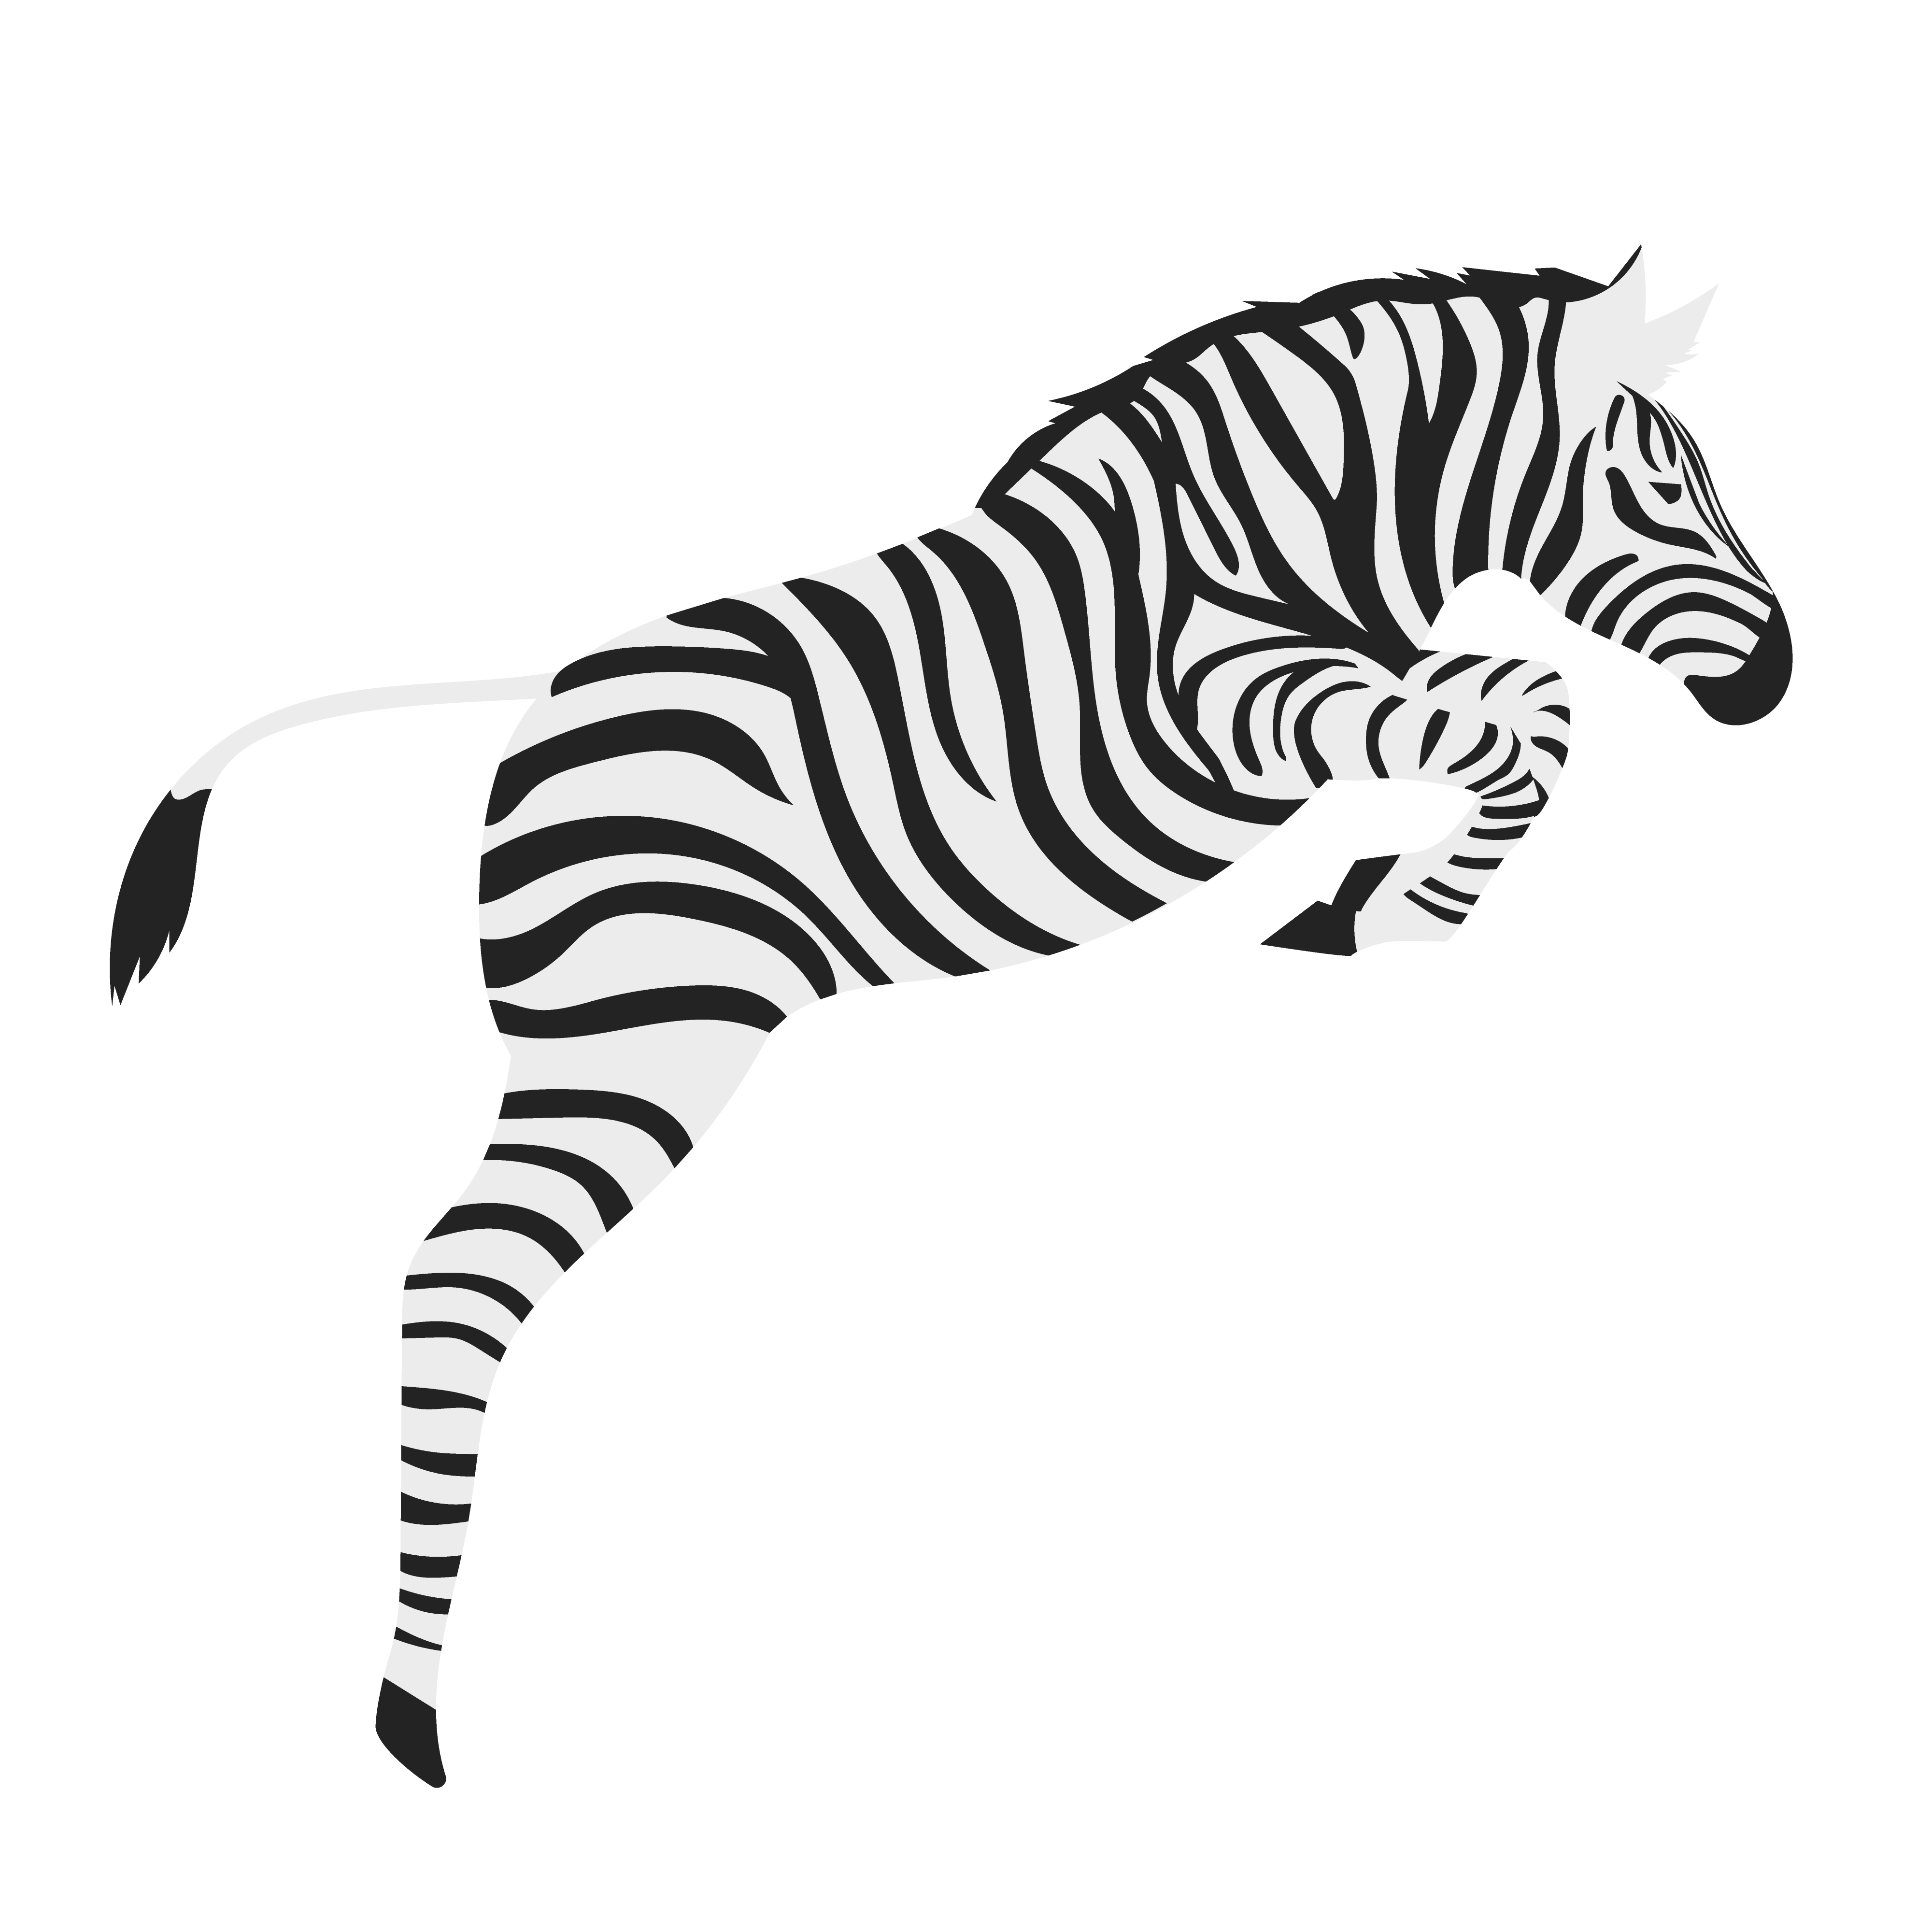
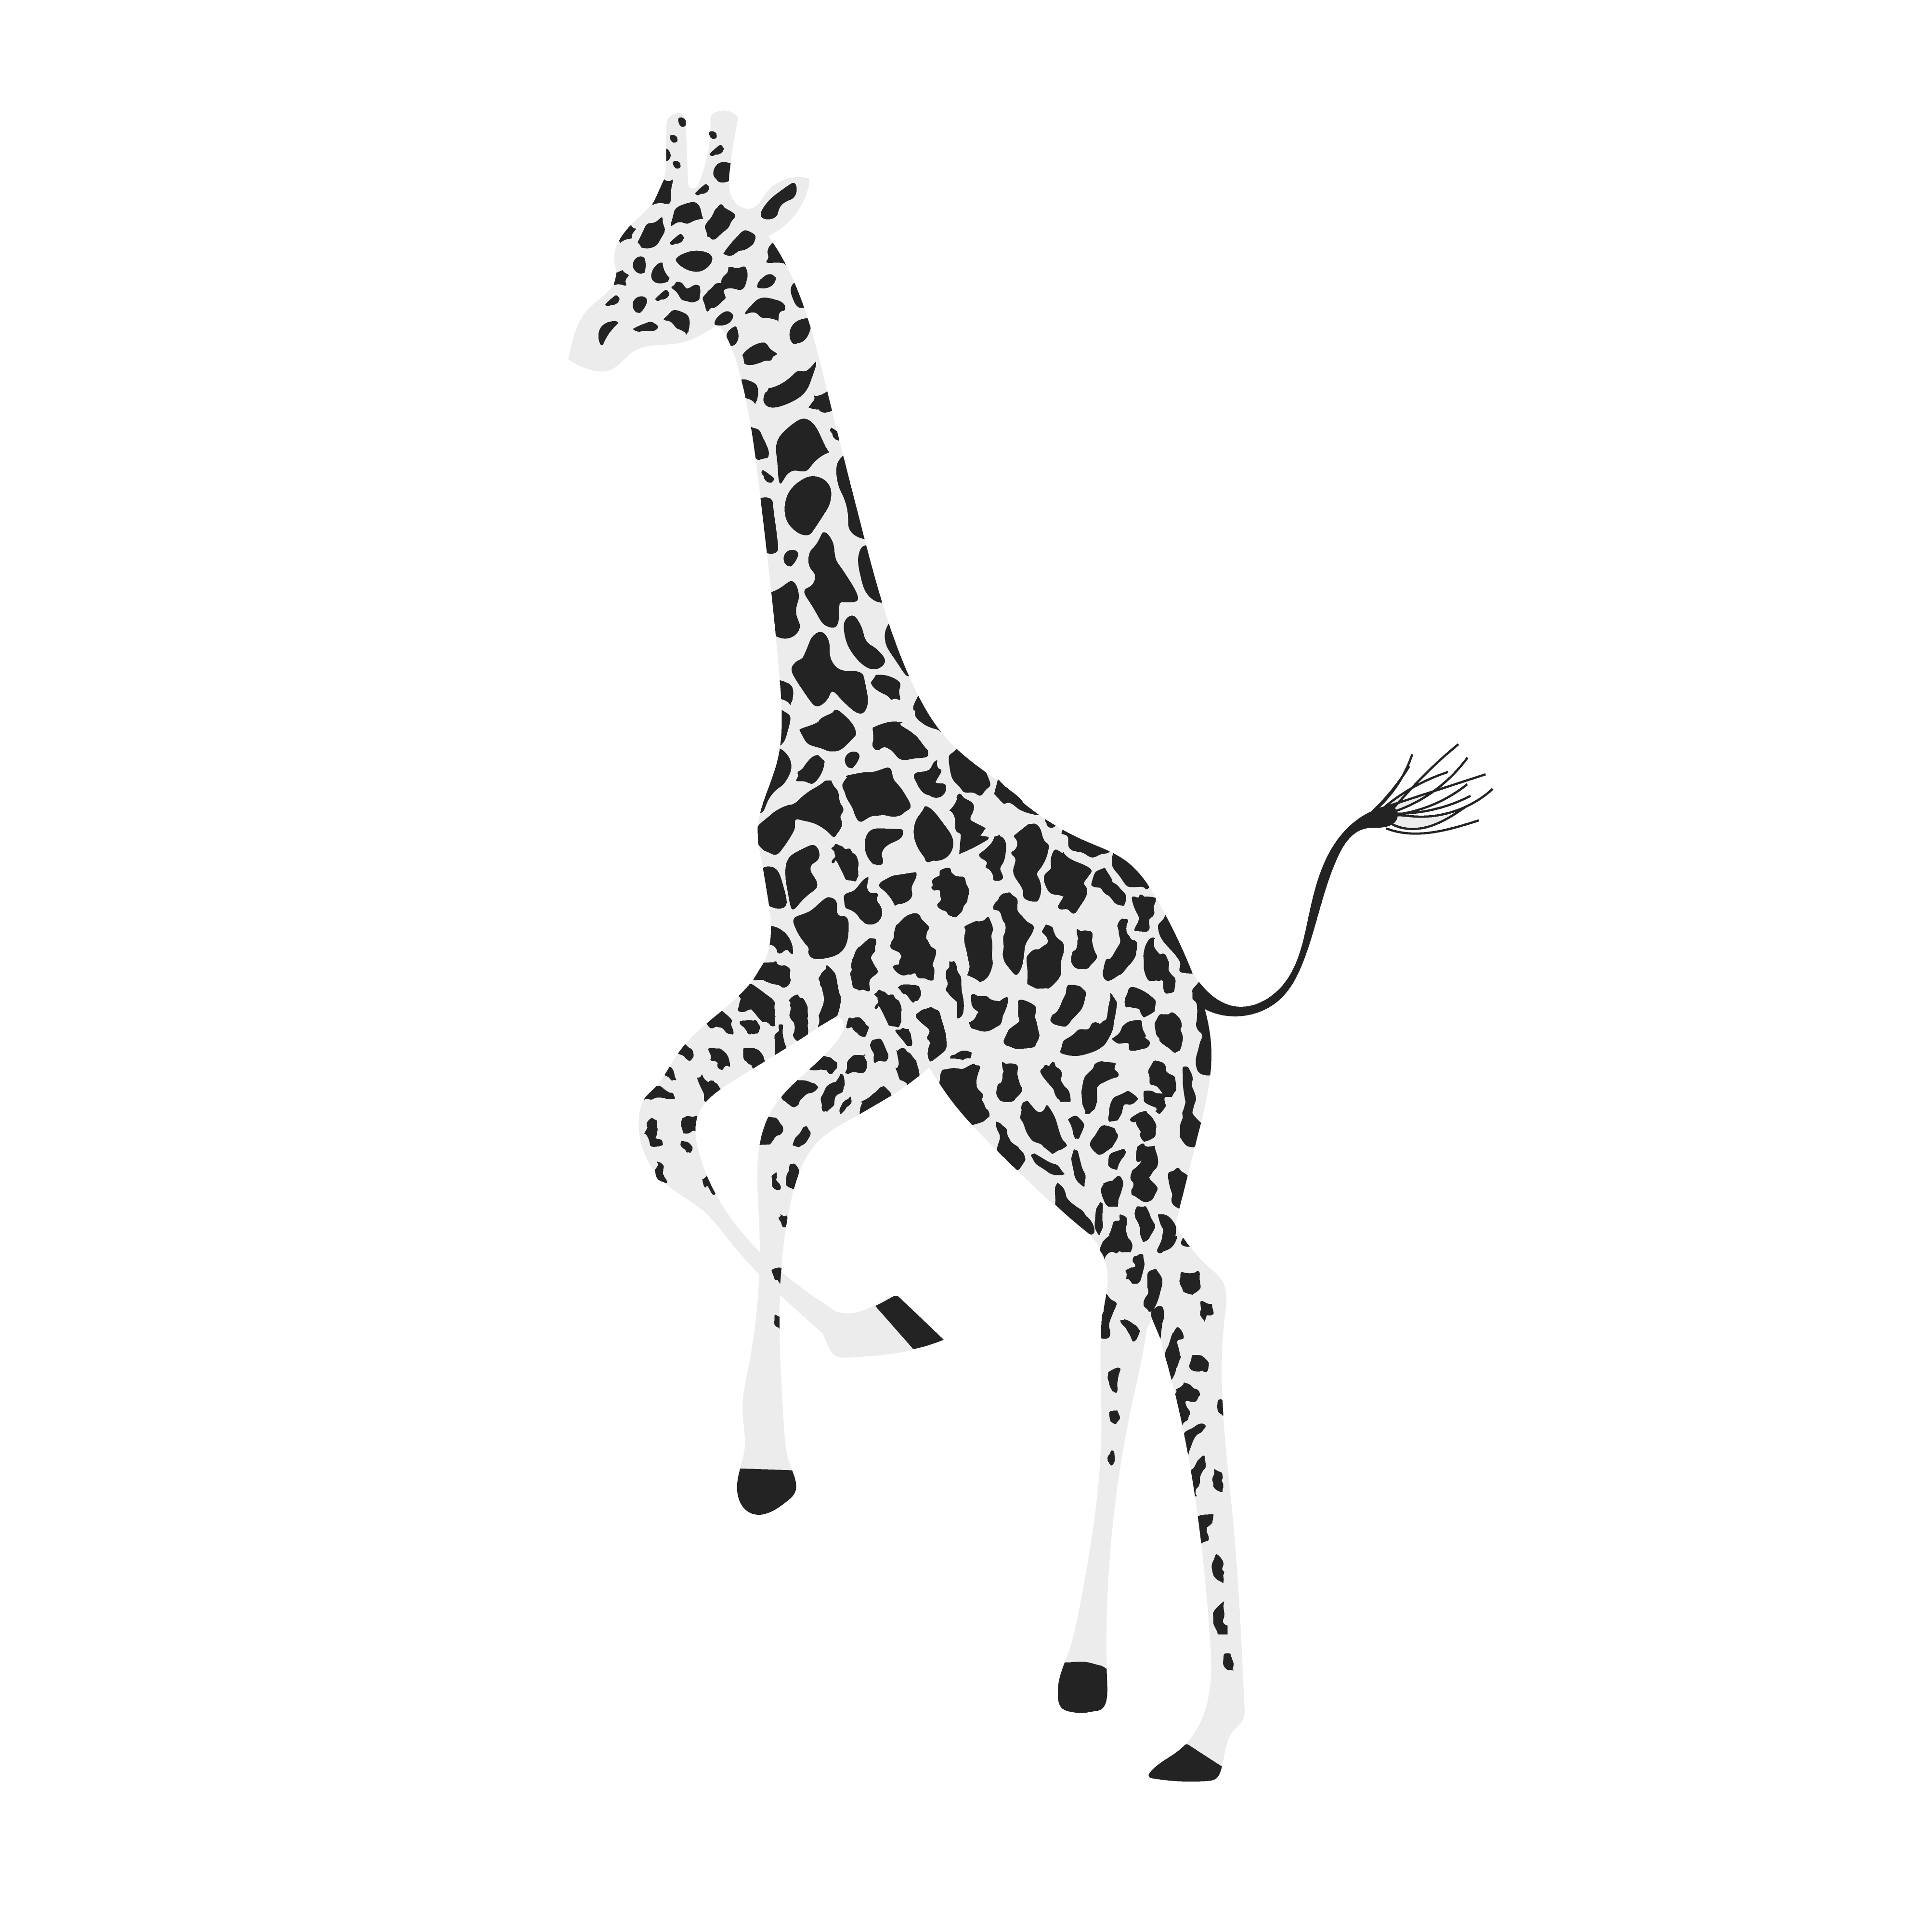
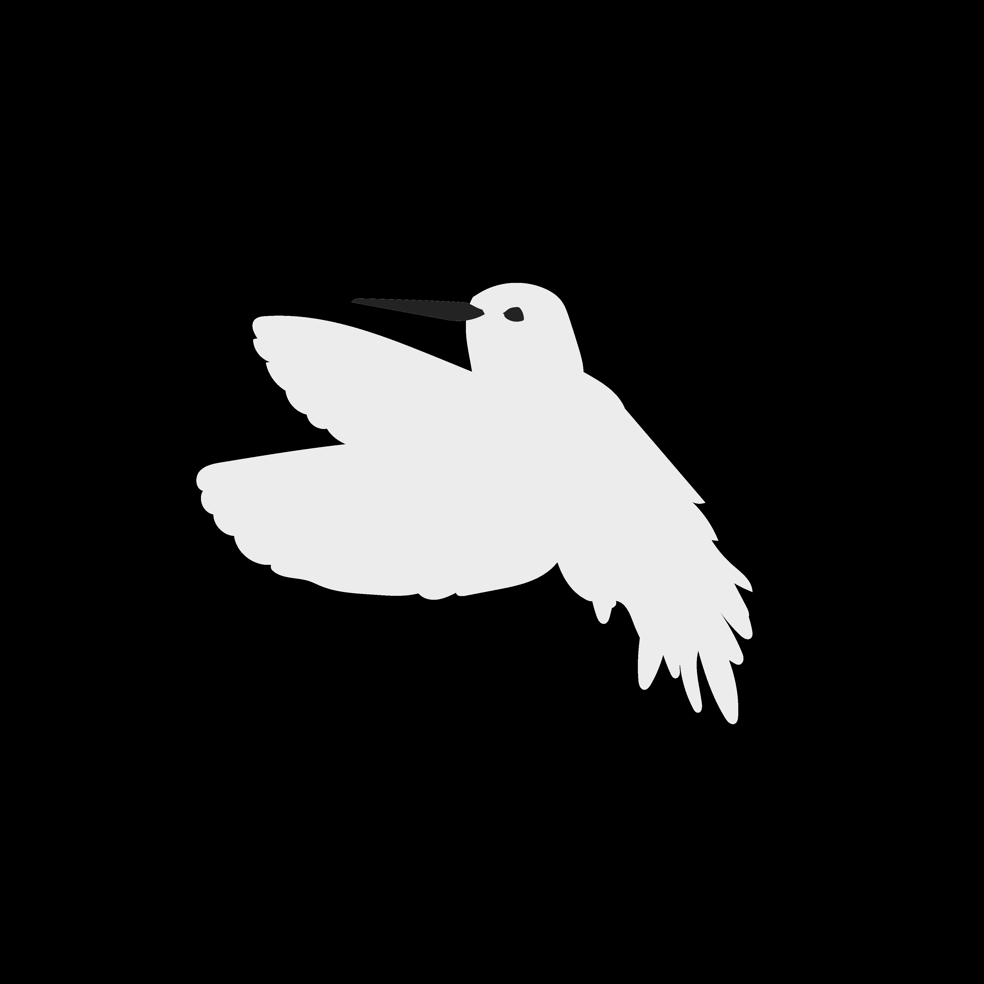
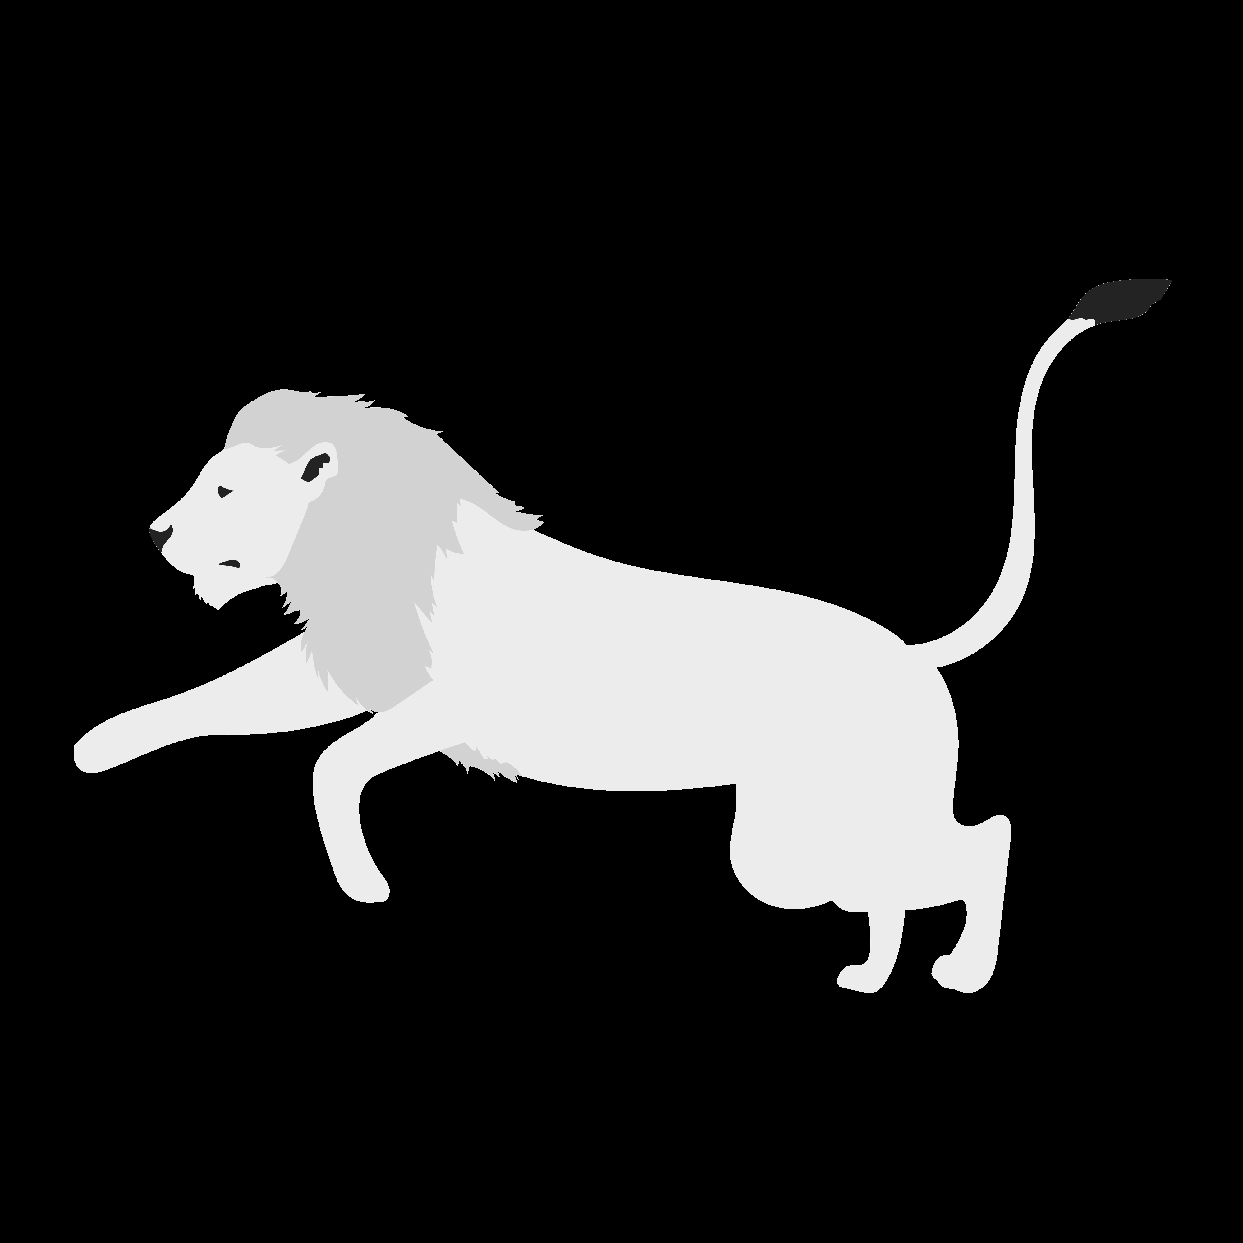
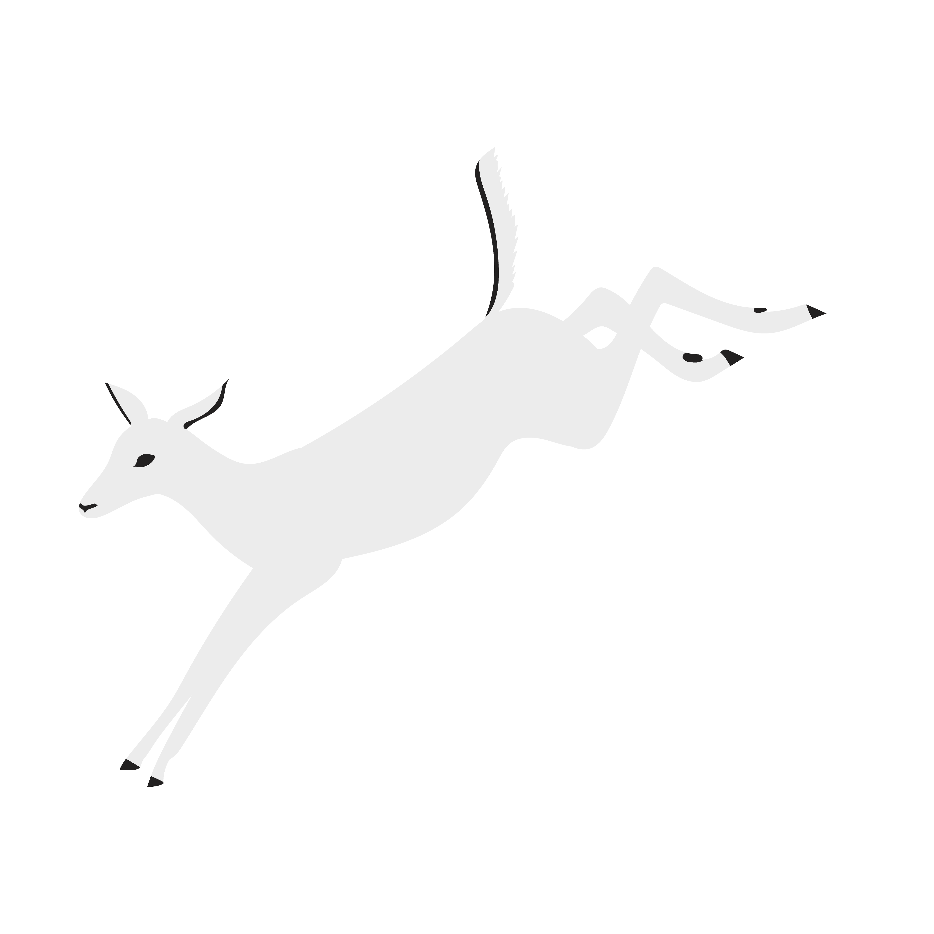
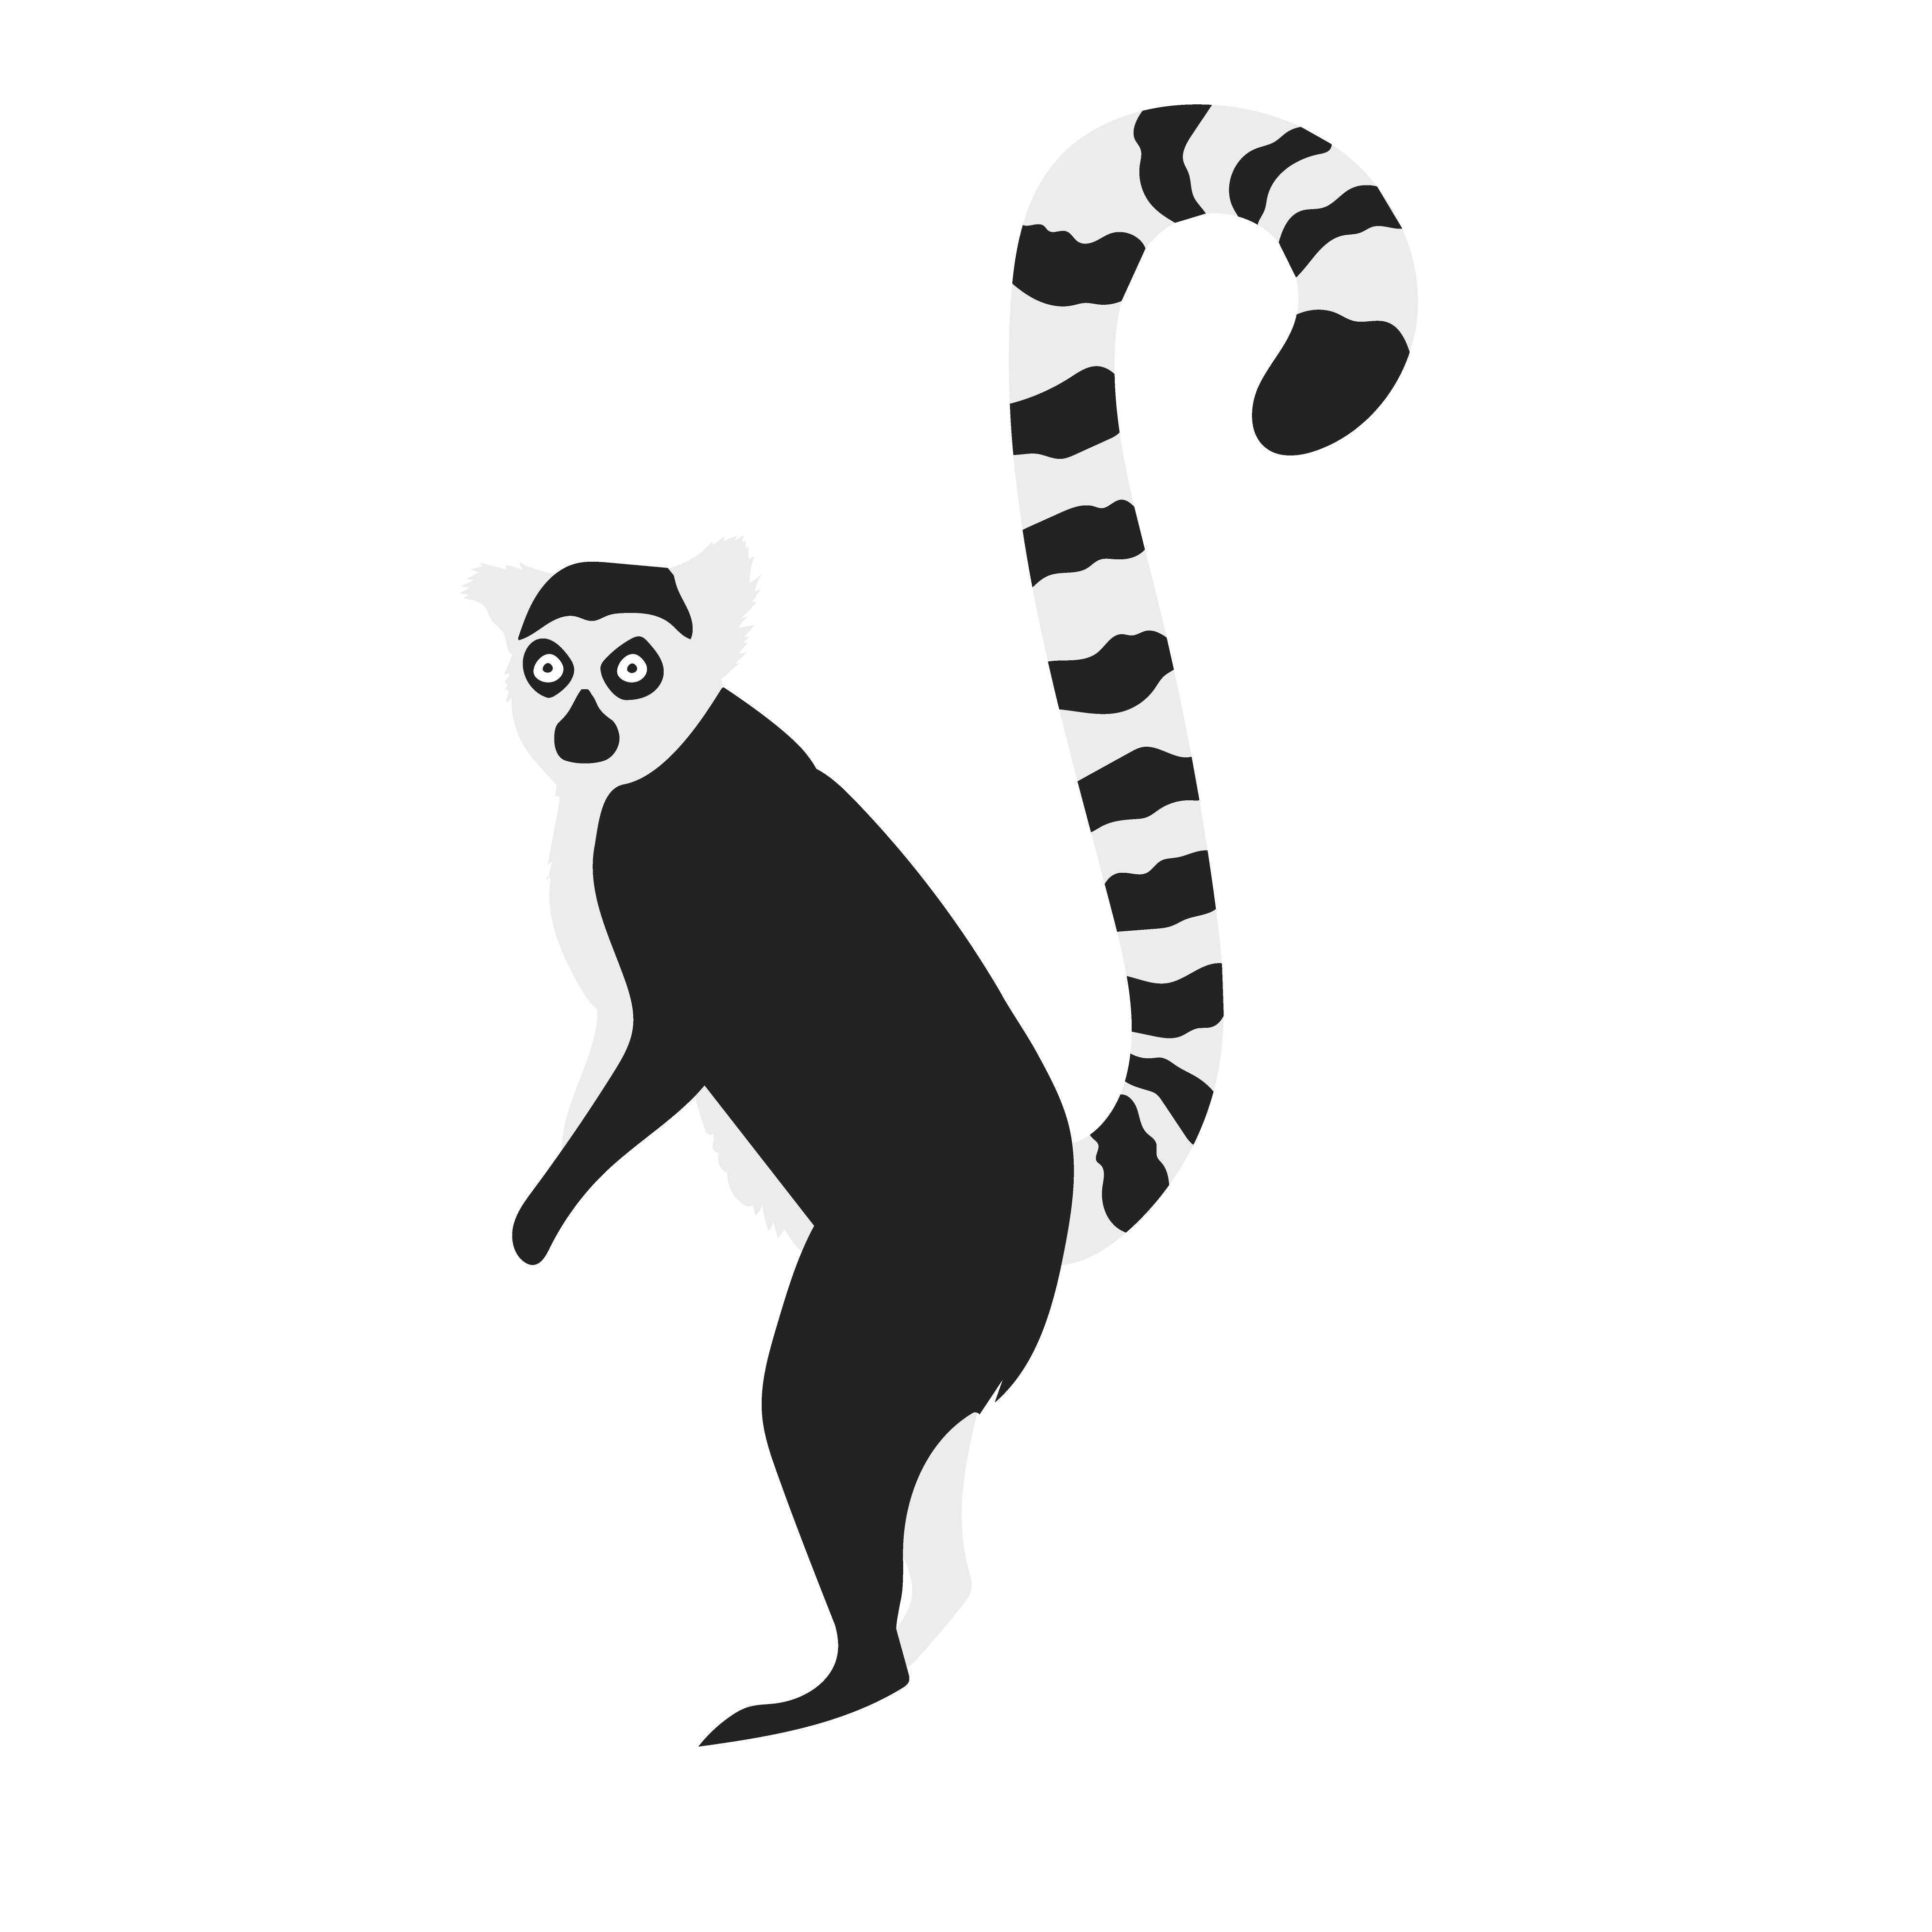
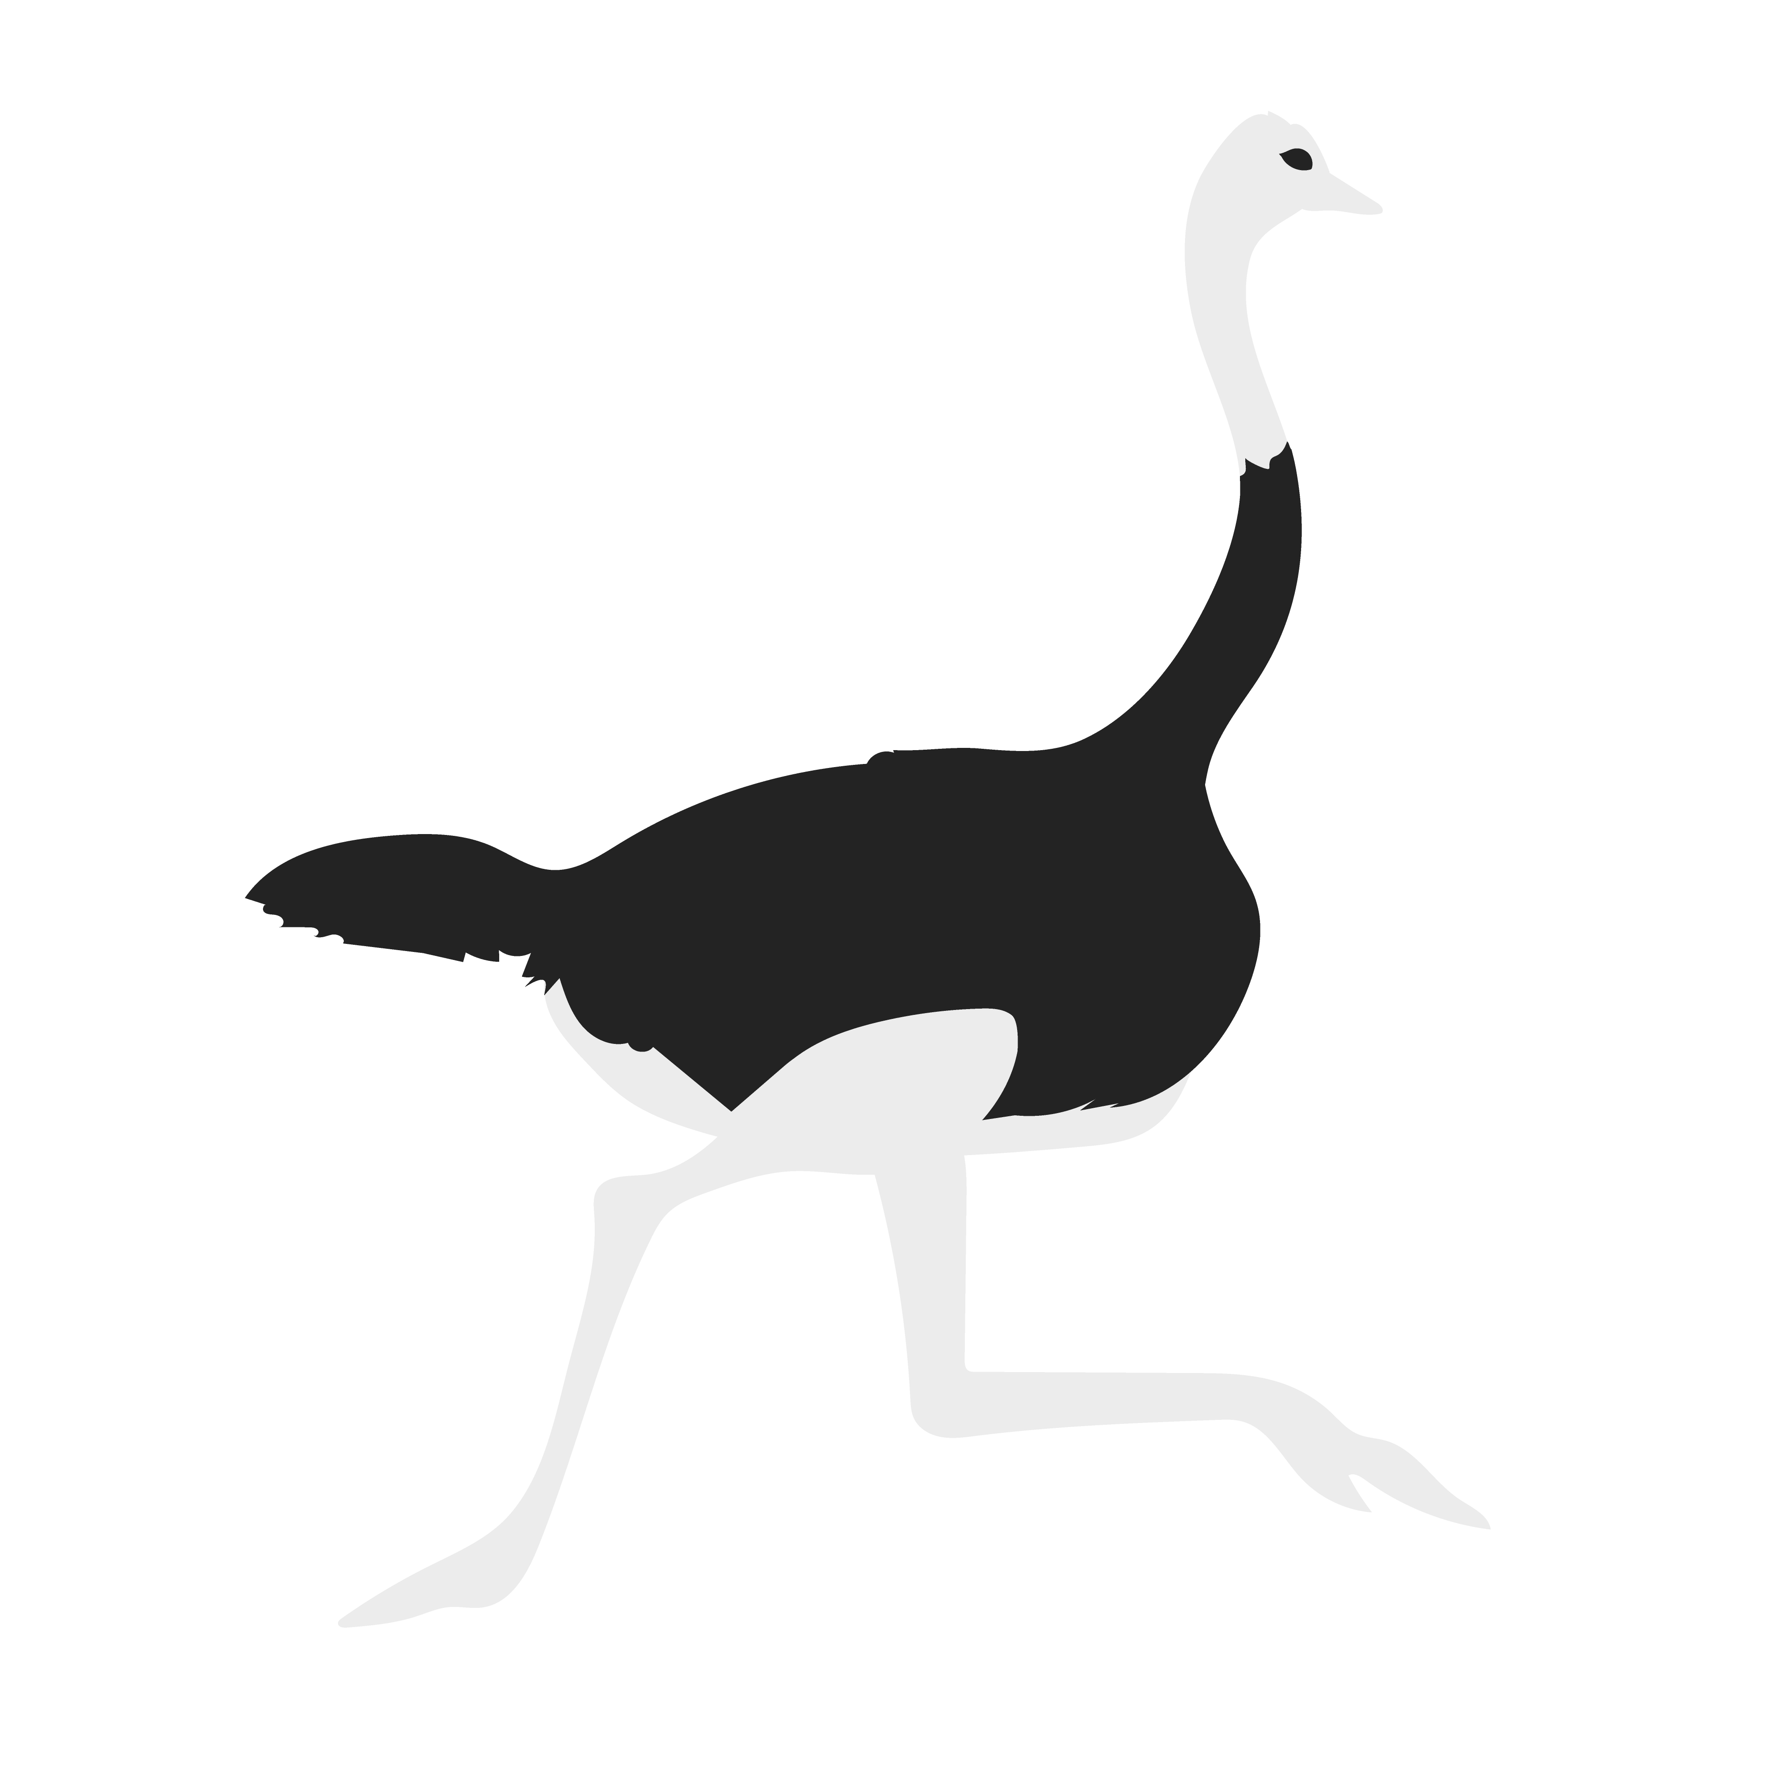
Animals
GCSE PHOTOGRAPHY

Slide 2
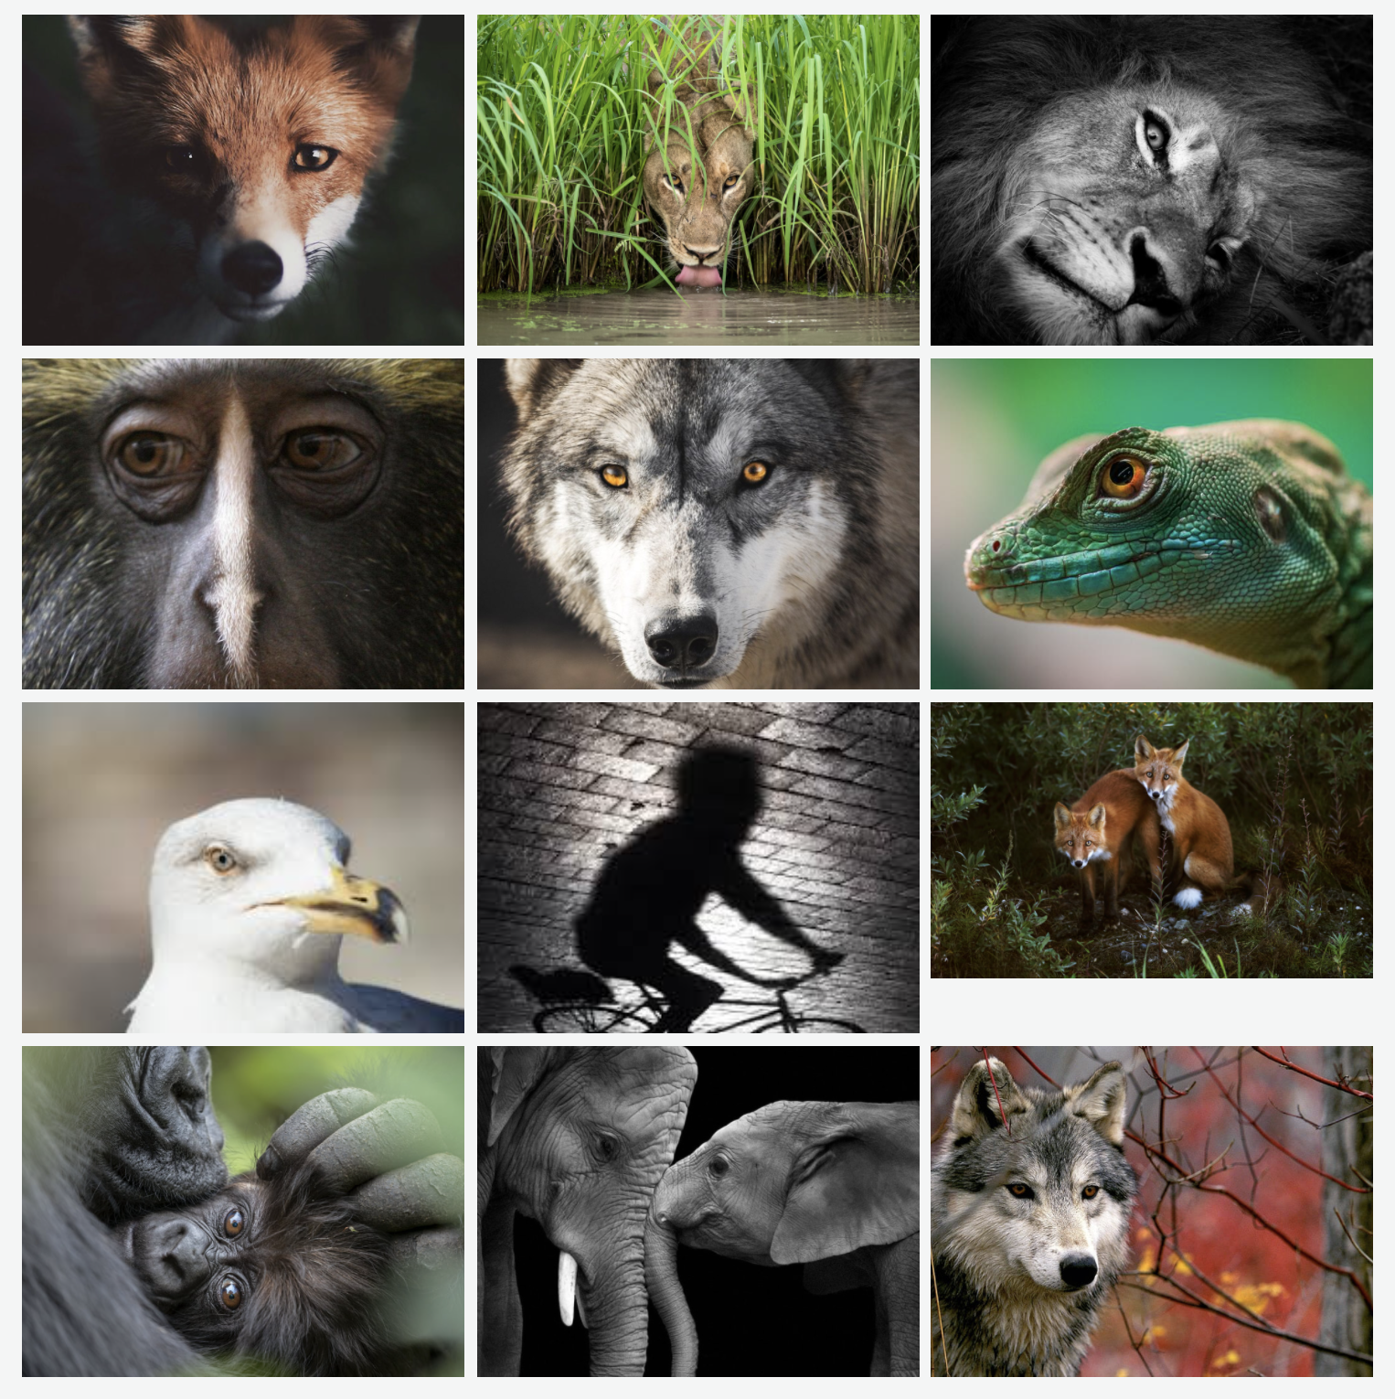
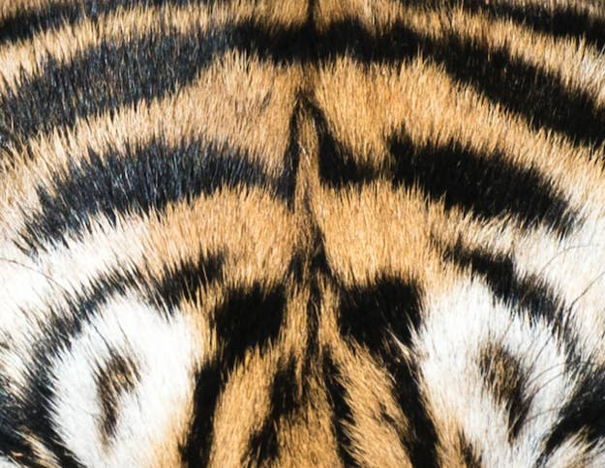
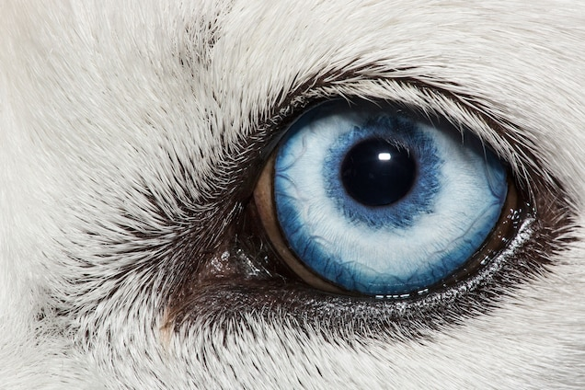
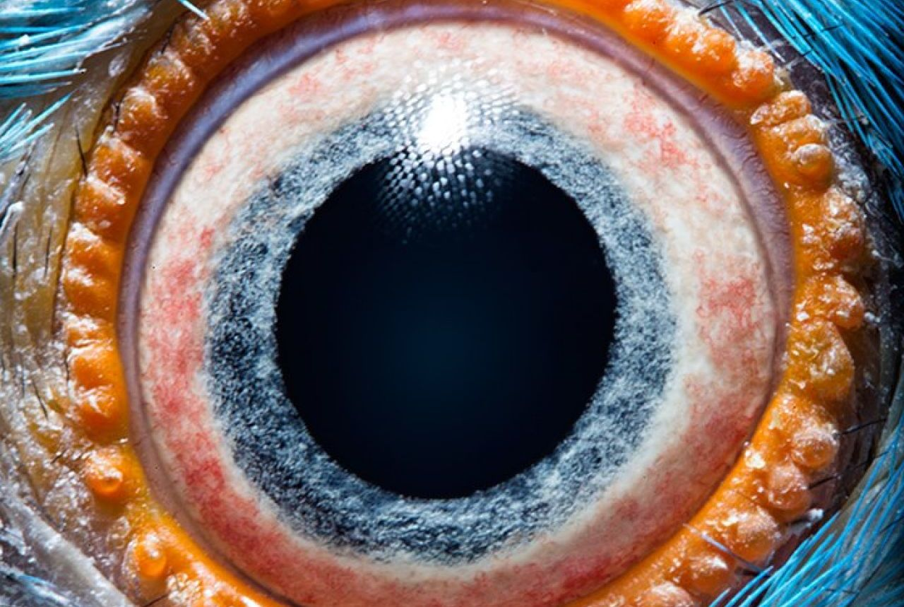
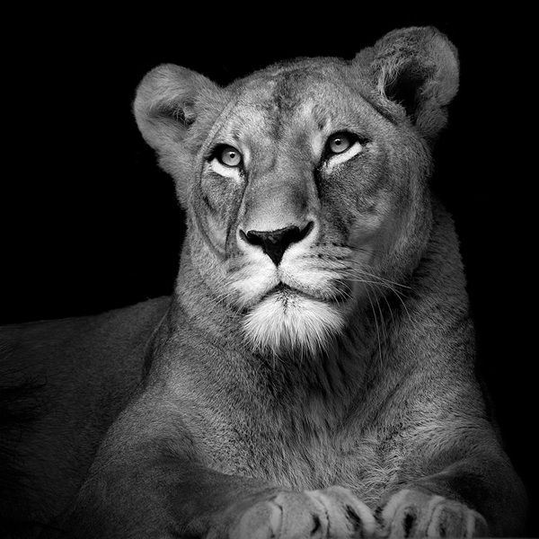
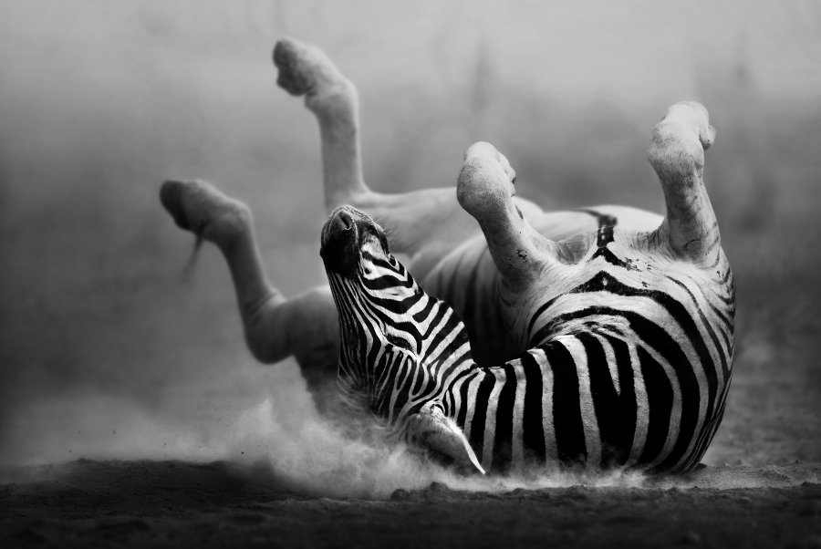
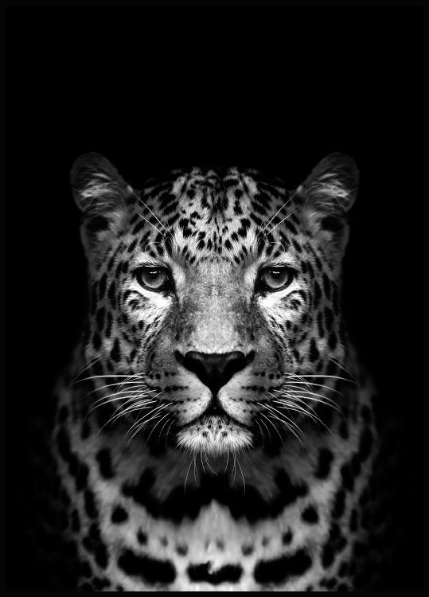
Idea board
Close up
Odd angles
Break rule of thirds
Textures
Patterns

Slide 4
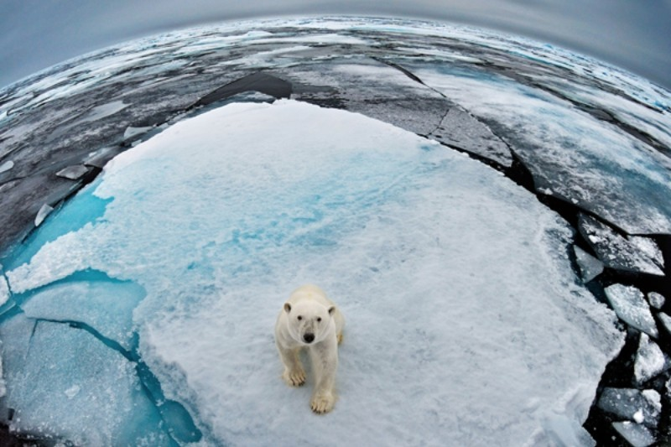
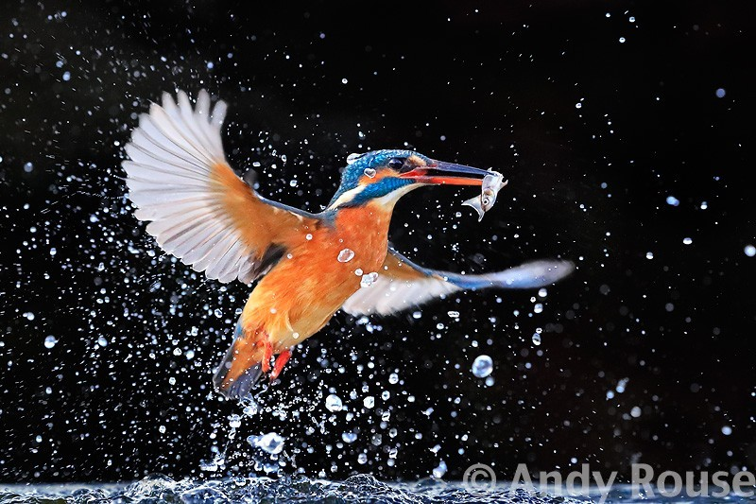
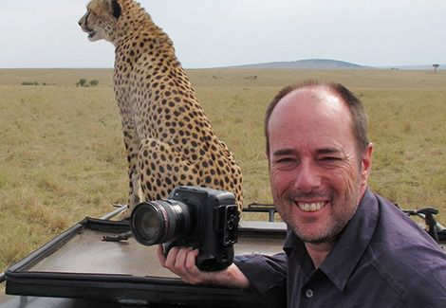
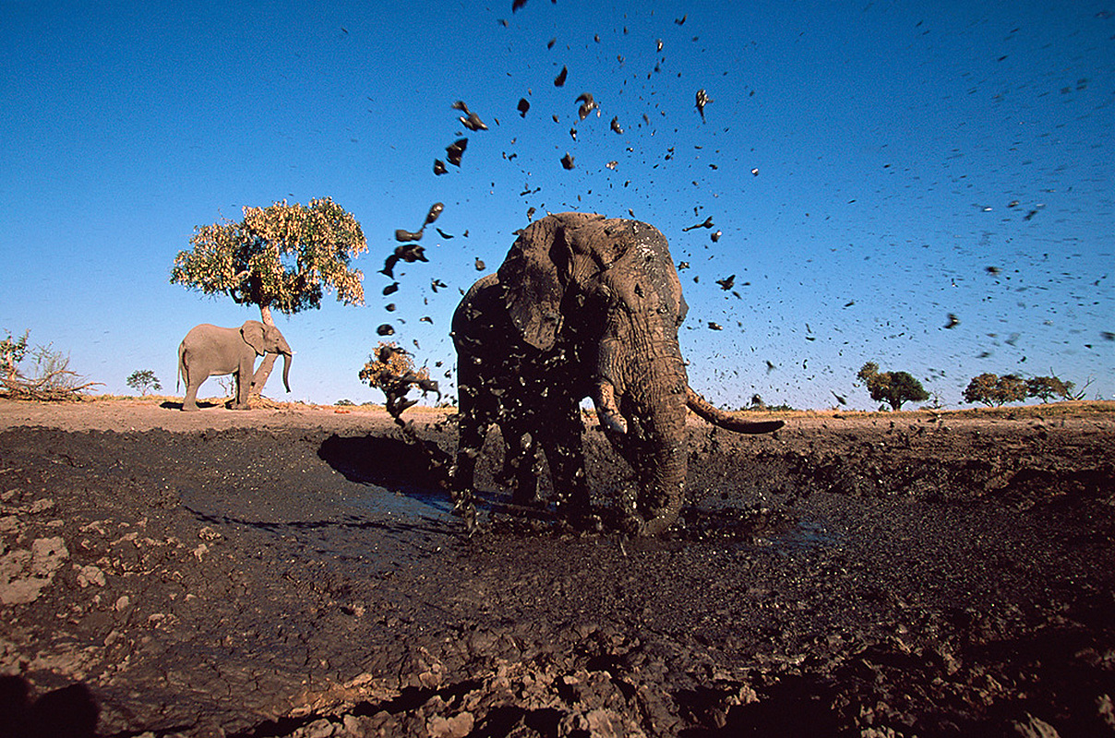
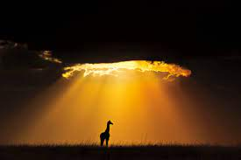

Slide 5
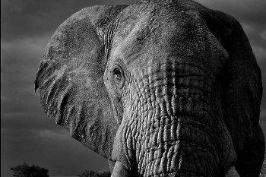
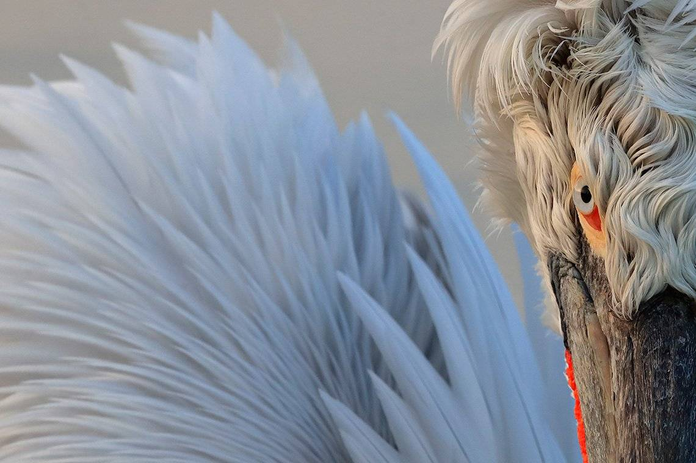
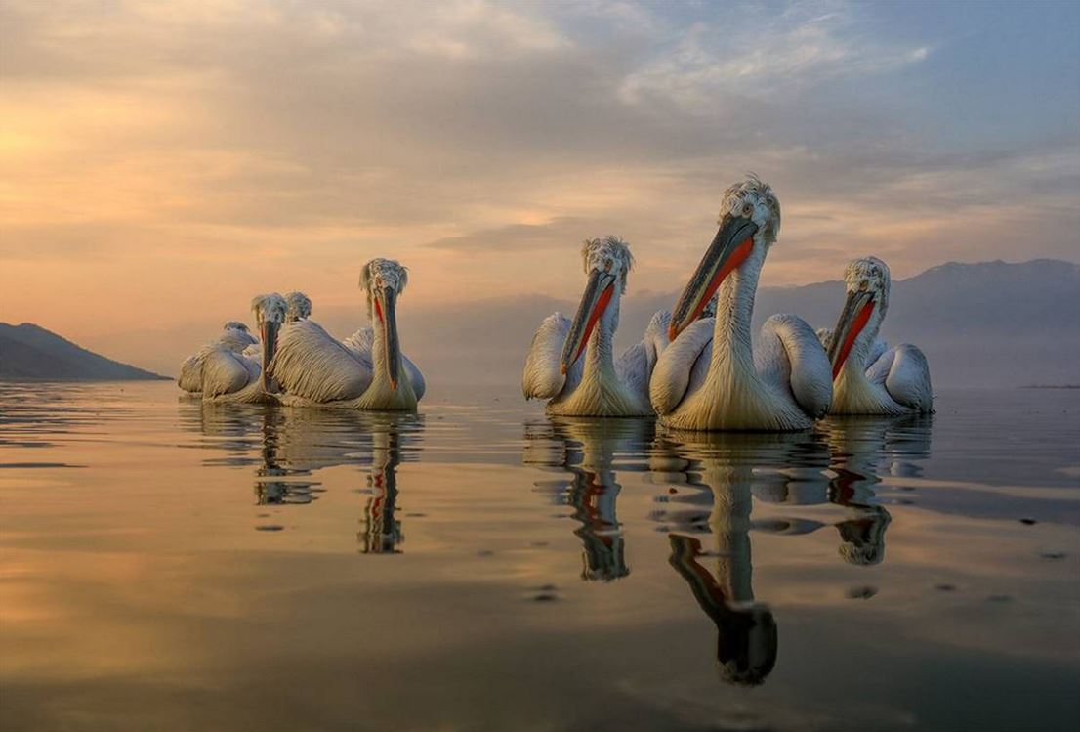

Slide 6
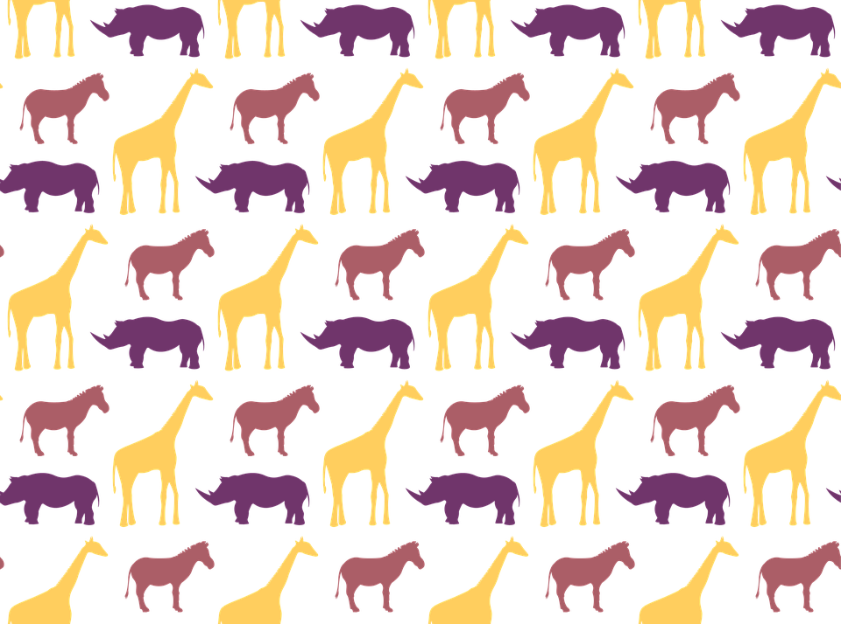

Slide 7
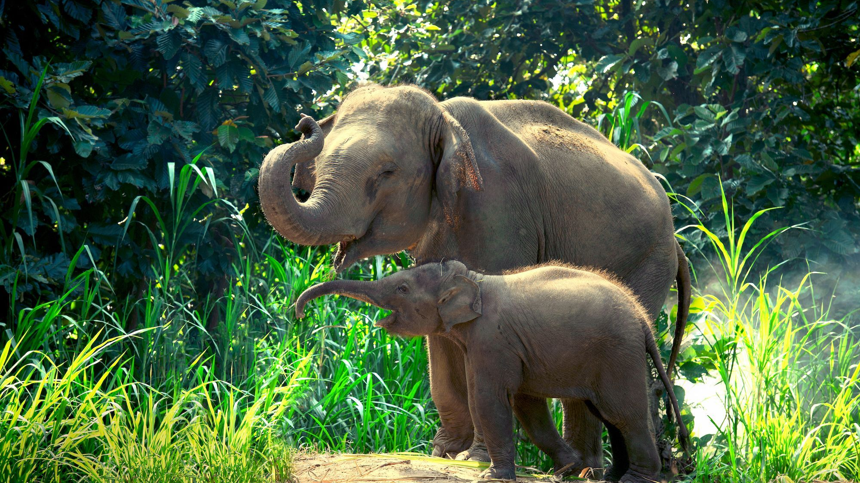
Statement of Intent
For my GCSE photography project I have chosen the theme ‘animal rights’. This was an easy choice for me, as I work with animals and am a passionate animal rights activist. This gives me access to lots of photographic opportunities in relation to my theme, as well as valuable insight to help move my ideas forward. I have always loved animals, and made a promise to myself I would always do everything I could to make this world a better place to be, to look after them, protect them and be a voice for them. Photographically speaking, animals are a popular subject. There are many sub genres within animal photography I can explore as well as looking at how to communicate a strong message. For my project, I will need to identify if I want to photograph animals, or just focus on the people that stand up for them. I don’t think it will be possible to photograph animals in this context, but I could photograph animals and try and capture their essence – who they are, and show their personalities, just like we have, and use various intentional photographic techniques to do this. On the other side of my project, I could photograph activists and maybe interview them… I could do two sets of images. I will choose 10 animal rights activists, and then use the interview significant wording to double expose over the image. This idea I will develop on. I am also interested in documentary photography, so I would like to take photos using this style, and this would fit during various events such as protests etc. Genres I am working in: •Wildlife photography •Animal portraiture •Documentary photography
Camera techniques: •Depth of field and shutter speed – animal portraiture needs to be sharp and in focus but I will also add a filter to soften the image •Editing techniques – I will need to use Photoshop to experiment with image/text collage Composition techniques •I would like to use foreground/background making sure to offer a distinctive depth of field to enhance the subject •I will experiment with locations, and maybe look at using natural frames to again enhance the animal within the frame
I will start by research photographers such as Sharron Lee Hart, as I like her black and white portrait approach. She uses quite odd compositions but the animals characters really stand out, and I think she achieves this by getting up close to them, without the shot turning into a close up. I also like Nick Brandt work, its just so captivating, as he captures the animals in their own environments and communicates a sense of freedom. For my documentary photography, I am going to look at Robert Franks work, as his images are very ‘real’ and powerful.. They make me feel a sense of urgency when I view some of the protesting shots, and this is exactly what I would like my work to do.
My overall aim: My aim is to raise awareness of animal rights, and to give them a voice. I will do this by photographing animals in a way that shows that they are the same as us. I will also show what is being done, what activists spend much of there lives doing. What it looks like to be a voice for the animals. I am hoping my project will at least plant a seed and influence people to make join animal rights and be a voice for them. My overall aim is to show them as emotional and their suffering is the same as ours.

Slide 9
