Slide 1
STUDIO LIGHTING BASICS

Slide 2
STUDIO GEAR
1
Stuff that you need to get started

Slide 3
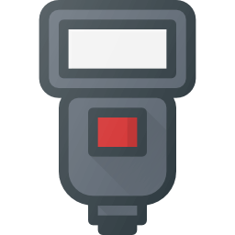
STUDIO GEAR : LIGHTS
Flash
Good old portable & reliable.
Strobe
The big guns.
LED
Not as bright, but gives nice soft light.

Slide 4
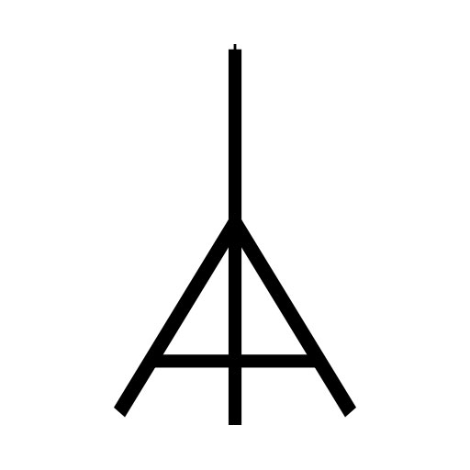
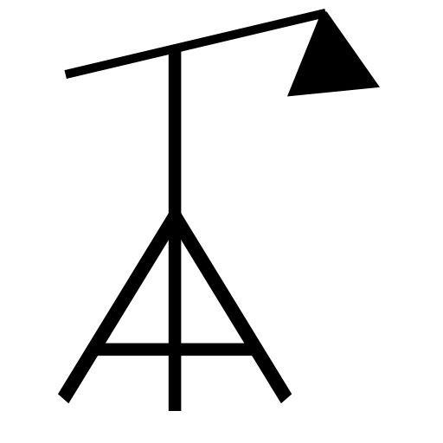
STUDIO GEAR : LIGHTSTANDS
Lightstand
To place your lights on… of course. Just look for the air-cushioned ones which prevents nasty slams.
Boom arm
Gives you more creative space, and holds the light high up.

Slide 5
STUDIO GEAR : SOFTBOXES
Octagon
Think of these as oversized spot lights.
Rectangular / Square
Evenly lights up a certain area.
Slid
Helps you put light into a small area.

Slide 6
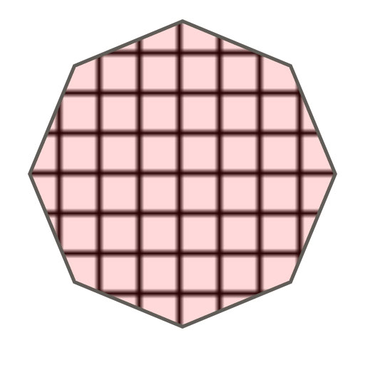
STUDIO GEAR : LIGHT MODIFIERS
Grid
Attached to softboxes, prevents “light spills”.
Barn Door
Allows you to control the direction of the light.
Snoot
Puts light onto a single spot.

Slide 7
STUDIO GEAR : OTHERS
Backdrop
Black or white backdrop, or just a green screen.
Reflector
Reflects light. Doh.
Color Gel
Adds funky colors.

Slide 8
HOW MANY LIGHTS DO YOU NEED?
JUST ONE!
There are no rules to the minimum number of lights in a studio setup. If you want, you can even call a one-light setup a studio.

Slide 9
4 LIGHT SETUP
2
The classic basic setup

Slide 10
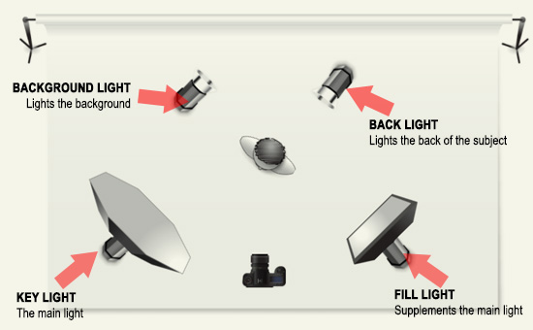
KEY LIGHT
The key light, is also your main light. This is the first light to setup, and all the rest will follow along.

Slide 11
FILL LIGHT
The fill light as its name implies, is the secondary light to “fill in” places where you want lights to be.

Slide 12
BACK LIGHT
The back light illuminates the back of the subject, often separating him/her/it from the background.

Slide 13
BACKGROUND LIGHT
This light is specially dedicated to lighting up the background.

Slide 14
DO YOU NEED ALL 4 LIGHTS?
NO!
Again, there are no rules that you need 4 lights in a studio setup. So just use whichever that works magic for you.

Slide 15
HOW TO SETUP?
3
How to deal with multiple lights

Slide 16
STEP 1 : START WITH THE BACKGROUND
Start dealing with the natural lights first..

Slide 17
STEP 2 : ADD KEY LIGHT
Place your subjects, and add the key (main) light to the setup. Take test photos, and readjust until you are satisfied.

Slide 18
STEP 3 : ADD FILL LIGHT
Now add any fill lights as required. Take test photos, and readjust until you are satisfied.

Slide 19
STEP 4 : ADD MORE LIGHTS
Should you need more lights add more as you see fit – Back light or background lights.

Slide 20
THE KEY STRATEGY
DEAL WITH LIGHTS ONE AT A TIME
Yes. Don’t panic.
Just deal with a multi-light setup one light at a time, and you will do just fine.

Slide 21
COMMON SETUPS & STYLES
4
The classics that you should know

Slide 22
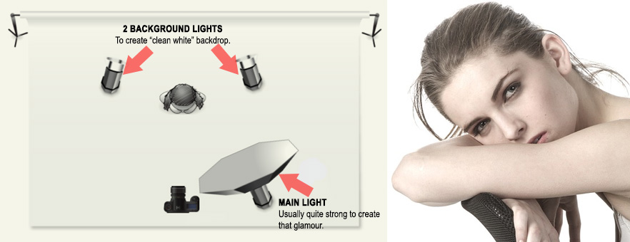
HIGH KEY
The bright “glamour” look, usually achieved by well-balanced all-round lighting.

Slide 23
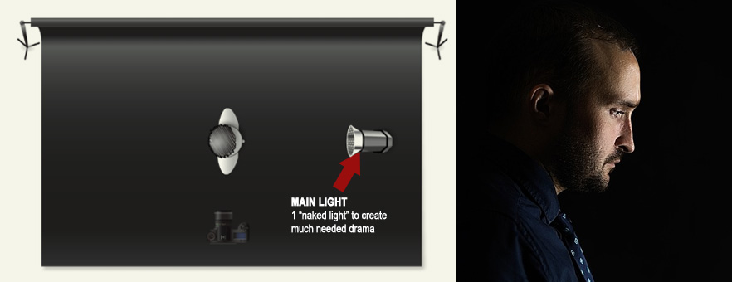
LOW KEY
Opposite of high key, and is portraits the dark dramatic look.

Slide 24
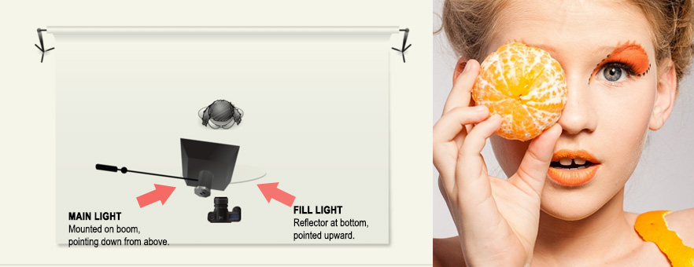
CLAM SHELL LIGHTING
Named after how the setup looks – One light on top, one below. Also known as butterfly lighting.

Slide 25
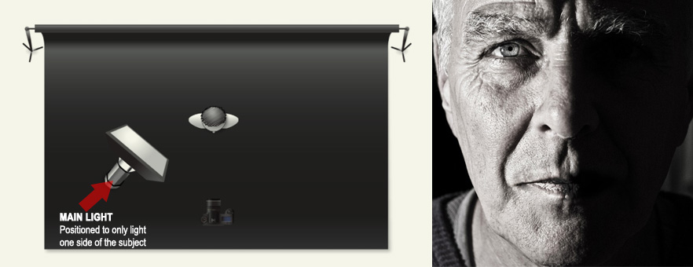
SPLIT LIGHTING
A dramatic look, lighting half of the subject only.

Slide 26
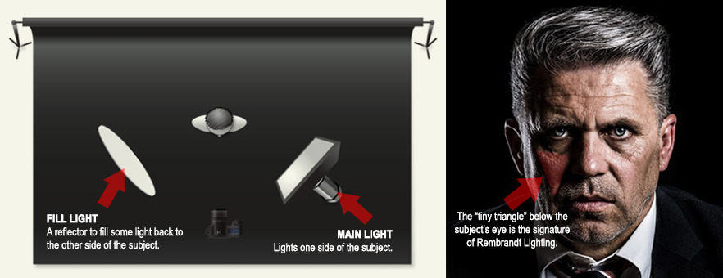
REMBRANDT LIGHTING
Named after the painter Rembrandt. Creates a signature triangle below the subject’s eye.

Slide 27
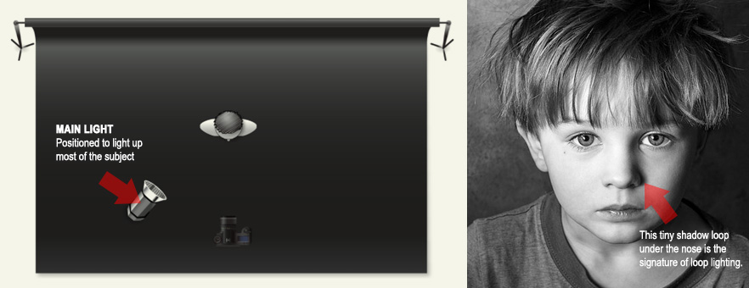
LOOP LIGHTING
Named after how it creates a signature shadow loop under the subject’s nose.

Slide 28
Task
On PowerPoint:
Title: Studio lighting
Provide an example image (internet) and title (with an explanation of it’s purpose) of the following:
Studio gear (Lights, light modifiers, other equipment)
Common set ups (High key, Low key, clam shell, split, Rembrandt, loop)
Basic 4 point lighting (3 point is also fine) set up - You can draw the set up - use shapes in PowerPoint to do this. Label everything (see example on next page)
www.gcsephotography10.weebly.com

Slide 29
4 point lighting set up
Backdrop
Backlight
Background light
model
Fill light
Main/key light
Camera

